Slide 1
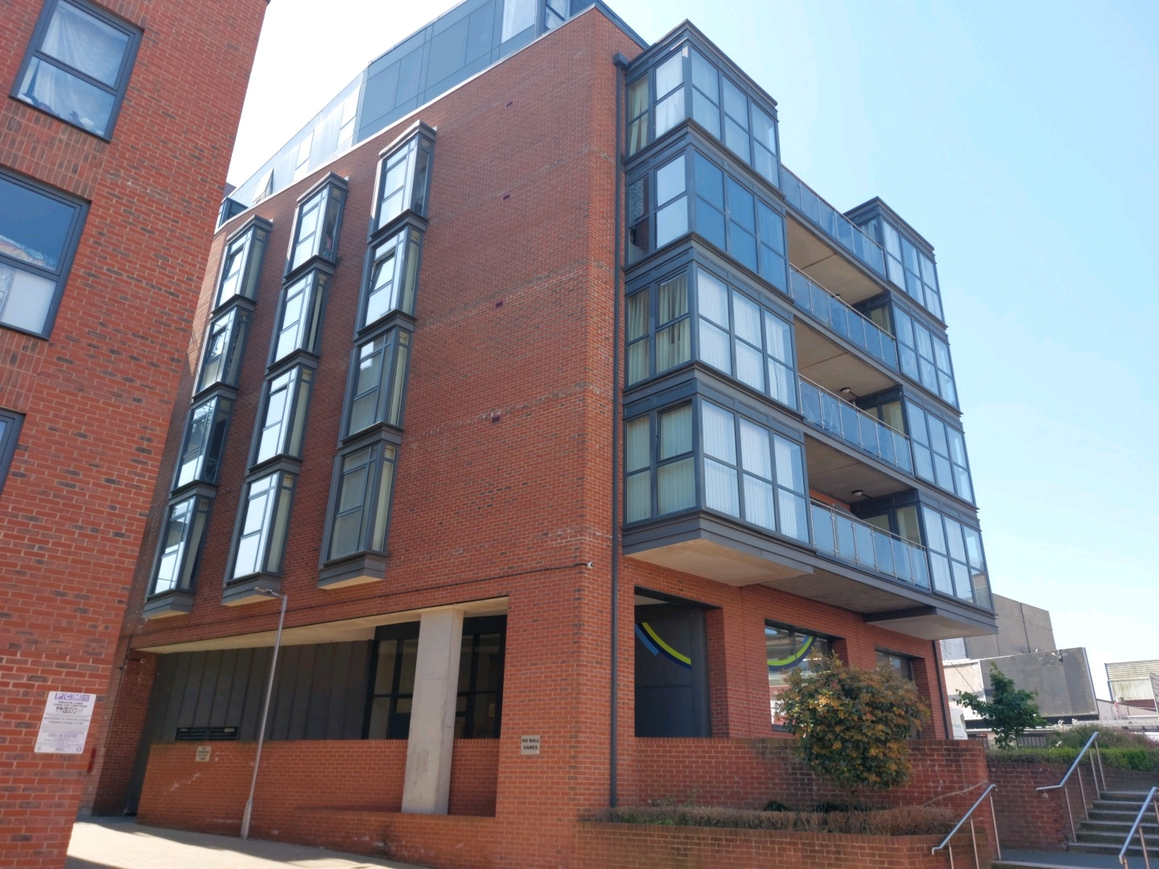
Building safety resident engagement commitment
11 Zenith Close
What is the commitment?
This engagement commitment sets out how we can work together to make decisions that affect the safety of your building. This could be about works being carried out or how we manage your building for example. Your Building Safety Manager (BSM) Symone Crossley has put this together based on responses from surveys, drop-ins and door knocking over recent weeks. If responses were low, we might use responses from other similar buildings to help us.
Methodology:
As your Building Safety Manager, I am committed to working with you to maintain a safe building. To support this, I visited your block on 17 September 2026 to carry out an inspection. While no significant issues were identified, a small number of minor items were noted, and actions were raised with the estate management team for follow-up. I also invited you to attend an online residents’ drop-in session on the 21 September to share your views, ask questions, and receive further clarification.
On the 16 September 2026, I wrote to you regarding the evacuation policy for your building, outlining both your responsibilities and those of NHG in keeping your building safe. I confirmed that your building had been registered with the Building Safety Regulator (BSR) and provided the registration number along with the BSR’s contact details should you wish to raise any concerns.
On 16 September 2026 I also sent you a building safety survey by email to better understand your information needs, vulnerabilities, and awareness of building safety.
We will continue to hold at least one resident drop-in session each year to provide updates and gather your feedback on how we are managing your building. This commitment has been made in September 2026 and will be reviewed in September 2028 or earlier if you tell us we need to.
How we will share information with you and ask for your opinion:
To cater for the diverse needs of our residents, we can communicate in a broad range of ways. We aim to provide this information in different formats that can be understood by all residents including those that have a physical or visual impairment, have other disabilities or who speak another language:
At sign up
New resident home visits
On our website
On local notice boards
At local surgeries
During building inspections
Face to face appointments
At pop up sessions
By introductory & animation videos
Local newsletters
Via email
Via postal or hand delivered letter
Via SMS text
Fire Action Notices

Slide 2
Building safety resident engagement commitment
11 Zenith Close
Types of information you would like to see:
Action to take in the event of fire / structural emergency
General information to understand legislation impacting your home including the Building Safety Act and the Fire Safety England Regs
Resident and landlord responsibilities
Changes in fire strategy
Remediation works affecting your building
Other major works
Costs
What decisions you would like to be involved in?
We encourage residents to get involved in making decisions relating to the safety of their buildings
We encourage residents to create resident associations to have a voice in the management of their buildings.
If you would like further information on setting up or joining an existing Resident’s Association, please contact your Housing Officer/ Property Management Officer
How you can influence decisions:
We are proactively seeking out resident feedback and using that information to tailor our building safety approach
Contacting your BSM
Surgeries in person and online
Building & Estate walkabouts with Housing Officer/ PMO
Inclusion at Residents Association meetings
Get involved though your Residents Association. If your building does not have RA and you would like to start one, please contact your housing officer for support and guidance in setting one up
How we’ll gather and use your opinions:
We’ll keep a record on our Workwise system from our interactions as listed above
We’ll gather your thoughts in line with our usual GDPR policies, just like when you contact us about anything else.
How we’ll measure and review this commitment:
Measure the number of cases raised on Workwise reviewing building safety content
Writing to you annually to let you know what engagement and influence that has had
Got a question or concern about this commitment? Get in touch with your Building Safety Manager here:
Email: Symone.Crossley@nhg.org.uk
Phone: 07353 895957

