Slide 1
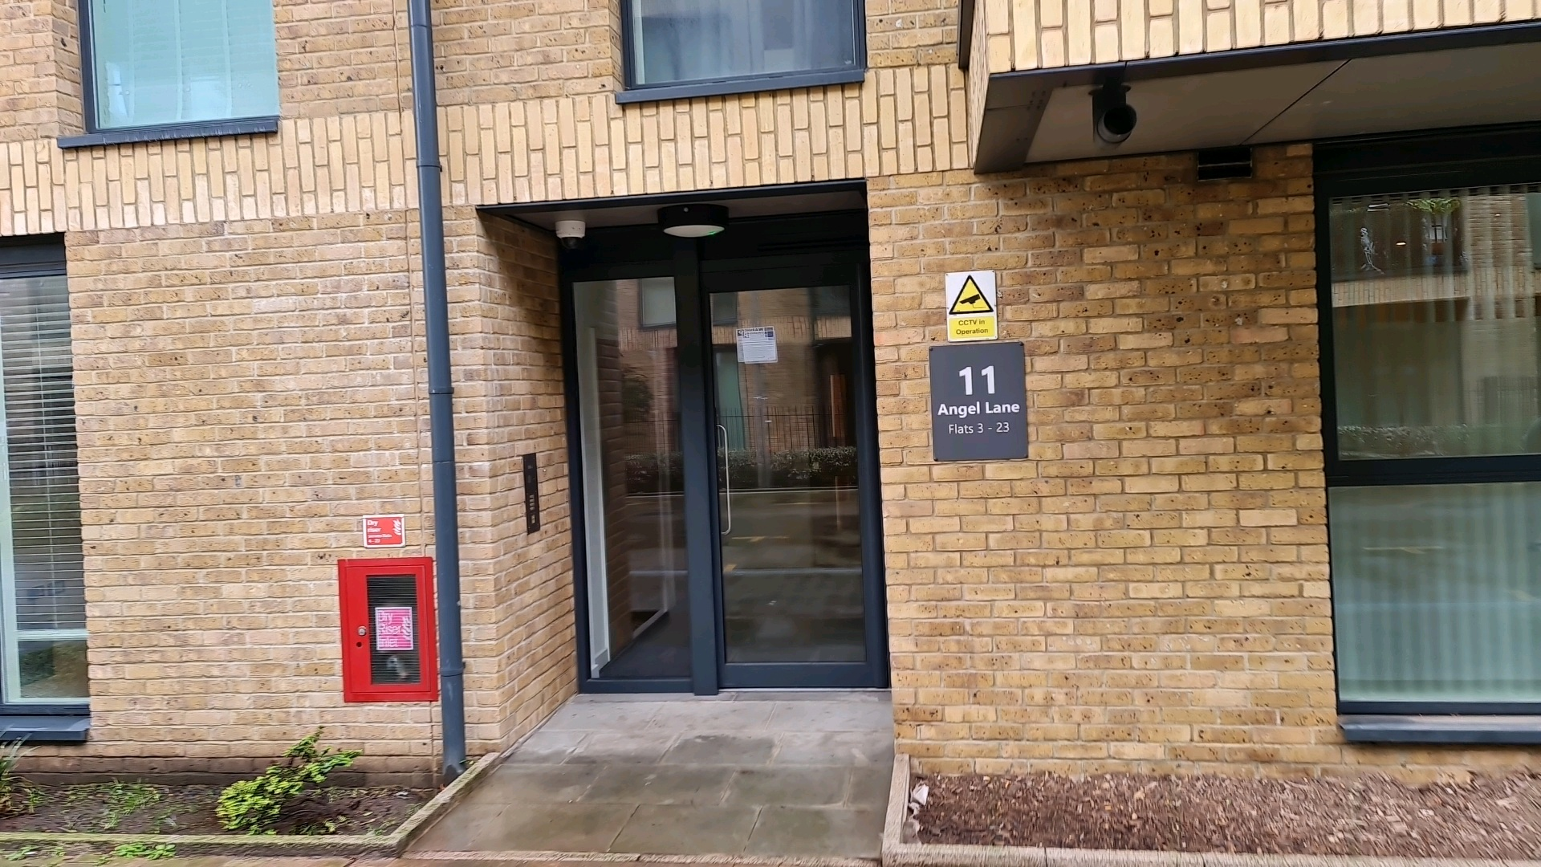
Building safety resident engagement commitment
11 Angel Lane London SE17
What is the commitment?
This engagement commitment sets out how we can work together to make decisions that affect the safety of your building. This could be about works being carried out or how your building is managed for example. Your Building Safety Manager Naomi Duce has put this together based on responses from surveys, drop ins and door knocking over recent weeks. If responses were low, we might use responses from other similar buildings to help us, as well as Notting Hill Genesis’ own processes.
Methodology
As your BSM, I aim to work with you to keep your building safe. To do this I invited you by email to join me as I visited your block to carry out an inspection on the 14 July 2025 and 18 August 2026. I knocked on a few resident doors to check what you know about fire safety in your home. Some of you told me that you were not clear on the evacuation strategy for your building. I explained and showed you some of the safety features in your flat such as sprinklers and fire detectors. I also showed you the smoke control vents and dry riser available in the communal area. All of the residents I spoke to confirmed they found that useful. During the inspection I found no major issues and the minor issues picked up have been raised for repairs with the estate management team.
A building safety survey to understand your information needs, vulnerabilities and awareness of building safety in July 2025 to understand how we can work together to keep your building safe. Response from the survey include concerns around defects, sprinkler and general repairs. These concerns were raised with our estate team to resolve these issues.
I sent you a fire safety letter by email in August 2026 informing you about the fire strategy for your building and the importance of fire doors, your responsibilities and those of NHG in keeping your building safe. We want to ensure all resident have information and are aware of what to do in the event of a fire incident. We want you to feel safe in your home, prevent fires and be confident you can evacuate safely if required. I also informed you that your building had been registered with the Building Safety Regulator (BSR) and provided you with the registration number and the BSR’s contact number for any concerns that you might want to bring to their attention.
You were invited to attend an online resident meeting on the 29 July 2025 and 20 August 2026 to further get your views and opinions and answer any queries or provide clarification. Residents who attended raised concerns about the damaged fire door in the lift lobby. I provided assurance that the repairs have been raised and got a confirmation from our estate team that the door has since been repaired.
We will continue to hold at least one resident meeting and one drop-in session yearly to give updates and get your views on how we are managing your block. This commitment has been made in July 2025 and will be reviewed in July 2027 or earlier if you tell us we need to.
How we will share information with you and ask for your opinion
To cater for the diverse needs of our residents, we can communicate in a broad range of ways. We aim to provide this information in different formats that can be understood by all residents including those that have a physical or visual impairment, have other disabilities or who speak another language:
At sign up
New resident home visit
On our website
On local notice boards
At local surgeries
During building inspections
Face to face appointments
At pop up sessions
By introductory & animation videos
Local newsletters
Via email
Via postal or hand delivered letter
Via text
Fire Action Notices

Slide 2
Building safety resident engagement commitment
11 Angel Lane London SE17
Information we will provide you with about building safety decisions
When we need to make decisions about building safety matters, we will make sure to provide you with information to help you understand and influence these decisions. For example: a summary of the technical advice we have received, advice we have received about how to reduce risk, timescales for completion of work, any cost implications for you, and details of who you can get in touch with to ask for more information.
Other types of information you would like to see
Action to take in the event of fire or structural emergency
General information to understand legislation impacting your home including the Building Safety Act and the Fire Safety England Regs
Resident and landlord responsibilities
  Changes in fire strategy
  Remediation works
  Other major works
  Topics or themes that you are interested in
What decisions you can be involved in
We encourage residents to get involved in making decisions relating to the safety of their buildings
You can contact BSM, PMO, and Estate Operations Team with any ideas or thoughts you have about safety in your building.
The types of building safety decisions you can expect to be involved in are:
Timings of works, particularly for accessing properties
Placement of equipment during works
Parts of the specification of works that aren’t guided by regulation or expert guidance
Some works can’t always be consulted on. These might involve:
Emergency works – where quick action is needed to reduce a risk
Where a specific product or material is needed to meet a regulation or other requirement
If works will take less than one day and won’t be very disruptive
We might only consult with people directly affected by the work. For example, works accessing the balconies would only be discussed with properties with balconies.

Slide 3
Building safety resident engagement commitment
11 Angel Lane London SE17
How you can influence decisions
Proactively seeking out resident feedback and using that information to tailor our building safety approach
Primarily contacting BSM, PMO & EOM
Contacting your BSM at NHG if you need to escalate any concerns
Drop ins
We will use your feedback in our discussions with our contractors, or other parties like housing management, to consider how we can adapt works planning, timescales and specifications to accommodate as much of your feedback as possible.
How we’ll gather and use your opinions
We’ll keep a record on our Workwise system from our interactions as listed above
We’ll gather your thoughts in line with our usual GDPR policies, just like when you contact us about anything else.
We will feedback to you any decisions made using the information you have told us
How we’ll measure and review this commitment
Use feedback you give your estate management team, property manager, or us– whether formal or informal – about how this commitment is working.
NHG will review feedback periodically to understand if the commitment needs to be reviewed.
Got a question or concern about this commitment? Get in touch with your building safety manager here:
Email: Naomi.Duce@nhg.org.uk
Phone: 07774781997

