Slide 1
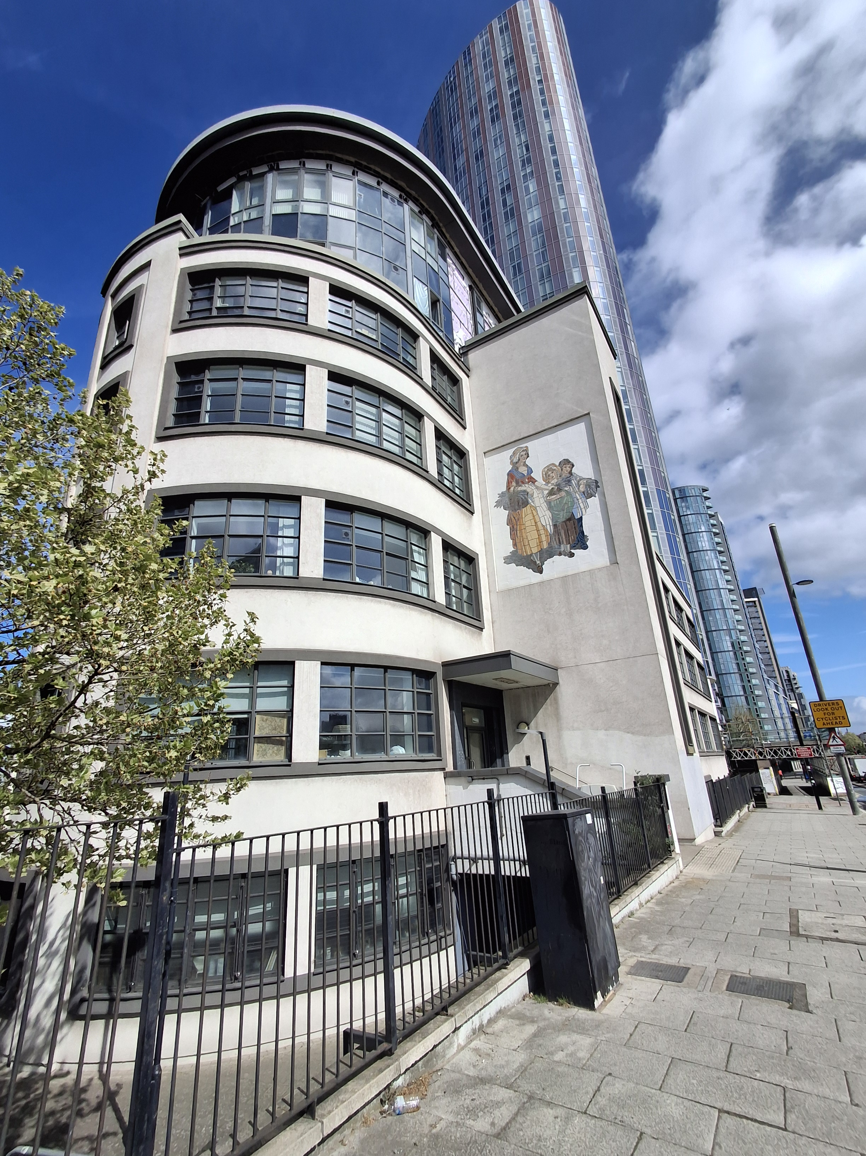
Building safety resident engagement commitment
Warton House
What is the commitment?
This engagement commitment sets out how we can work together to make decisions that affect the safety of your building. This could be about works being carried out or how your building is managed for example. Your Building Safety Manager Freya has put this together based on responses from surveys, drop ins and door knocking over recent weeks. If responses were low, we might use responses from other similar buildings to help us, as well as Notting Hill Genesis’ own processes.
Methodology
As your BSM, I aim to work with you to keep your building safe. To do this I visited Warton House to carry out an inspection on the 16th April 2026. I knocked a few resident doors to check what you know about fire safety in your home but was unable to engage with any residents that day. During the inspection, I noted that the bin shed door fob access was faulty and so this has been raised to our contractors to remedy. I also inspected all risers as part of my inspection and found a very small number of these had materials being stored in them. This has been highlighted to your Estate Operations Team to arrange removal of these items. Please continue to report any repair concerns and especially faults for any of the fire safety equipment which may arise.
I understand there is also on-going remedial works to your building which is being overseen by our Remediation Project Manager in relation to the external wall, internal compartmentation and the glazing at Halo Tower, adjoining Warton House. The Remediation Team sent residents an update to you all on 16/04/2026 and will be sending regular updates on any progress that is made. Please also reach out to me if you have any concerns.
In addition to this, residents have raised concerns about the on-going issue with the lifts going down which is also causing people to become trapped in the lift. Our lifts team are carrying out investigations with our contractors to try and identify a long-term resolution for this issue. On the day of my visit, both lifts were in operation but please do report any issues to NHG should the lifts go down. If you find that the lift stops operating when in use, please contact NHG on 020 3815 0000 and we will raise an emergency repair for you. The lift alarm button can also be used as this will connect you to an emergency line. The operator will then assist in raising a call out. In the event of a medical emergency please call 999, and the emergency services will be able to assist in those instances.
I sent a building safety survey to understand your information needs, vulnerabilities and awareness of building safety earlier this month by email. This was to understand how we can work together to keep your building safe. The general feedback was residents weren’t aware of the evacuation strategy and what safety equipment is installed in your building. As part of my communications to you, I sent you a letter to inform you about the fire strategy for your building and the importance of fire doors, your responsibilities and those of NHG in keeping your building safe. There are also Fire Action Notices around your building detailing what to do if a fire occurs.
Please do reach out to me any point should you like to raise any building safety concerns for your building, discuss any vulnerability or would like any relevant safety information.
I also informed you that your building had been registered with the Building Safety Regulator (BSR) and provided you with the registration number and the BSR’s contact number for any concerns that you might want to bring to their attention.
I invited you to attend an online drop-in session on the 24th April but I was not able to engage with any residents that day. I will continue to hold at least one resident drop-in session yearly to give updates and get your views on how we are managing your block.
This commitment has been made in April 2025, and was reviewed and updated this month as part of the annual Building Safety Audit. This will be reviewed in July 2027 or earlier if you tell us we need to.
How we will share information with you and ask for your opinion
To cater for the diverse needs of our residents, we can communicate in a broad range of ways. We aim to provide this information in different formats that can be understood by all residents including those that have a physical or visual impairment, have other disabilities or who speak another language:
At sign up
New resident home visit
On our website
During building inspections
Face to face appointments
At pop up sessions
By introductory & animation videos
Local newsletters
Via email
Via postal or hand delivered letter
Via text
Fire Action Notices
On local notice boards
At local surgeries

Slide 2
Building safety resident engagement commitment
Warton House
Information we will provide you with about building safety decisions
When we need to make decisions about building safety matters, we will make sure to provide you with information to help you understand and influence these decisions. For example: a summary of the technical advice we have received, advice we have received about how to reduce risk, timescales for completion of work, any cost implications for you, and details of who you can get in touch with to ask for more information.
Other types of information you would like to see
Action to take in the event of fire or structural emergency
General information to understand legislation impacting your home including the Building Safety Act and the Fire Safety England Regs
Resident and landlord responsibilities
  Changes in fire strategy
  Remediation works
  Other major works
  Topics or themes that you are interested in
What decisions you can be involved in
We encourage residents to get involved in making decisions relating to the safety of their buildings
You can contact your Building Safety Manager, Housing Officer and Estate Manager with any ideas or thoughts you have about safety in your building.
The types of building safety decisions you can expect to be involved in are:
Timings of works, particularly for accessing properties
Placement of equipment during works
Parts of the specification of works that aren’t guided by regulation or expert guidance
Some works can’t always be consulted on. These might involve:
Emergency works – where quick action is needed to reduce a risk
Where a specific product or material is needed to meet a regulation or other requirement
If works will take less than one day and won’t be very disruptive
We might only consult with people directly affected by the work. For example, works accessing the balconies would only be discussed with properties with balconies.

Slide 3
Building safety resident engagement commitment
Warton House
How you can influence decisions
Proactively seeking out resident feedback and using that information to tailor our building safety approach
Primarily contacting your BSM or HO
Contacting your BSM at NHG if you need to escalate any concerns
Drop ins
We will use your feedback in our discussions with our contractors, or other parties like housing management, to consider how we can adapt works planning, timescales and specifications to accommodate as much of your feedback as possible.
How we’ll gather and use your opinions
We’ll keep a record on our Workwise system from our interactions as listed above
We’ll gather your thoughts in line with our usual GDPR policies, just like when you contact us about anything else.
We will feedback to you any decisions made using the information you have told us
How we’ll measure and review this commitment
Use feedback you give HO, EM or us – whether formal or informal – about how this commitment is working.
NHG will review feedback periodically to understand if the commitment needs to be reviewed.
Got a question or concern about this commitment? Get in touch with your building safety manager here:
Email: Freya.Jewett@nhg.org.uk
Phone: 07352744438

Slide 4

Building safety resident engagement commitment
Warton House
Transparency of building safety information
At Notting Hill Genesis residents are at the heart of what we do. We want our resident to know they are safe and more importantly feel they are safe. To do this will be transparent in our management of your building’s safety and the information we provide to you. This includes but is not limited to fire protection measures, fire prevention measures, maintenance of fire safety systems , fire risk assessments and building safety inspections
Maintenance and testing | Frequency
Automatic opening vents | Bi-annually
Smoke detection | Monthly
Fire-fighting lifts | Monthly
Lifting operations and lifting equipment regulations (LOLERS) | Bi-annually
Communal fire door checks | Quarterly
Flat door checks | Annually
Dry risers | Monthly
Door closers | Monthly
Electrical (EICR) | Five yearly
Emergency lighting | Monthly – discharged annually
Maintenance and testing | Frequency
Estate inspections | Monthly
Fire Risk Assessment | Annually
Building safety inspections | Annually
Legionella | Two yearly
Lightning protection | Annually
Mansafe | Annually
Wayfinding signage | Monthly and annually
Get in touch with your building safety manager here:
Email: Freya.jewett@nhg.org.uk
Phone: 07352744438

