Slide 1
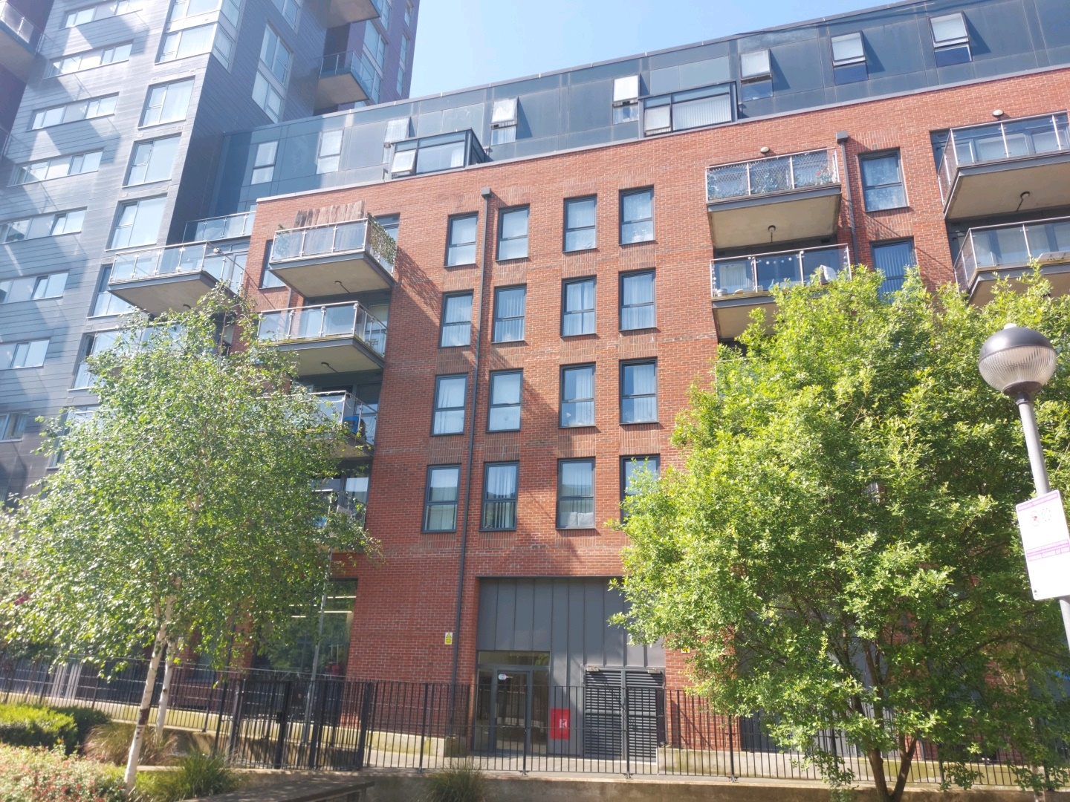


Building safety resident engagement commitment
13 Zenith Close
What is the commitment?
This engagement commitment sets out how we can work together to make decisions that affect the safety of your building. This could be about works being carried out or how we manage your building for example. Your Building Safety Manager (BSM) Joseph Vereenooghe has put this together based on responses from surveys, drop-ins and door knocking over recent weeks. If responses were low, we might use responses from other similar buildings to help us.
Methodology:
As your BSM, I aim to work with you to keep your building safe. To do this I visited your block to carry out an inspection on 8 July 2024. During the inspection I found no major issues. Minor issues were raised with the Estate Management Team.
I sent a survey to understand your information needs , vulnerabilities and awareness of building safety in this month to understand how we can work together to keep your building safe. I also informed you that your building had been registered with the Building Safety Regulator (BSR) and provided you with the registration number and the BSR’s contact number for any concerns that you might want to bring to their attention.
In February 2024, the Compliance Team sent you letter to inform you about the fire strategy for your building and the importance of fire doors on. I sent you information on your responsibilities and those of NHG in keeping your building safe on 15 July 2024.
This commitment has been made in July 2024 and will be reviewed in July 2026 or earlier if you tell us we need to
How we will share information with you and ask for your opinion:
To cater for the diverse needs of our residents, we can communicate in a broad range of ways. We aim to provide this information in different formats that can be understood by all residents including those that have a physical or visual impairment, have other disabilities or who speak another language:
At sign up
New resident home visits
On our website
On local notice boards
At local surgeries
During building inspections
Face to face appointments
At pop up sessions
By introductory & animation videos
Local newsletters
Via email
Via postal or hand delivered letter
Via SMS text
Fire Action Notices

Slide 2






Building safety resident engagement commitment
13 Zenith Close
Types of information you would like to see:
Action to take in the event of fire / structural emergency
General information to understand legislation impacting your home including the Building Safety Act and the Fire Safety England Regs
Resident and landlord responsibilities
Changes in fire strategy
Remediation works affecting your building
Other major works
Costs
What decisions you would like to be involved in?
We encourage residents to get involved in making decisions relating to the safety of their buildings
We encourage residents to create resident associations to have a voice in the management of their buildings.
If you would like further information on setting up or joining an existing Resident’s Association, please contact your Housing Officer/ Property Management Officer
How you can influence decisions:
We are proactively seeking out resident feedback and using that information to tailor our building safety approach
Contacting your BSM
Surgeries in person and online
Building & Estate walkabouts with Housing Officer/ PMO
Inclusion at Residents Association meetings
Get involved though your Residents Association. If your building does not have RA and you would like to start one, please contact your housing officer for support and guidance in setting one up
How we’ll gather and use your opinions:
We’ll keep a record on our Workwise system from our interactions as listed above
We’ll gather your thoughts in line with our usual GDPR policies, just like when you contact us about anything else.
How we’ll measure and review this commitment:
Measure the number of cases raised on Workwise reviewing building safety content
Writing to you annually to let you know what engagement and influence that has had
Got a question or concern about this commitment? Get in touch with your Building Safety Manager here:
Email: joseph.vereenooghe@nhg.org.uk
Phone: 07443442739 / 02038151846

Slide 3

Building safety resident engagement commitment
13 Zenith Close
Transparency of building safety information
At Notting Hill Genesis residents are at the heart of what we do. We want our resident to know they are safe and more importantly feel they are safe. To do this will be transparent in our management of your building’s safety and the information we provide to you. This includes but is not limited to fire protection measures, fire prevention measures, maintenance of fire safety systems , fire risk assessments and building safety inspections
Maintenance and testing | Frequency
Automatic opening vents | Bi-annually (N/A)
Alarm sounders | Monthly
Asbestos surveys | (N/A)
Building safety inspections | Annually
Communal fire door checks | Quarterly
Dry/wet risers | Monthly
Door closers | Monthly
Electrical | Five yearly
Emergency lighting | Monthly – discharged annually
Estate inspections | Monthly
Fire Risk Assessment | Annually
Fire alarms | Monthly
Flat door checks | Annually
Fire alarm panel servicing | Bi-annually
Fire extinguishers | Annually
Fire Blankets | Annually (N/A)
Legionella | Two yearly
Maintenance and testing | Frequency
Gas safety checks | Annually
Lifts servicing | Bi-annually
Lightning protection | Annually
Lifting operations and lifting equipment regulations (LOLERS) | Bi-annually
Manual opening vents | Bi-annually
Mansafe | Annually
Portable appliance testing | Annually
Permanent opening vents | N/A
Smoke alarms
Sprinklers | Annually
Wayfinding signage | Monthly
Get in touch with your Building Safety Manager here:
Email: joseph.vereenooghe@nhg.org.uk
Phone: 07443442739 / 02038151846

