Slide 1
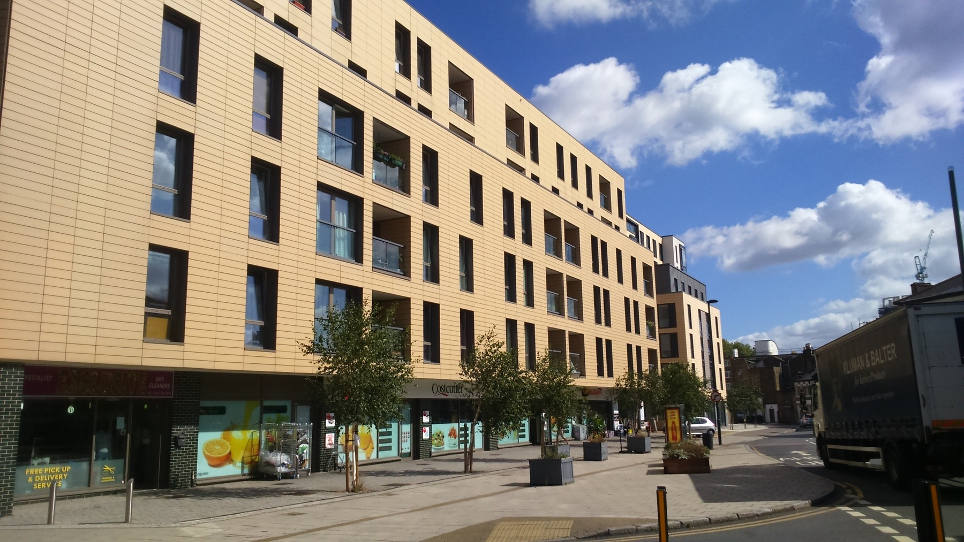
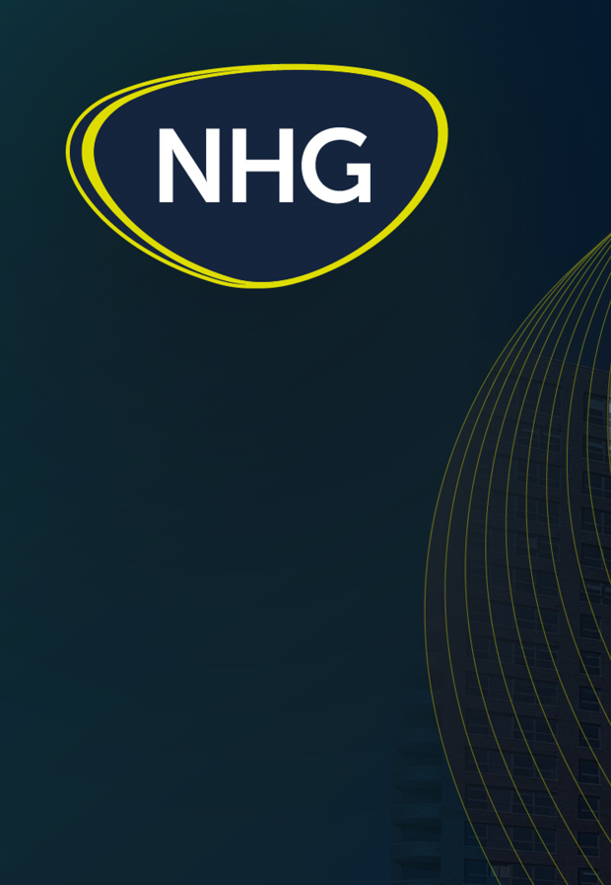
Oak Square
External Wall & MVHR Programme
June 2026

Slide 2
Project Team – Notting Hill Genesis
Building Safety Remediation
Petronila Osodo – Head of Building Safety, Remediation, Notting Hill Genesis
Jo Knight – Senior Project Manager, Notting Hill Genesis
Irine Cheptoo- Project Manager, Notting Hill Genesis
Estate Management & Operations
Valentina Ciaccio -Estate Operations Manager, Notting Hill Genesis
Cam Kunyeda – Relocations Officer, Notting Hill Genesis
Dominik Chlebowski – Interim Relocations Officer, Notting Hill Genesis (since Easter)
Olalekan Ameen- Housing Officer
Zara Begum-Housing Officer

Slide 3
PROJECT BACKGROUND
Higgins are undertaking External Wall Remediation Works and replacement of the existing Ventilation Equipment with a new supply-and-extract mechanical ventilation with heat recovery (MVHR).
The works commenced in 2023 and are still scheduled to complete in June 2027 (further programme detail to follow)
The planned works mean residents will need to temporarily relocate to another home within the Oak Square estate. This will be for up to 10 weeks, while this essential work is completed to your home.

Slide 4
NHG Update

Slide 5
Decant Relocation Update
Decant moves commenced 13/01/26, so far 56 residents have been relocated with 53 residents scheduled to relocate from their permanent properties.
We’ve received 136 signed decant licenses (75%) with moves scheduled until middle of Sept '26.
The aim is to finalise all signatures by August 2026 to meet the December 2026 end date for MVHR & internal works.
We’ve now handed over 43 permanent properties back to residents with essential handover documents provided i.e;
  MVHR & Cooker Hood Warranty and manuals- Contacts in case of repairs are also provided in the packs.
  MVHR Commissioning Certificate
  Electrical Installation Condition Report
  Fire Detection Certificate.
  Quality Assurance Pictures
Relocation Officer working closely with residents for the moves, issues being managed by NHG.

Slide 6
Lessons learnt
Since commencing the moves, we have picked up additional works in the properties as follows;
  Paint works to architraves to match existing wall colour.
  Improved cleaning of flats and light clean of fridges in permanent properties, deep clean on a case-by case basis.
  Mould found in properties- treatment of mould and paint to match ceiling colour.
  Removal of old MVHR ducting along ceilings in permanent properties and making good ceilings.
  Internet speeds- all flats with hyper-optic cabling now have upgraded internet speeds
  Windows and balconies- contractor instructed to commence repair of faulty windows and doors in decant void properties
Defects raised in permanent properties, are being managed by NHG. Residents to raise any issues with pictures where possible, within 2-weeks of moving back to permanent properties with the relocation officers. NHG has weekly meetings with Higgins to follow up on defects for each property.
We are dealing with broken furniture and any damaged equipment on a case-by-case basis. We have resolved several cases successfully so if this is a concern when you move back, please raise this with the relocation officers.

Slide 7
Lessons learnt
Higgins newsletters- Issued monthly via email and on Microsite to provide notices on use of lifts and expected noise disturbances.
Reinstatement of gardens- The Estate management team have commenced plans to reconstitute estate following removal of scaffolding in certain areas, TRA have been engaged in the discussions, works to be done at the end of the programme at no costs to residents.

Slide 8
Key issues
Late cancellations of moves by residents;
  This causes delays to the schedule as this affects the upcoming moves for other residents. The moving company is also having to reschedule moving dates, and this comes at a cost.
  Higgins issue access notices and reminders- 4 weeks, 2 weeks and a 1 week to move. NHG also sends email reminders to residents.
  This is a breach of decant license terms.
  If unable to meet move date, please communicate to Relocation officer minimum 1-week notice
Lift breakdown causing delays;
  One side of the lift in Rowan court has been down for 1 month and needs parts replaced. Parts have been procured but experiencing shipping delays, delivery expected on site on 30/06/2026, NHG chasing.

Slide 9
Focus over the next 2 months
Finalise remaining circa 40 outstanding decant licenses by end of August 2026 to meet December 2026 completion.
Residents to finalise raising any key concerns on the licenses by 30/06/2026 with the Relocation officers to allow enough time to reach an agreement.
If unable to reach an agreement;
  Leaseholders- the MVHR units are demised to the leaseholder so we will formally note that an agreement to carry out works could not be reached and without the agreement, works will not be able to proceed.
  Social Housing tenants- a formal process will be followed to gain access to the property.
Our priority remains the safety of our residents so we are hopeful we will reach a reasonable agreement with all.

Slide 10
Higgins Update

Slide 11

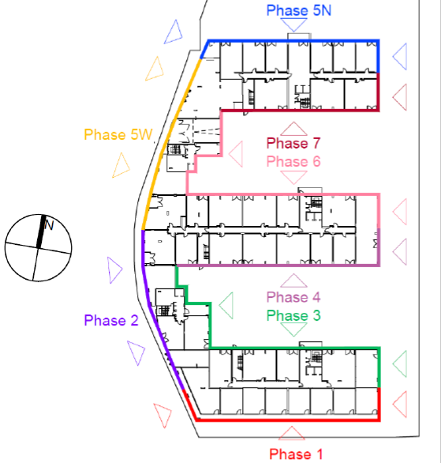
Oak Square Phase Plan
Phoenix
Ivy
Rowan
Dahlia
Acacia

Slide 12
Progress – On Site.
Phase 1
New Masonry support design completed. Additional Masonry Support manufactured and delivered. Inner leaf works completed. New masonry support installation has commenced on Level 1.
Phase 2
Completed & Scaffold Struck.
Phase 3
Completed & Scaffold Struck.
Small section remains to provide required support to scaffold staircase which will be struck along with Phase 1 scaffold.
Phase 4
Completed & Scaffold Struck.

Slide 13
Progress – On Site.
Phase 5W
Completed & Scaffold Struck.
Phase 6
Cladding Sub Grid installation completed, and Terracotta tile installation commenced and progressing.
Render works completed Level 2 to Roof.
Scaffold Strike due to commence in August 2026 and to be completed during December 2026.
Phase 7
New Outer leaf blockwork completed.
Cladding Sub Grid Installation nearing completion.
Scaffold Strike due to commence in October 2026 and to be completed during March 2027.

Slide 14
Progress – Design.
Progress – On Site.
Phase 5N
New Masonry Support installation & Outer Leaf Completed.
Window Membrane installation nearing completion.
Cladding Sub grid Installation commenced.
Monar Flex & Scaffold Canopy removed and Debris Netting installed.
Scaffold Strike due to commence in December 2026 and to be completed during April 2027.
New Masonry Support
Phase 1 Design complete.
New Cladding Design
Design complete.
All material required to complete is currently in our “off site” storage facility and will be delivered to site when required.

Slide 15
Anticipated Scaffolding Works
Phase | Anticipated Monar Flex Removal | Anticipated Strike Commencement | Original Scaffold down dates | Anticipated Scaffold down dates
Phase 1 | October 2026 | March 2027 | October 2024 | June 2027
Phase 2 | Completed | Completed | February 2025 | March 2026
Phase 3 | Completed | Completed | July 2025 | April 2026
Phase 4 | Completed | Completed | December 2025 | July 2026
Phase 5 W | Completed | Completed | November 2025 | July 2026
Phase 6 | Completed | August 2026 | February 2026 | December 2026
Phase 7 | Completed | October 2026 | April 2026 | March 2027
Phase 5 N | Completed | December 2026 | July 2026 | May 2027

Slide 16
Indicative Programme
Activity | Timeframe
Commence installation of new Terracotta tiles Phase 4 | Completed
Commence installation of new Terracotta tiles Phase 5W | Completed
Commence New Terracotta support structure Phase 6 | Completed
Commence installation of new Terracotta tiles Phase 6 | Commenced & Progressing
Commence Installation of Masonry Support and new blockwork to Phase 7 | Completed
Commence New Terracotta support structure Phase 7 | Commenced & Progressing
Commence installation of new Terracotta tiles Phase 7 | July 2026

Slide 17
Indicative Programme
Activity | Timeframe
Commence Installation of Masonry Support and new blockwork to Phase 5N | Completed
Commence Installation of Masonry Support, Insulation and new blockwork to Phase 5N | Completed
Commence New Terracotta support structure Phase 5N | Commenced & Progressing
Commence installation of new Terracotta tiles Phase 5N | September 2026
Commence Installation of Masonry Support, Insulation and new blockwork to Phase 1 | Commenced & Progressing

Slide 18
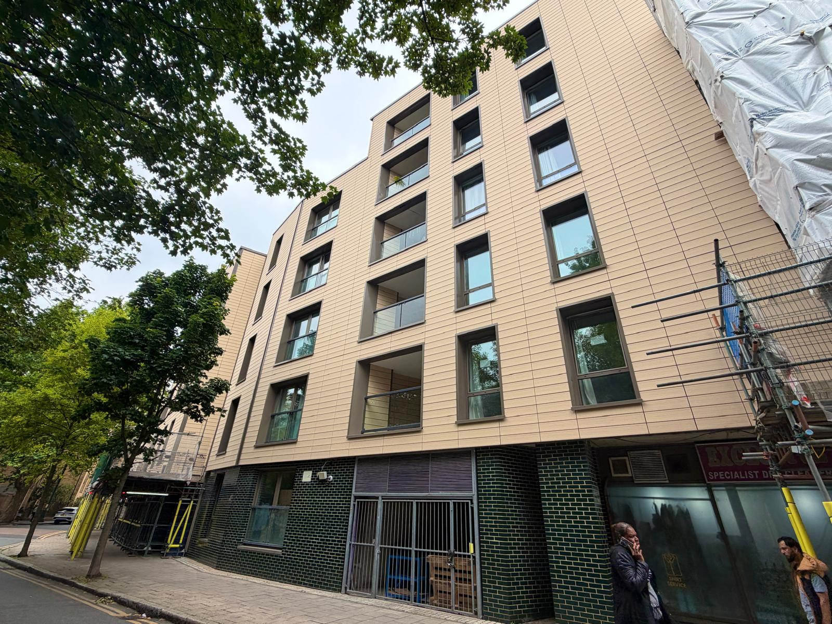
Progress Photos
Phase 2 – Scaffold Struck.

Slide 19
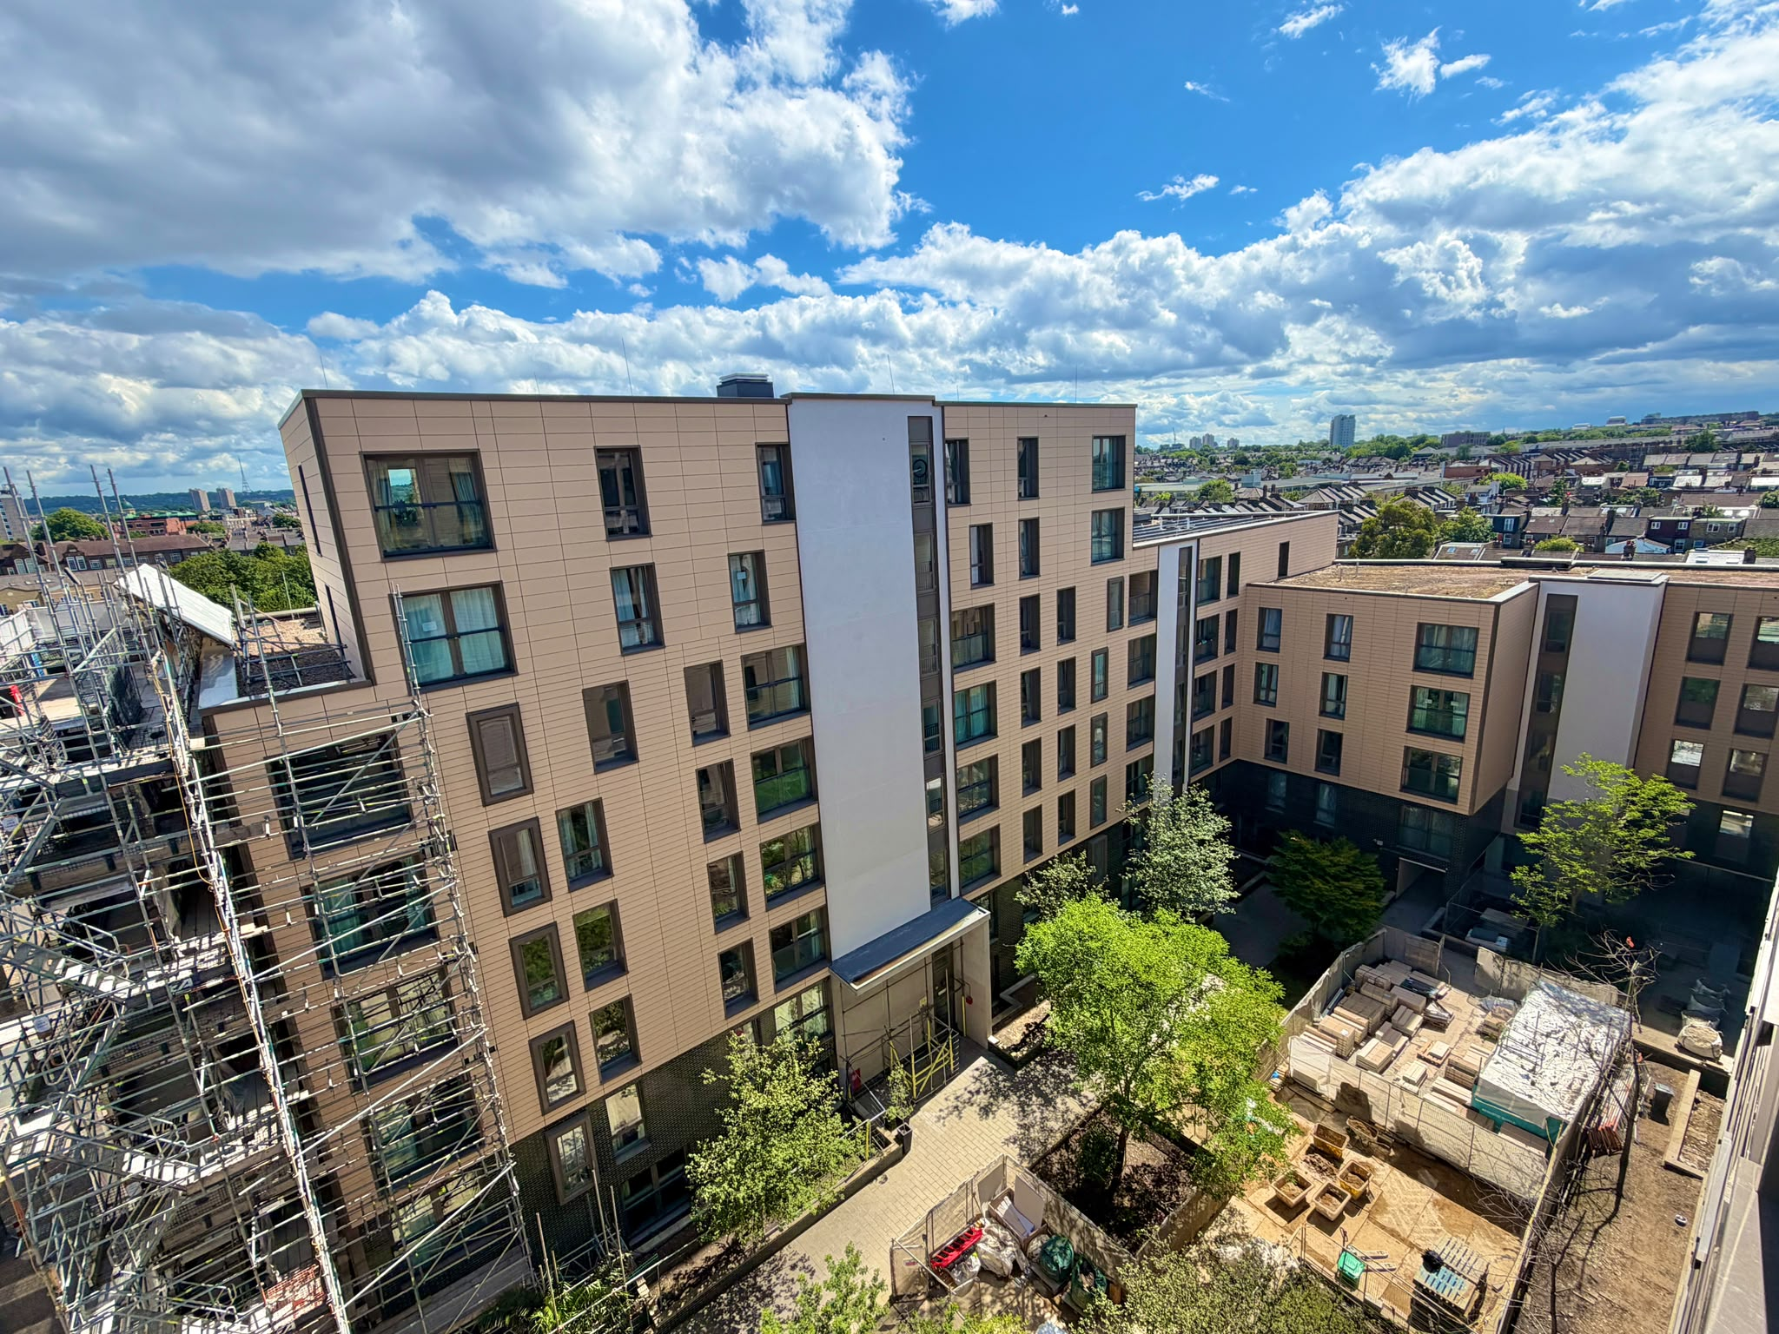
Progress Photos
Phase 3 – Scaffold Struck. Small section remains to provide required support for scaffold staircase to access Phase 1.

Slide 20
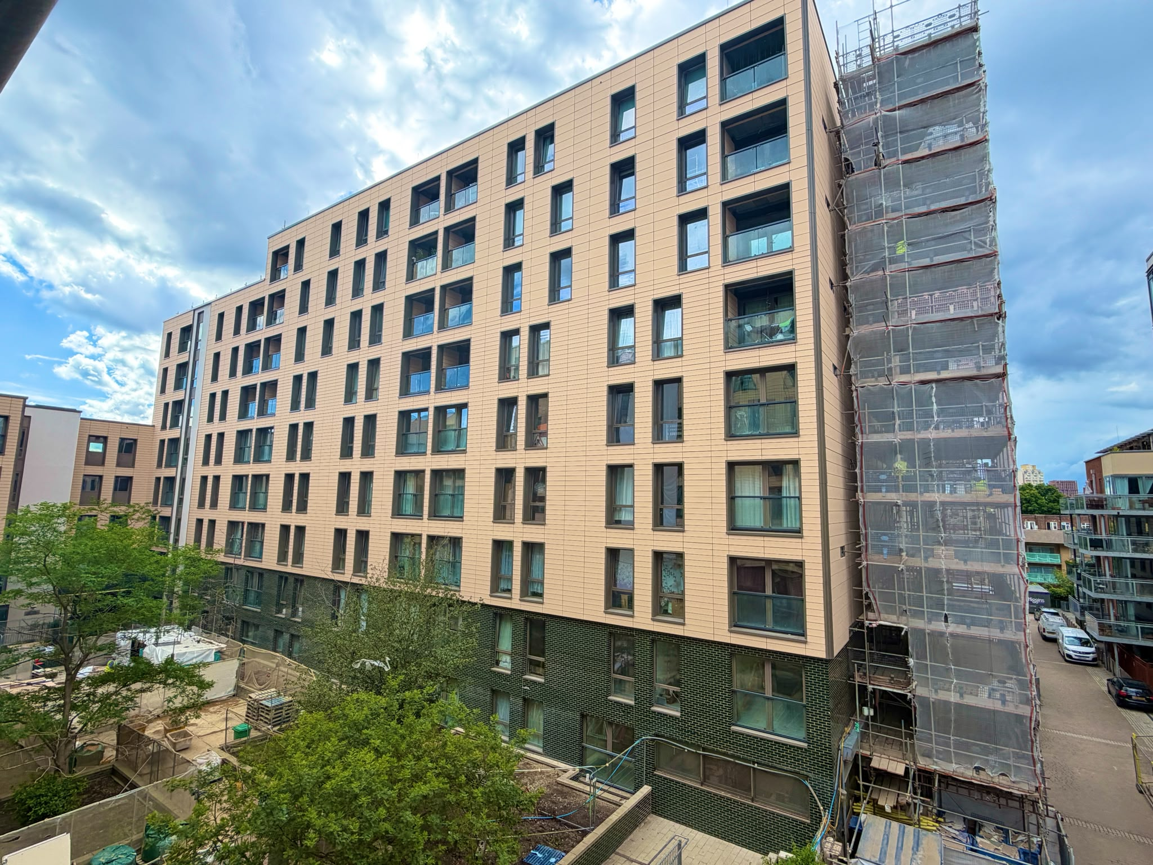
Progress Photos
Phase 4 – Scaffold Struck.

Slide 21
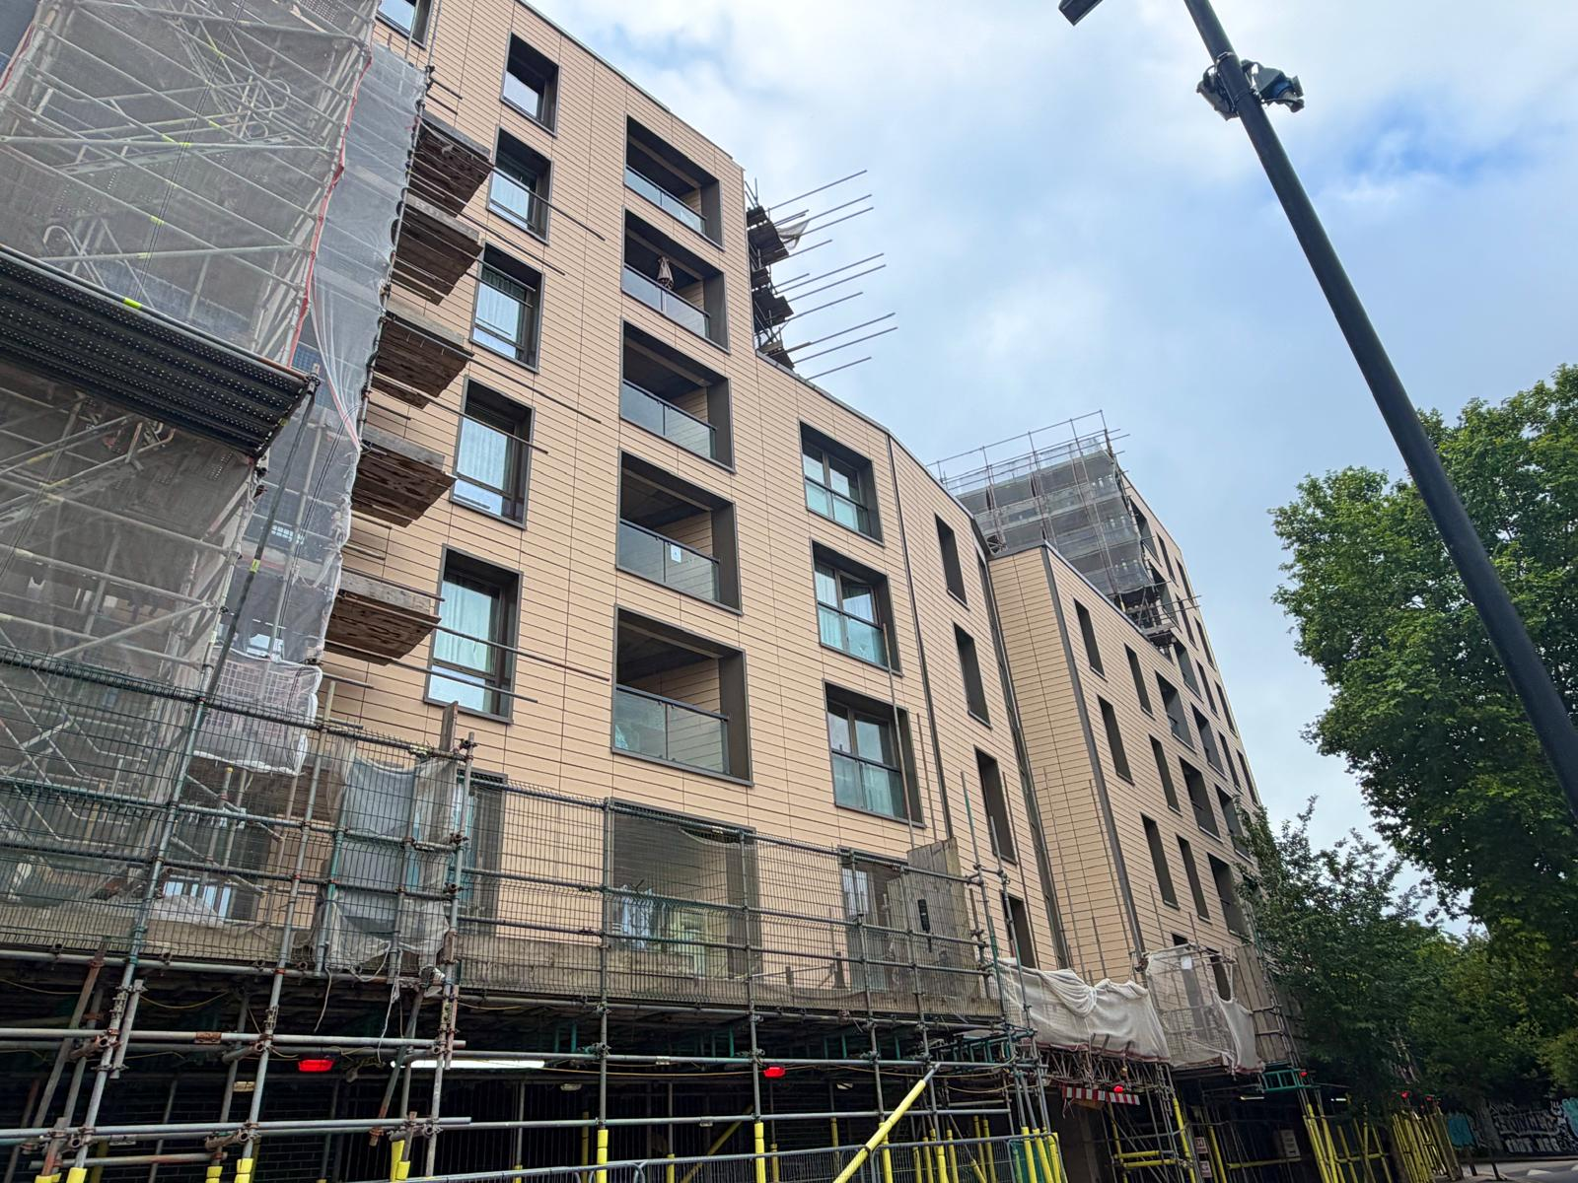
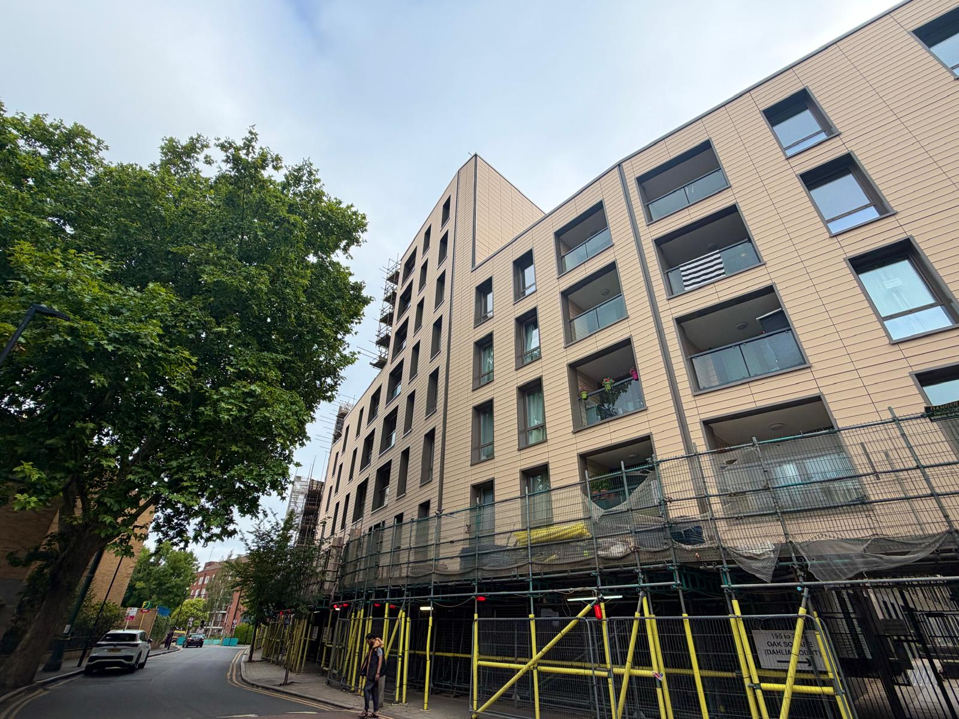
Progress Photos
Phase 5W – Scaffold Struck & Gantry strike progressing.

Slide 22
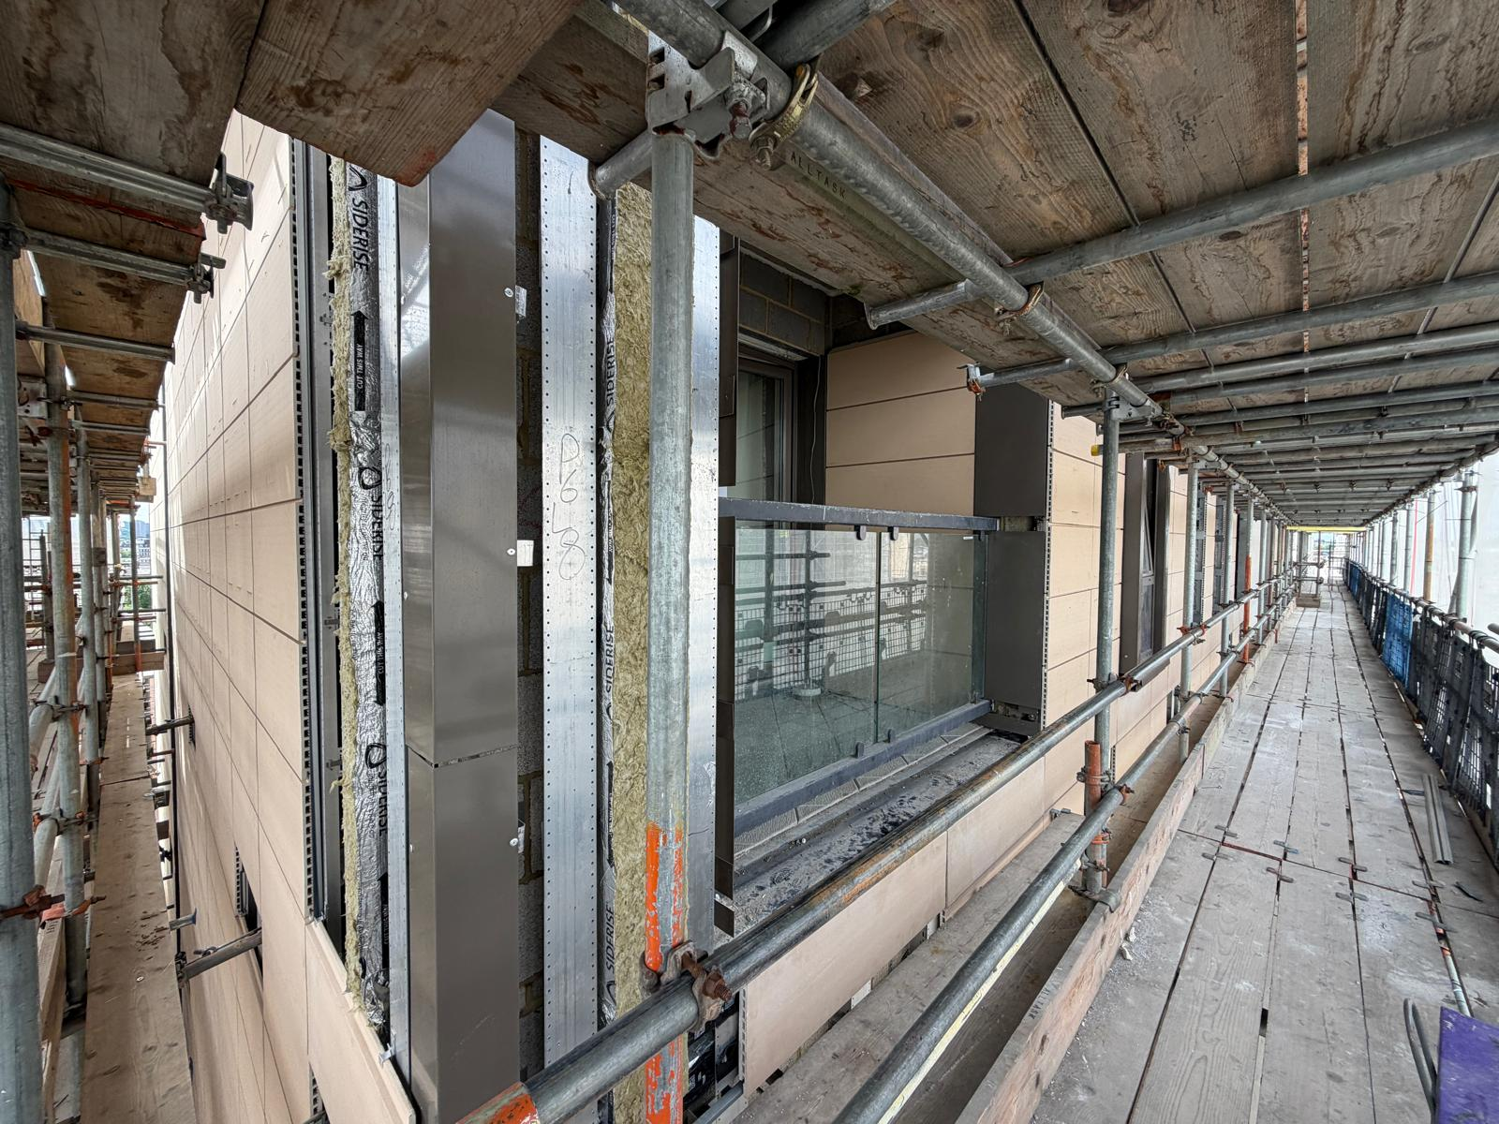
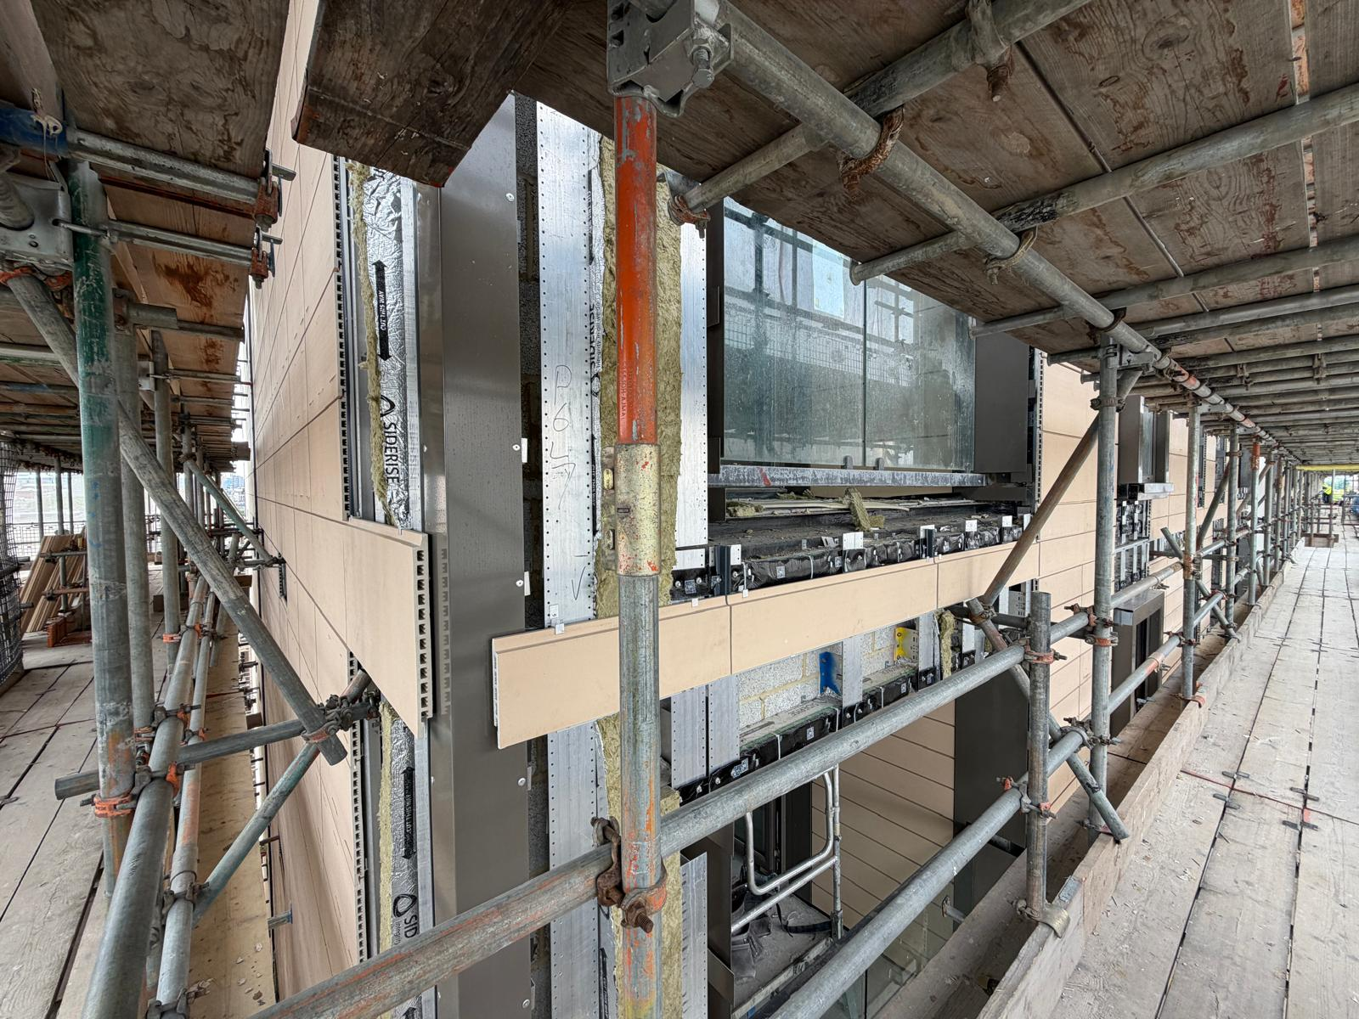
Progress Photos
Phase 6 – Terracotta Installation in Progress – Levels 3 to 8

Slide 23
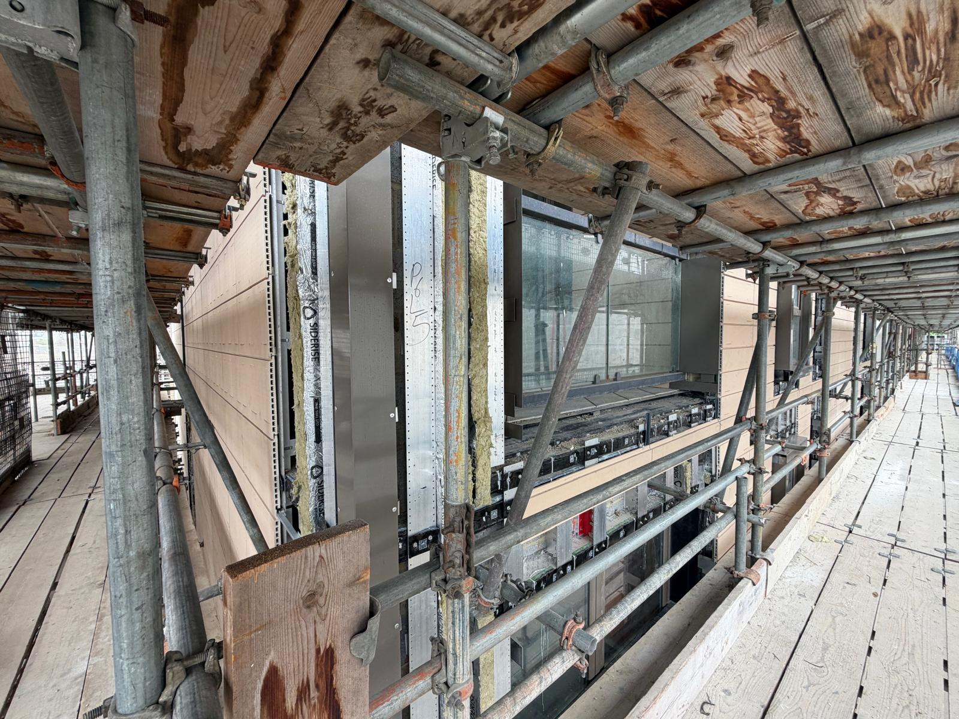
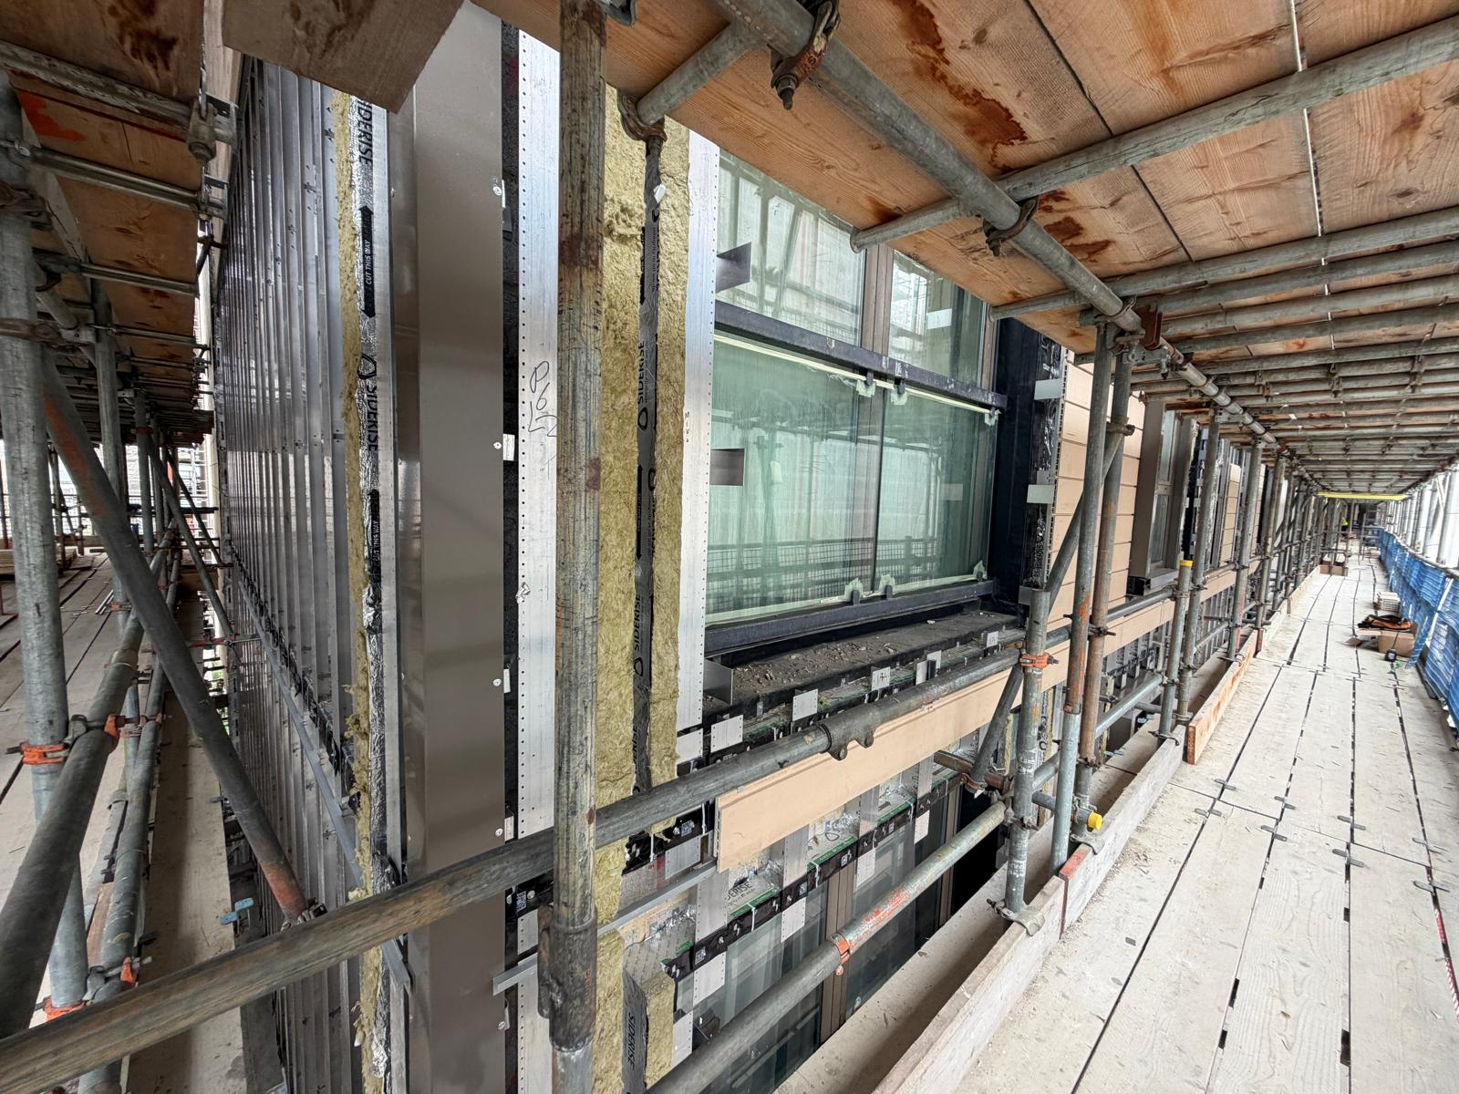
Progress Photos
Phase 6 – Terracotta Installation in Progress – Levels 3 to 8

Slide 24
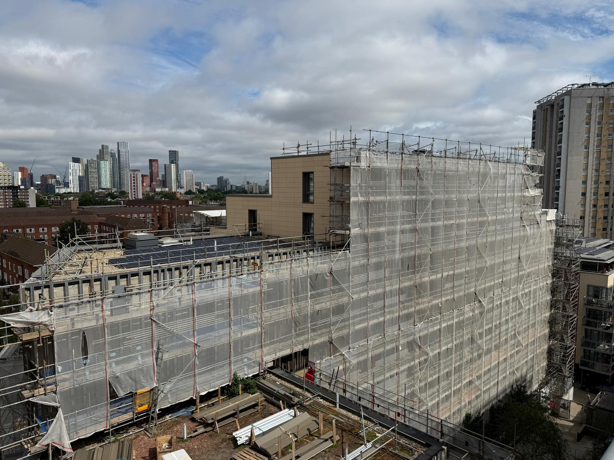
Progress Photos
Phase 7 – Scaffold Canopy removed

Slide 25
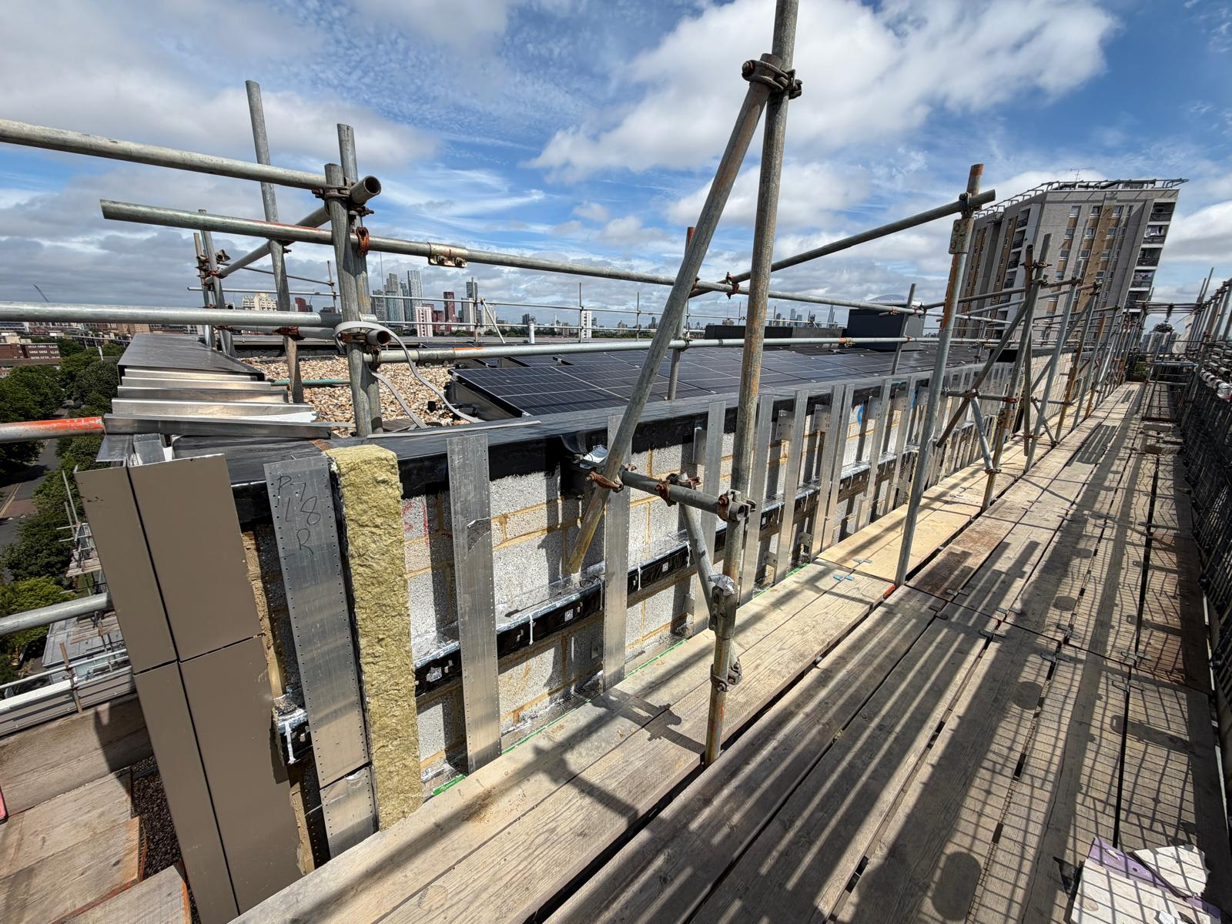
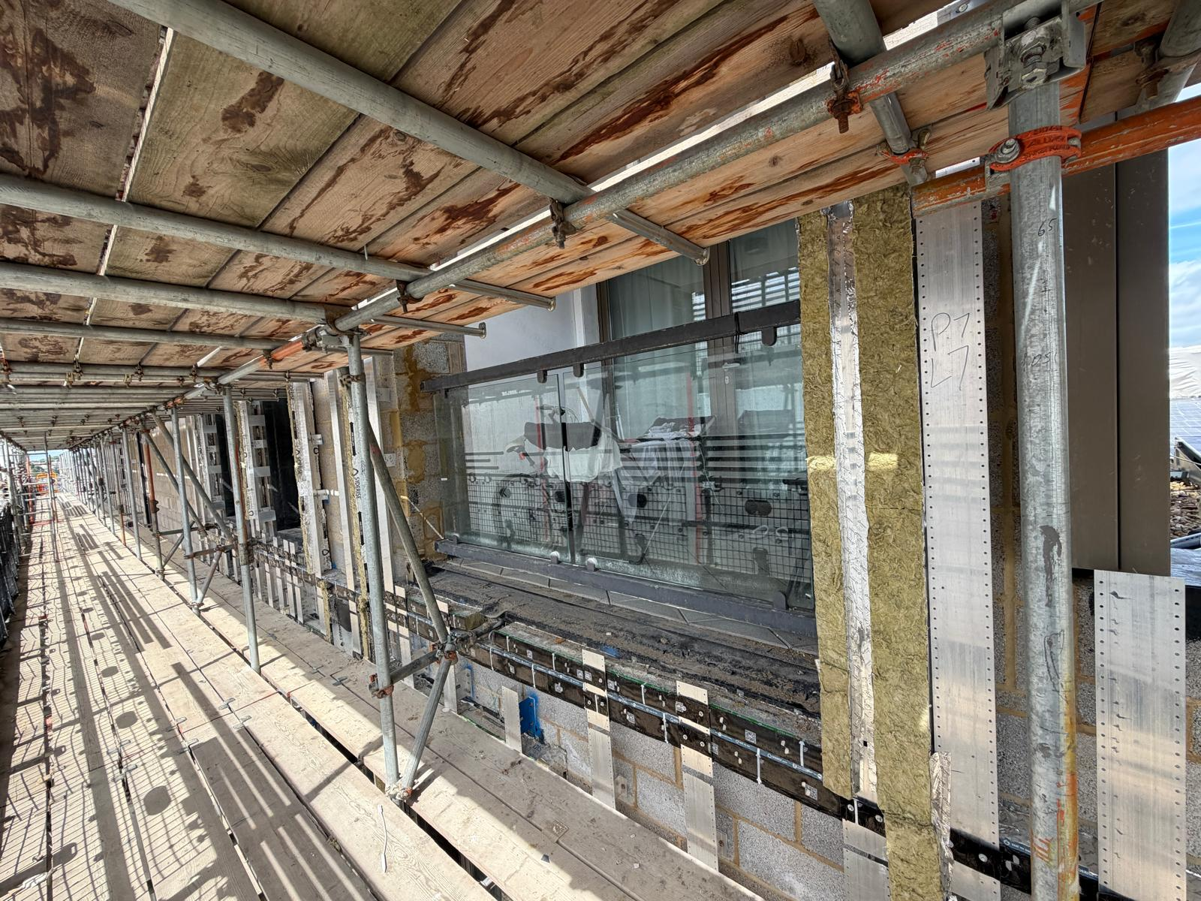
Progress Photos
Phase 7 – Cladding Sub Grid & Fire Break Installation Progressing – Level 8 to Level 2

Slide 26
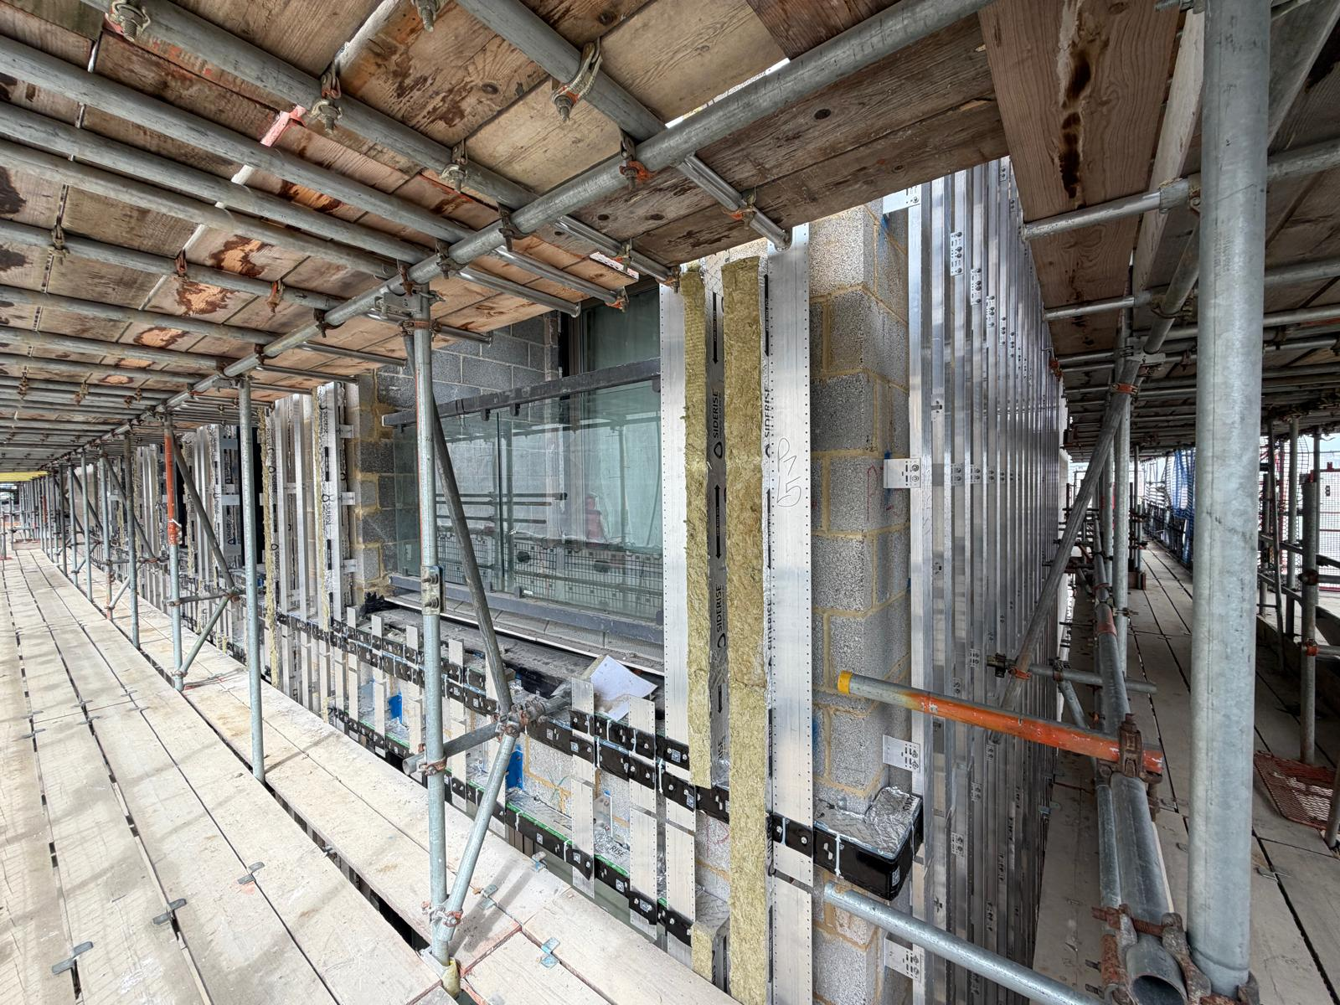
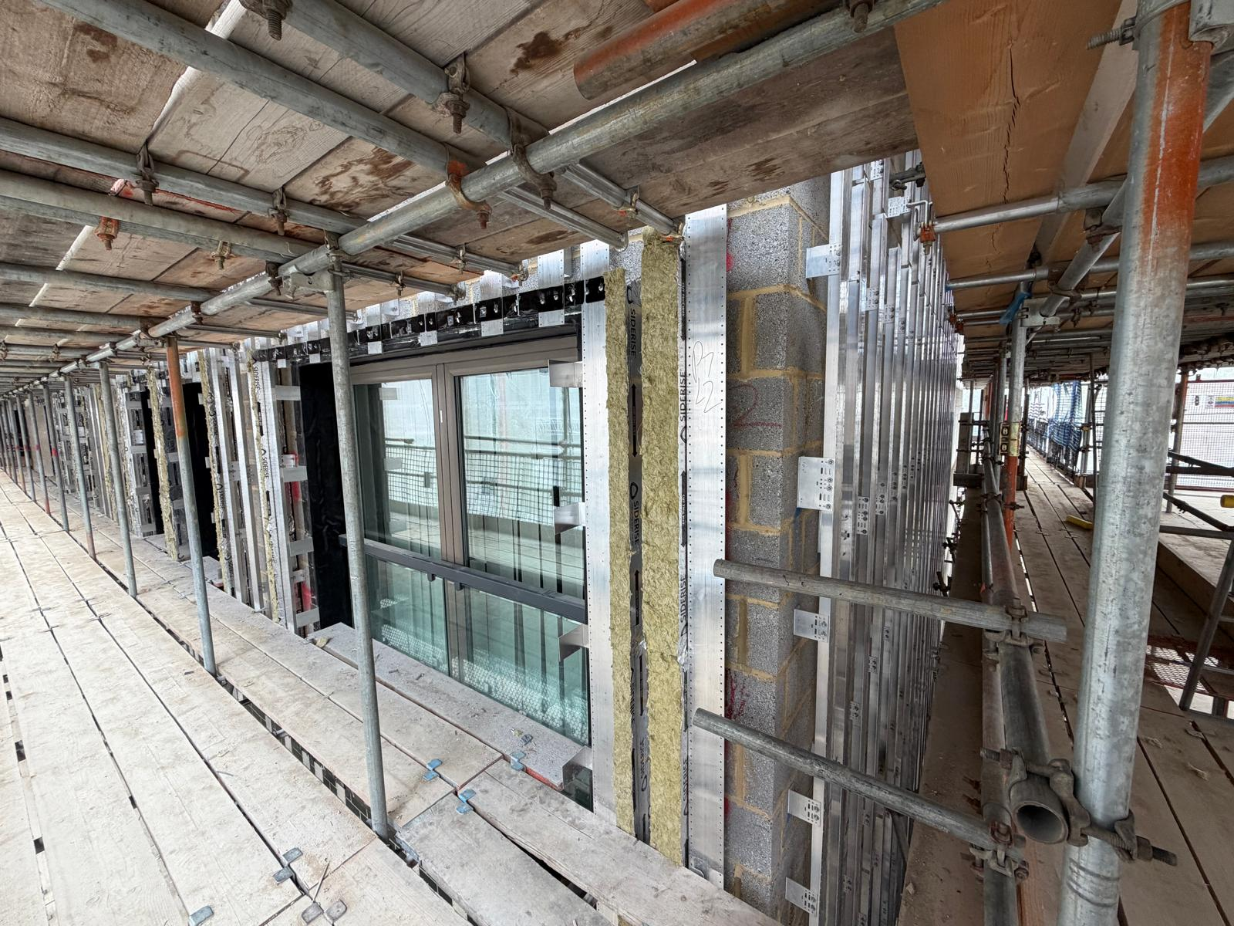
Progress Photos
Phase 7 – Cladding Sub Grid & Fire Break Installation Progressing – Level 8 to Level 2

Slide 27
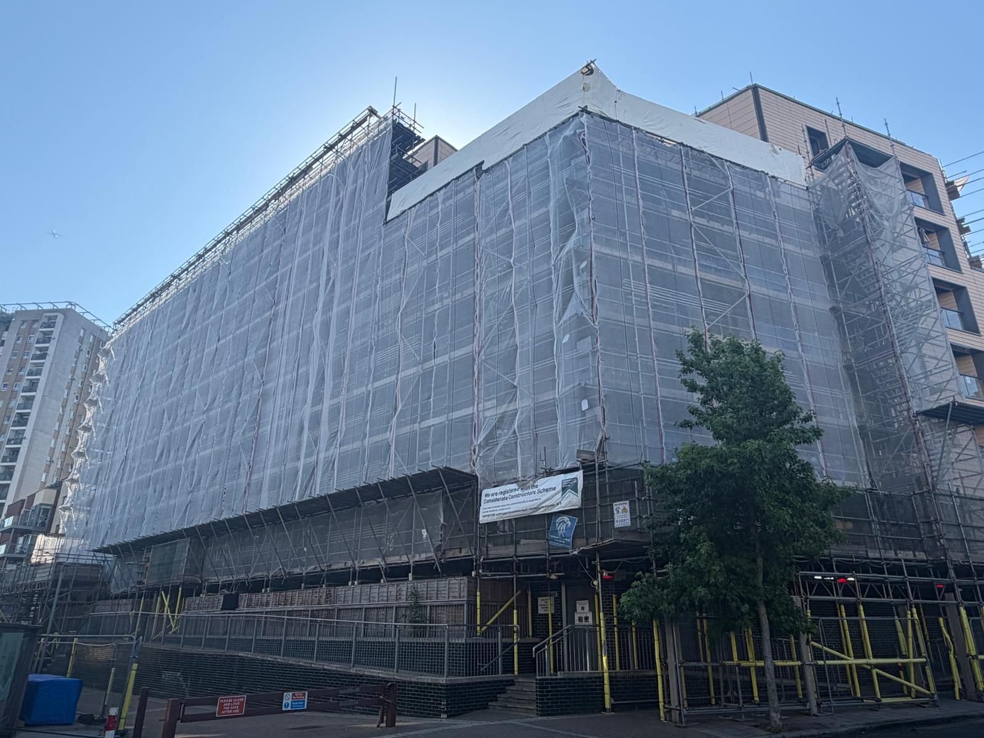
Progress Photos
Phase 5N – Monar Flex removed & Debris Netting installed. Scaffold Canopy Removal in progress.

Slide 28
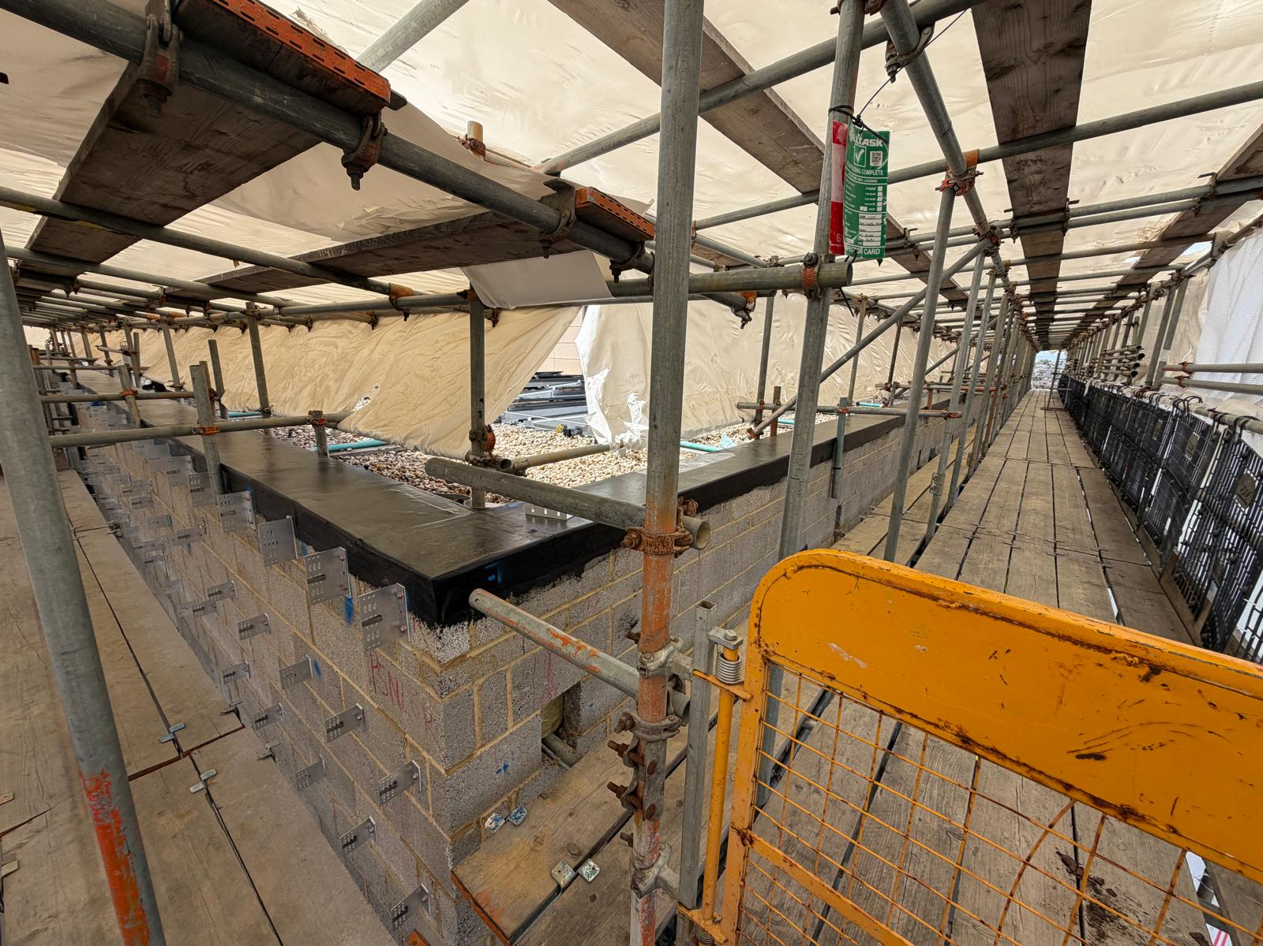
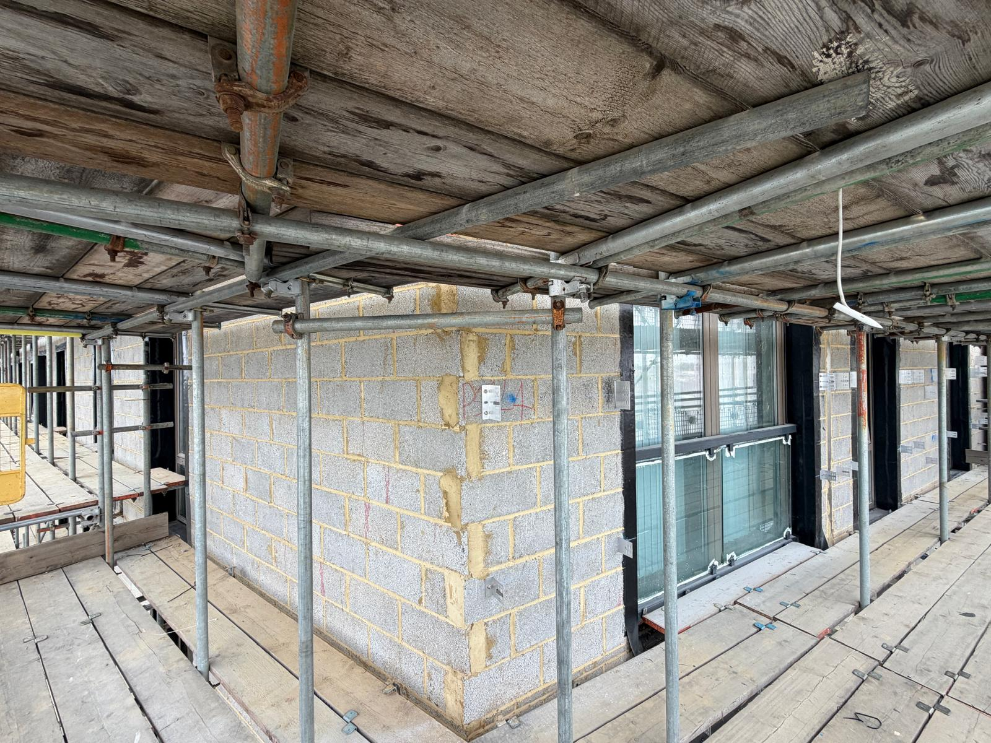
Progress Photos
Phase 5N – New Outer Leaf Completed. Window Membrane progressing. Cladding Sub Grid commenced.

Slide 29
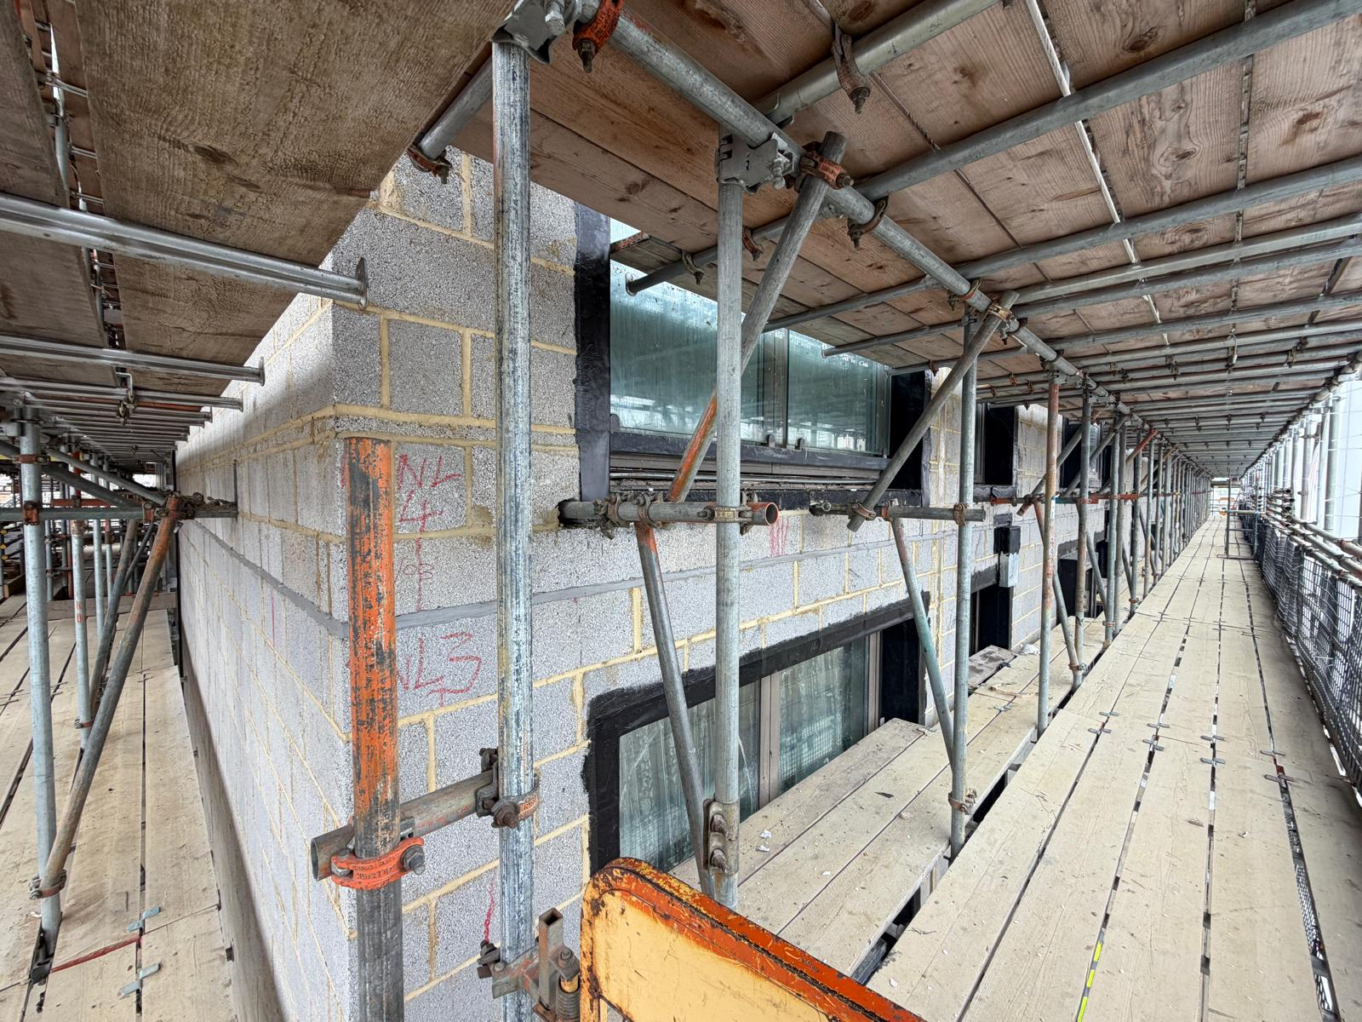
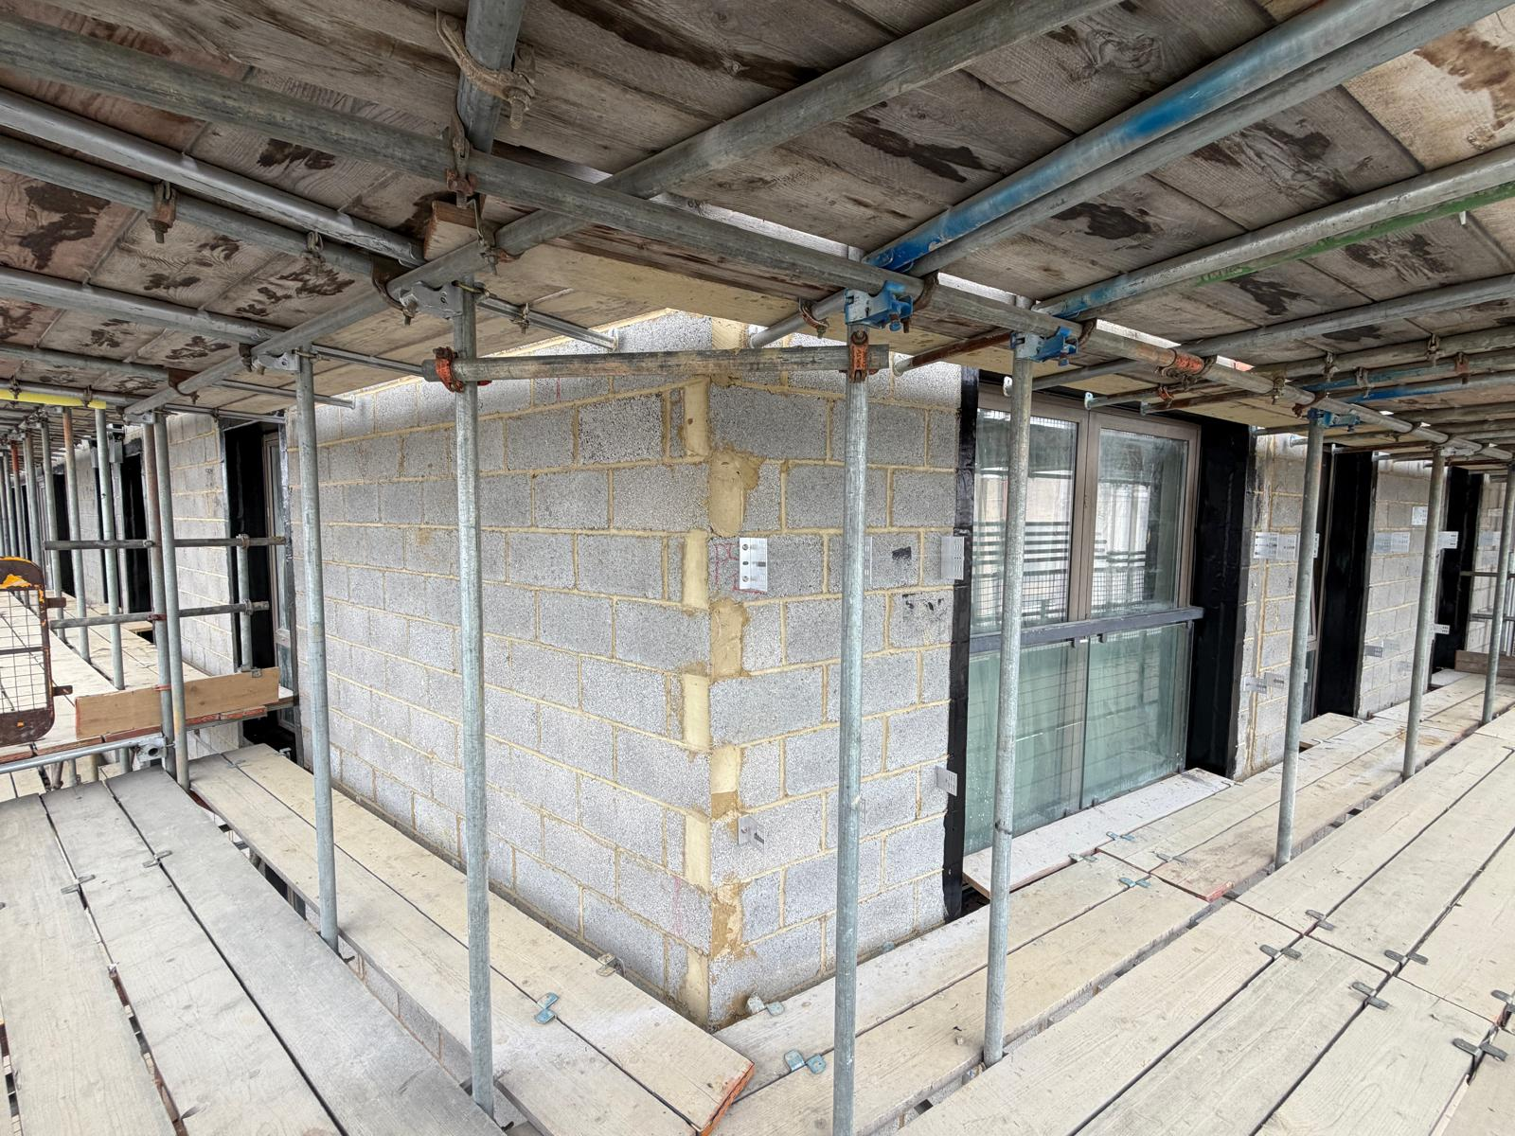
Progress Photos
Phase 5N – New Outer Leaf Completed. Window Membrane progressing. Cladding Sub Grid commenced.

Slide 30
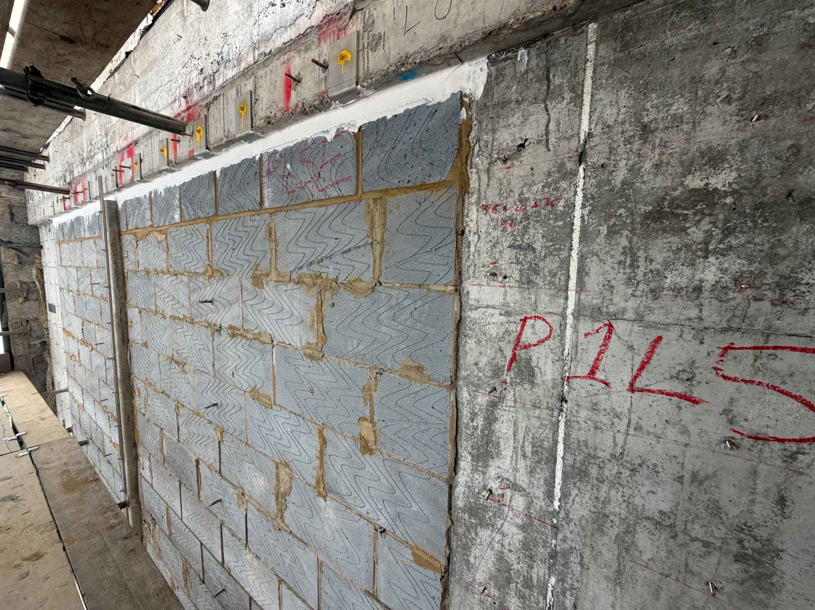
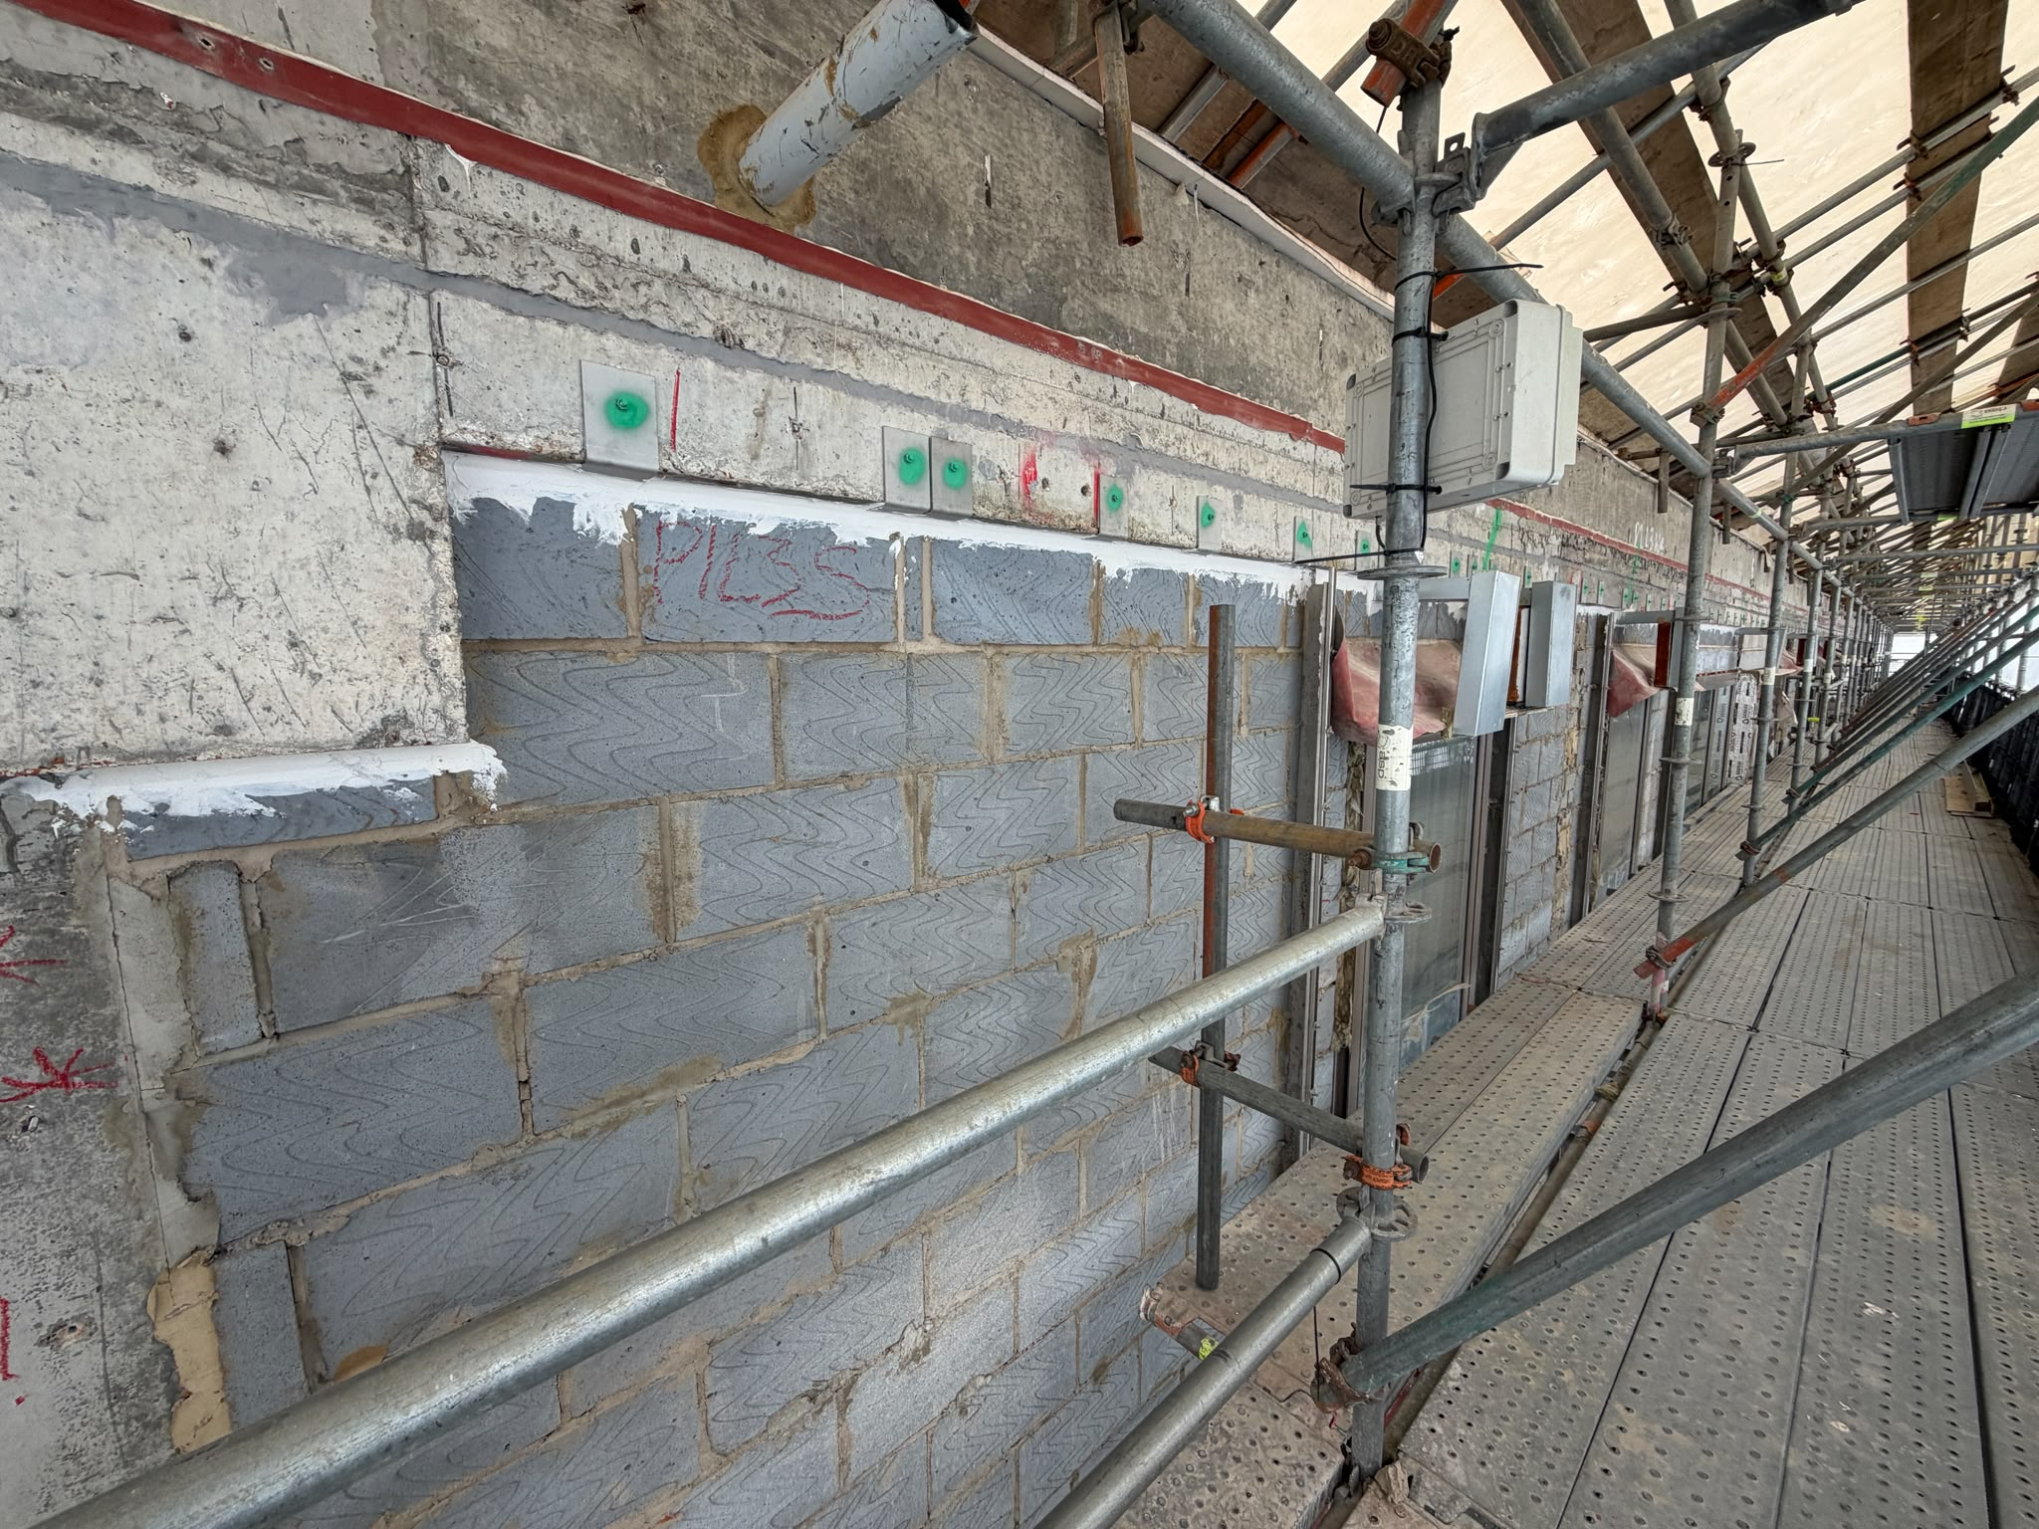
Progress Photos
Phase 1 – Inner Leaf works completed to all floors.

Slide 31
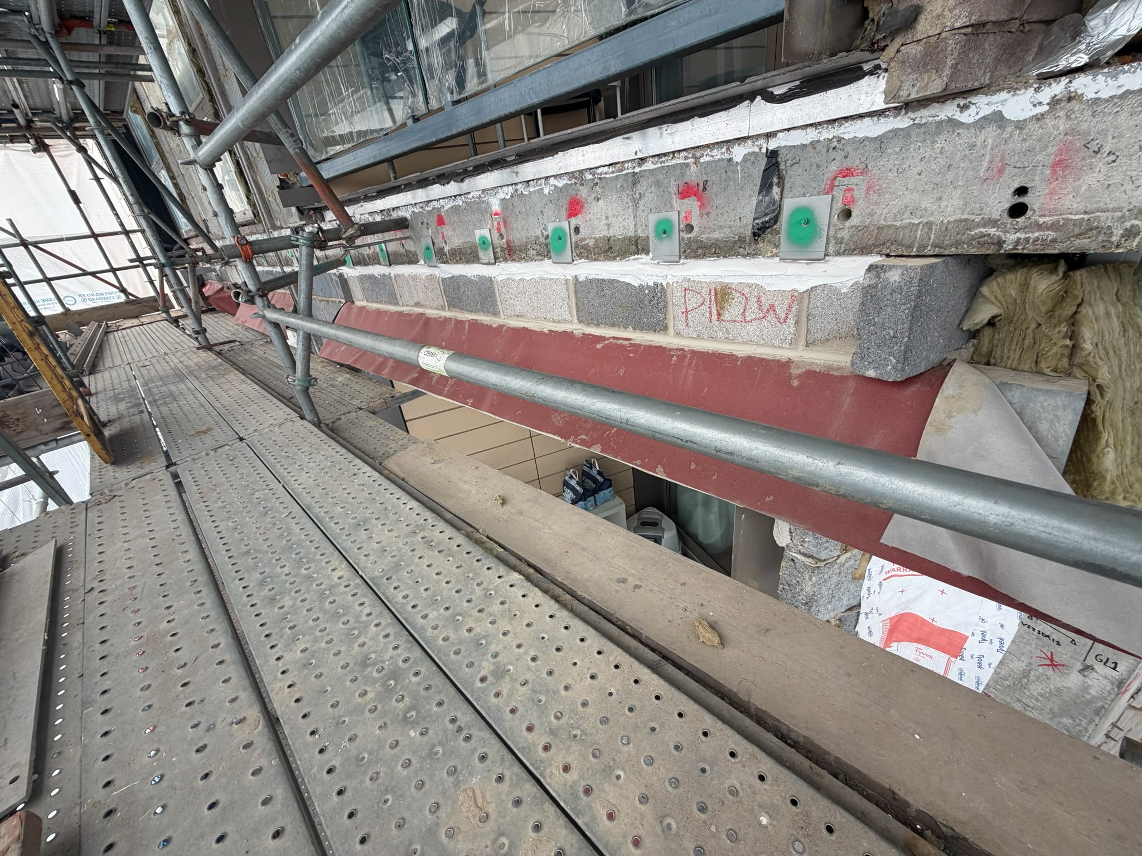
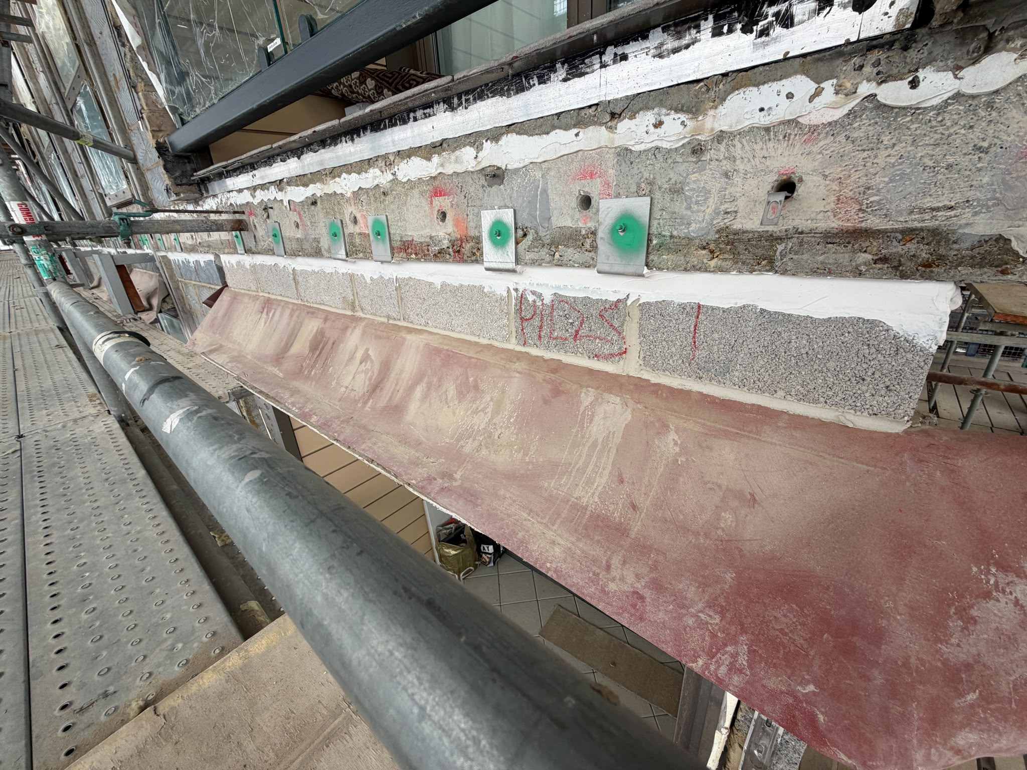
Progress Photos
Phase 1 – Inner Leaf works completed to all floors.

Slide 32
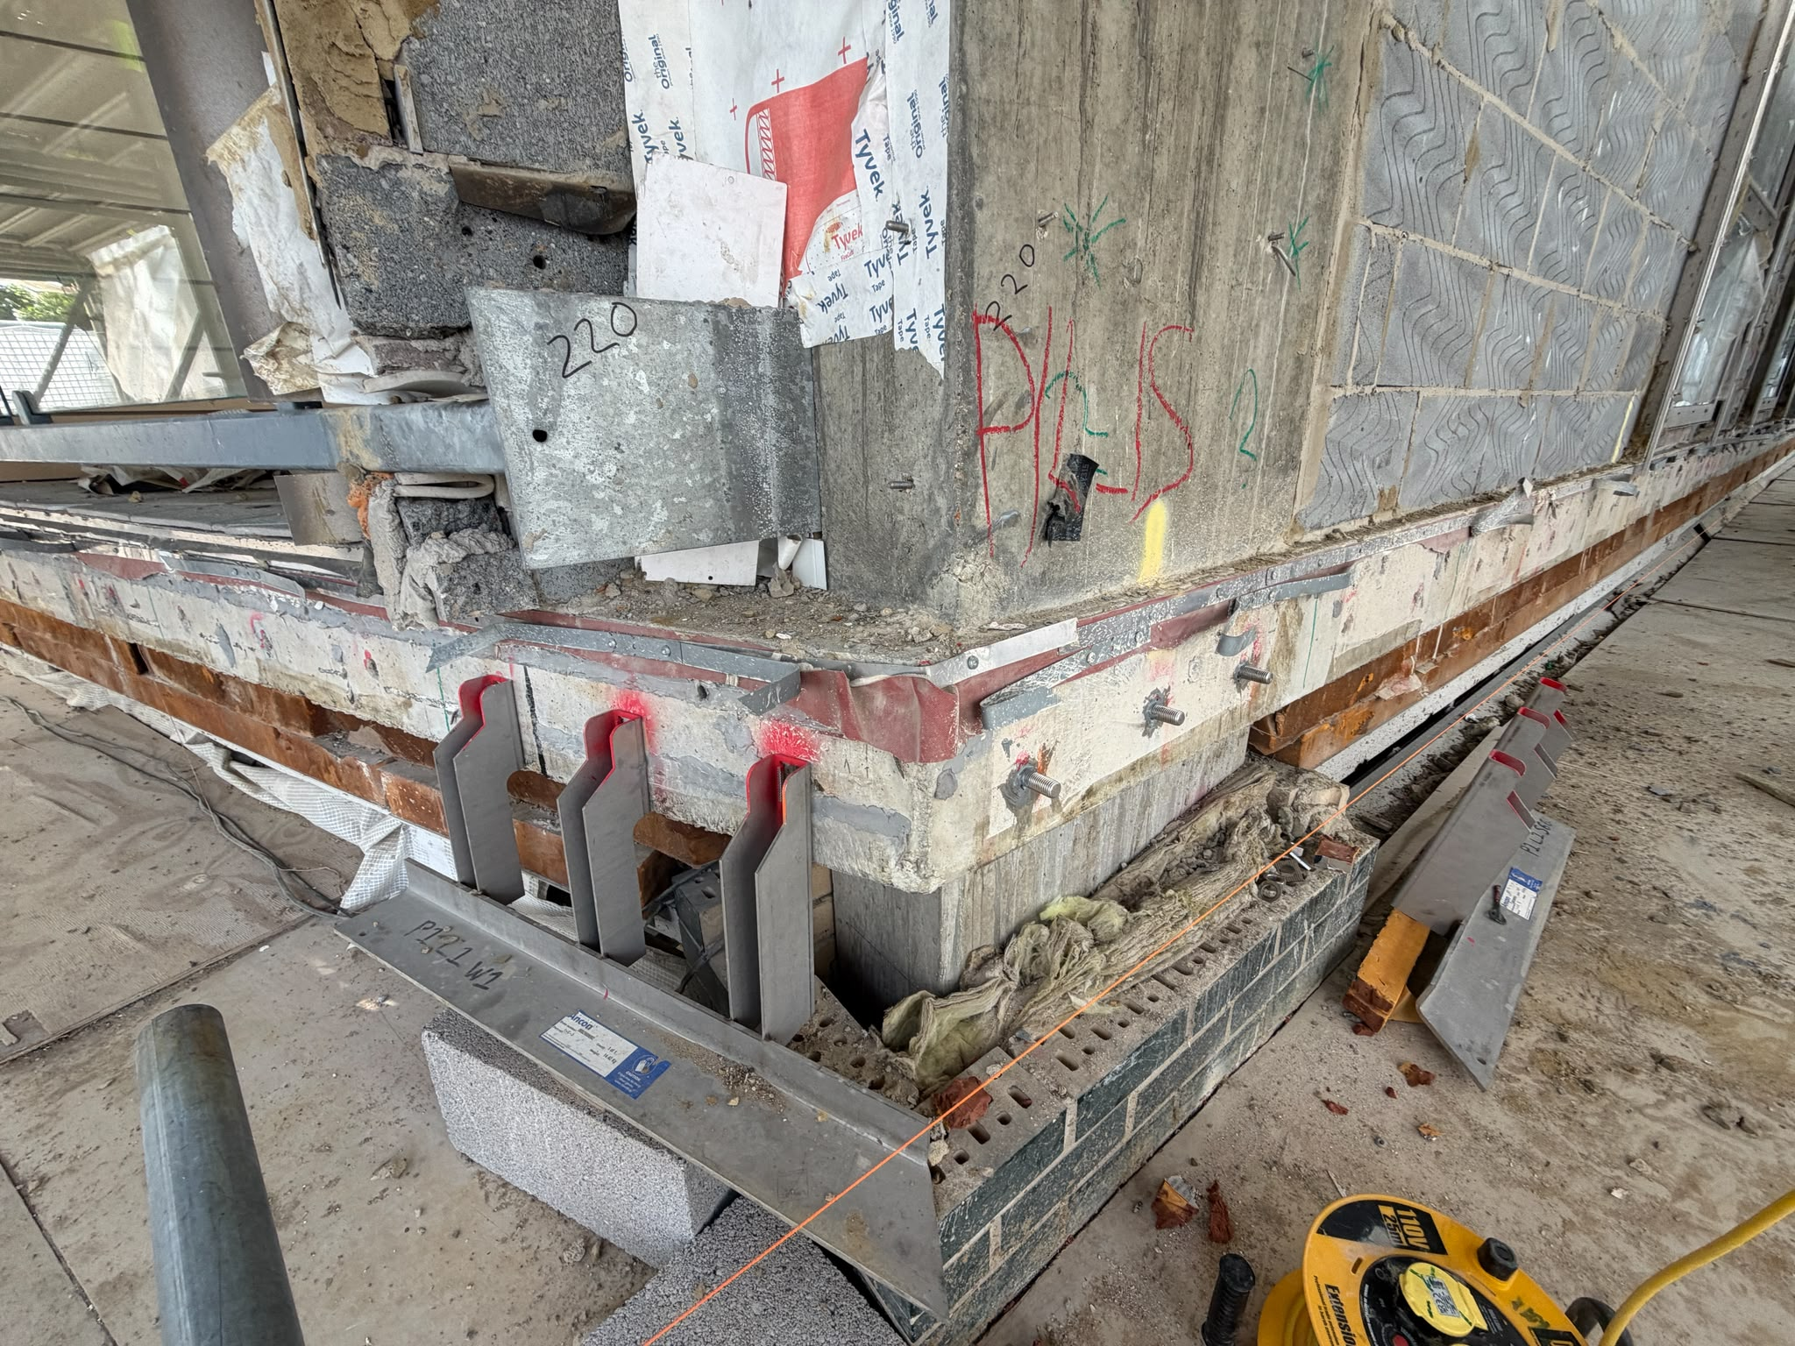
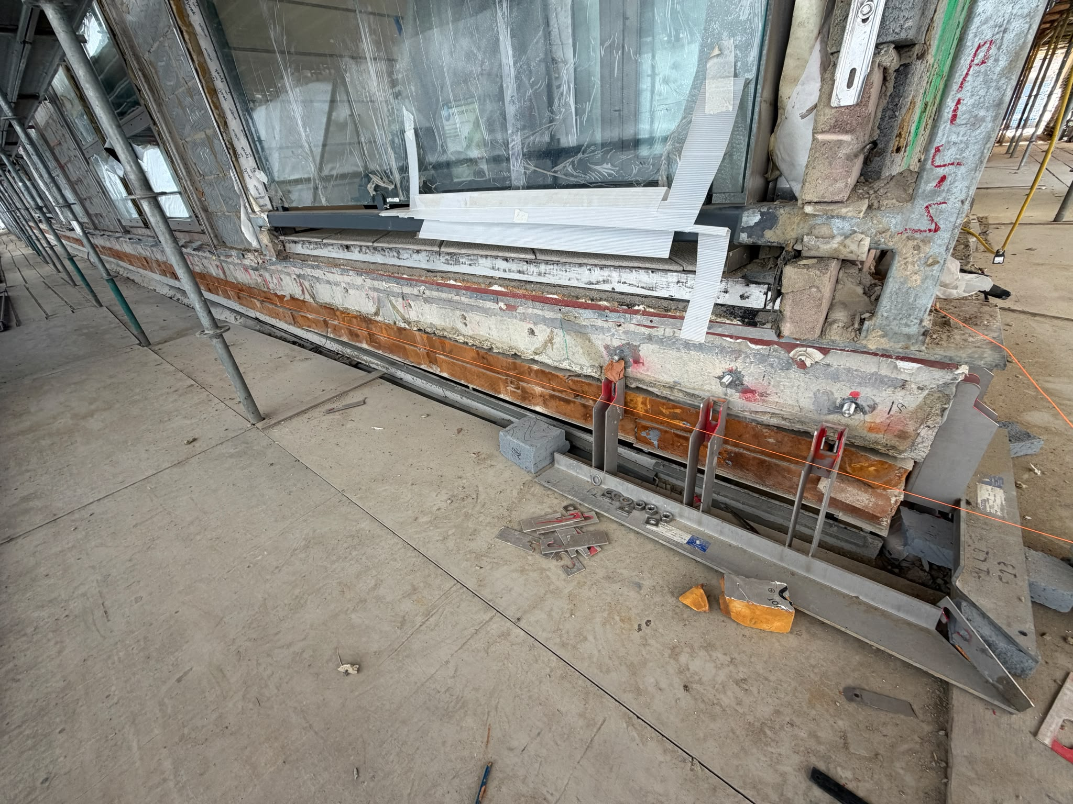
Progress Photos
Phase 1 – Masonry Support installation commenced Level 1.

Slide 33

Decants & MVHR Installation works within Residents Properties
Resident Moves are being completed as per programme where able.
Please note that the more that has been packed prior to the day you move, the smoother and more efficiently your items can be transferred to your Temporary Decant Flat.
Please ensure that you are fully aware of the move date as detailed in the letter received from our RLO to ensure that
Works have commenced and are currently progressing in line with schedule of works and flats are being reoccupation moves have commenced and are progressing.
Once works are completed in your property warranties can then be activated for both the MVHR and Cooker hood.
User guides for the new MVHR & Cooker hood will be issued upon completion of your unit.

Slide 34
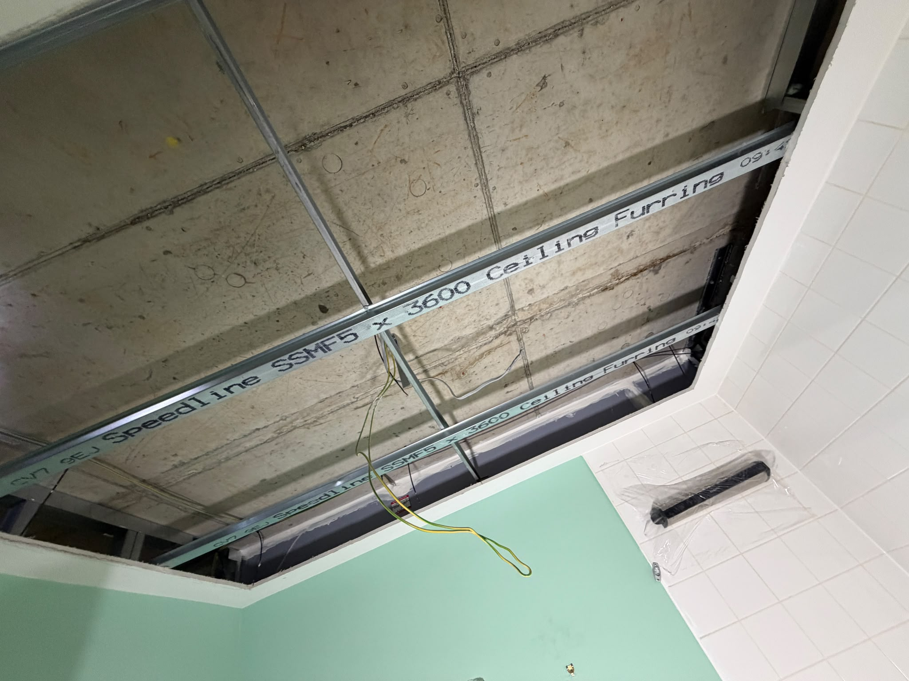
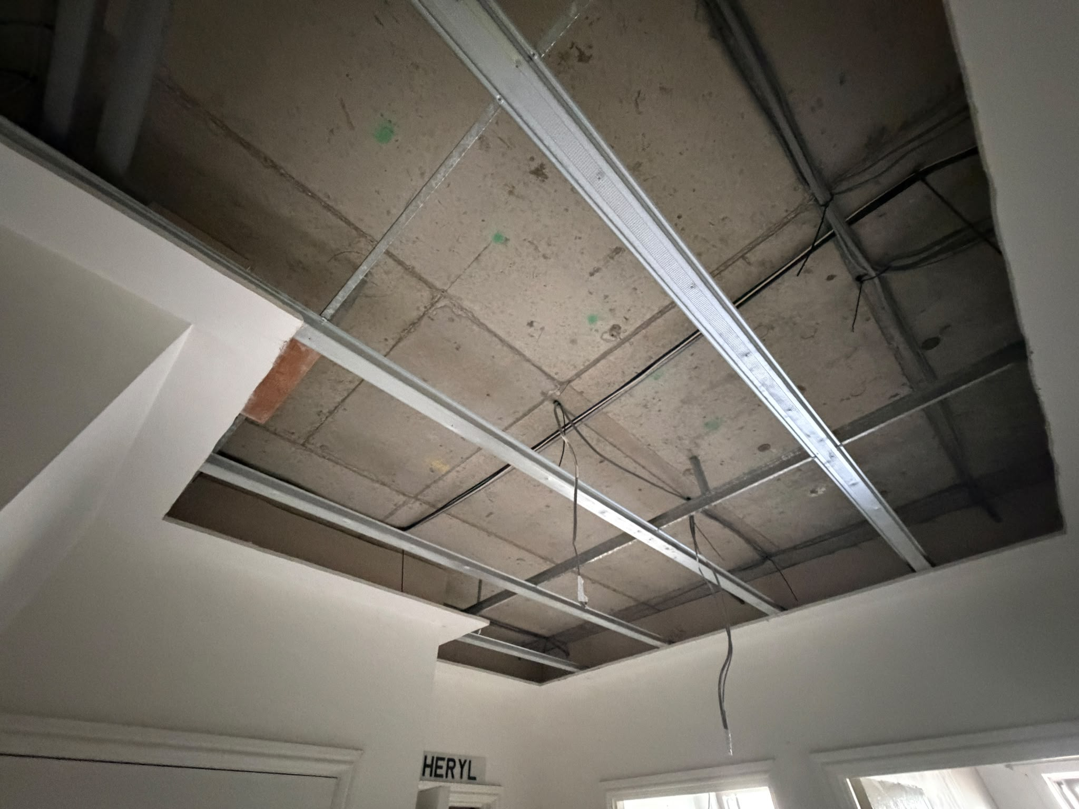
Progress Photos
Old Ceiling and Old MVHR Ducts Removed

Slide 35
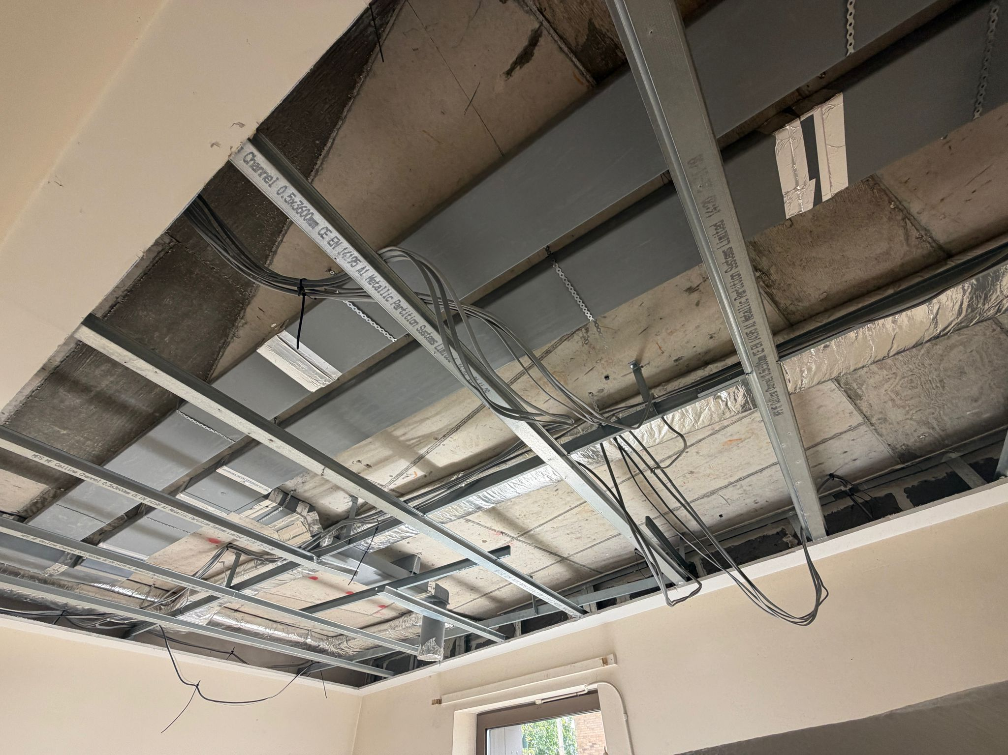
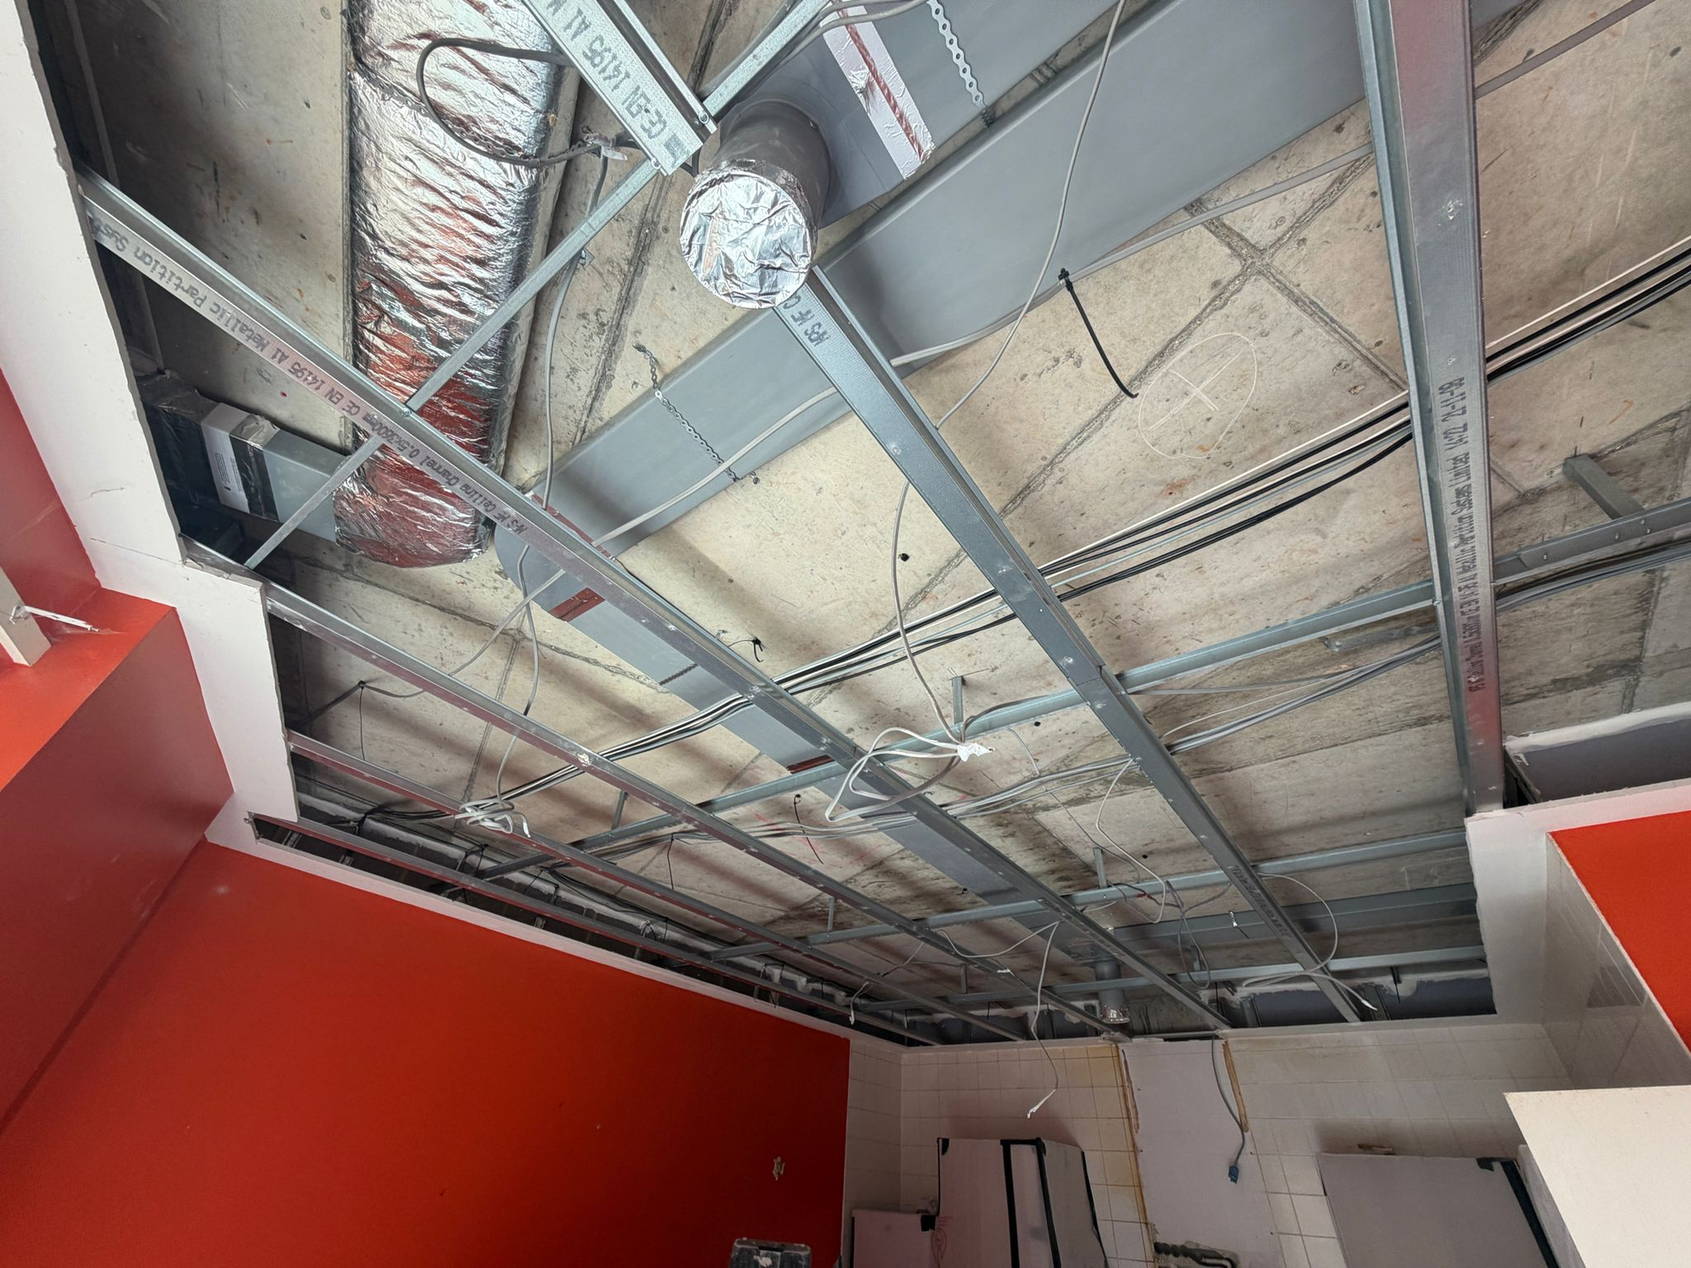
Progress Photos
New MVHR Ducting Installed

Slide 36
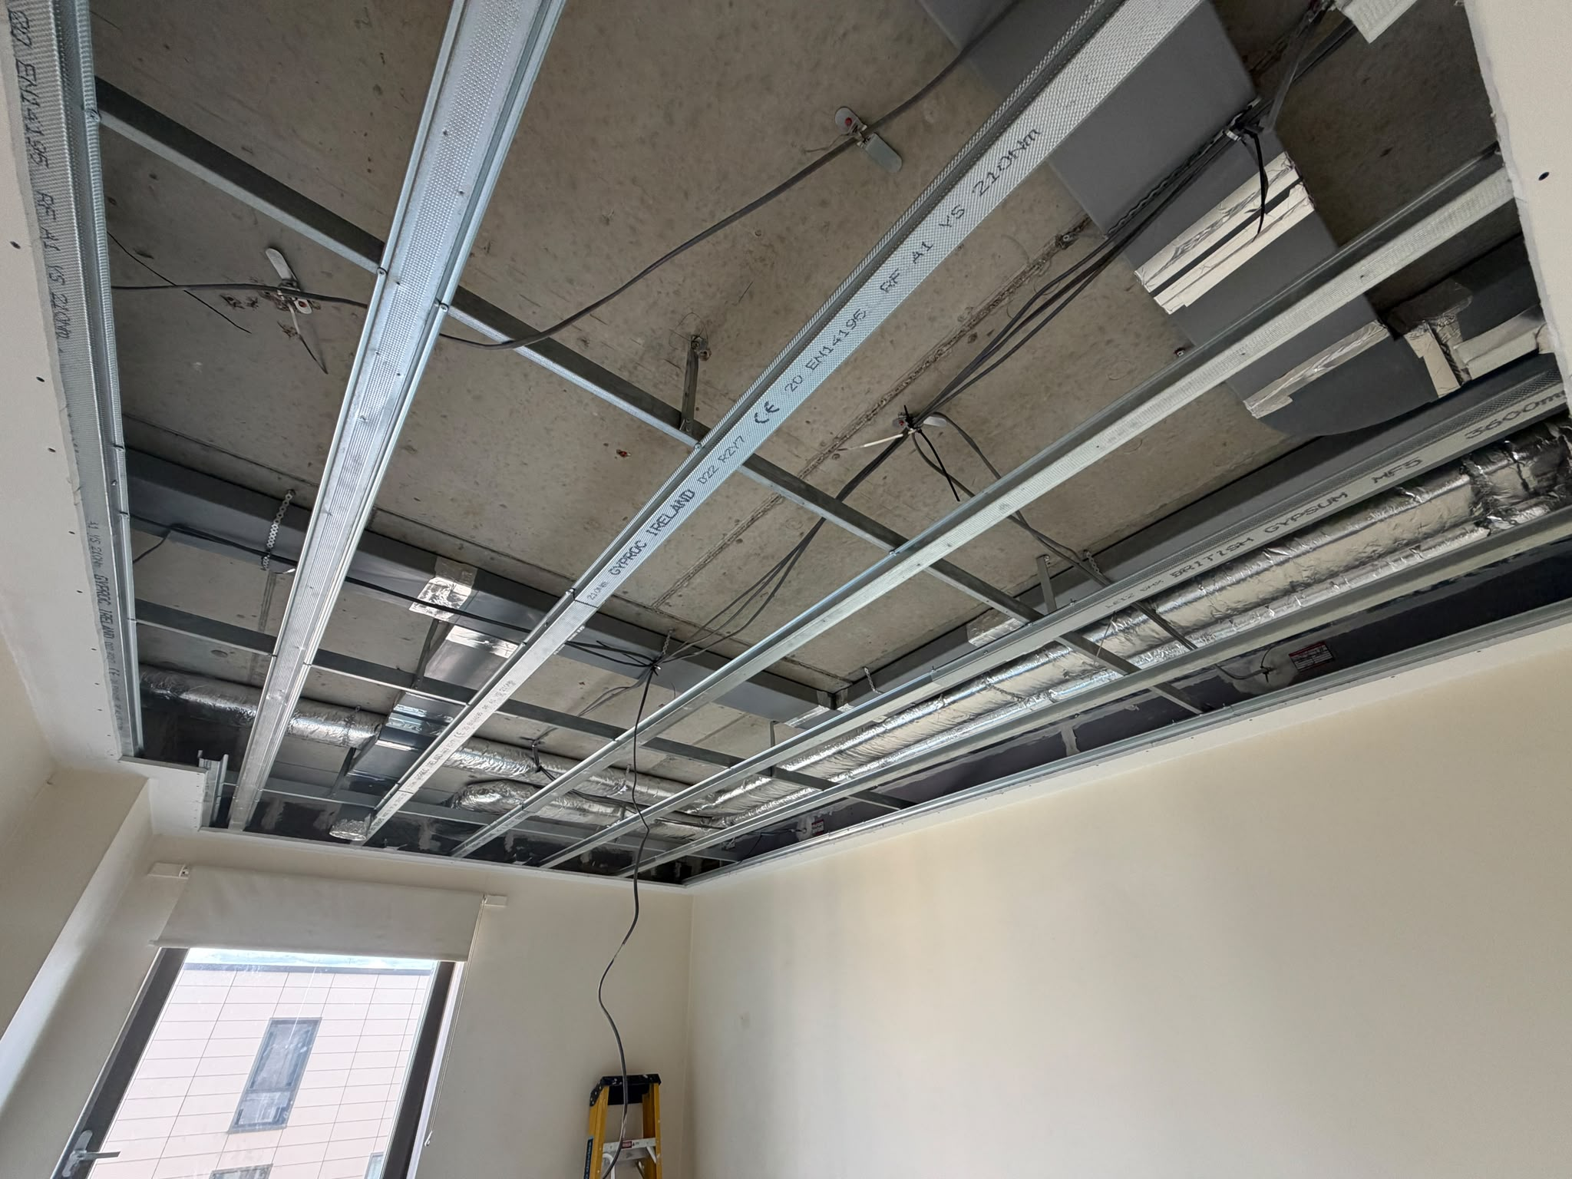
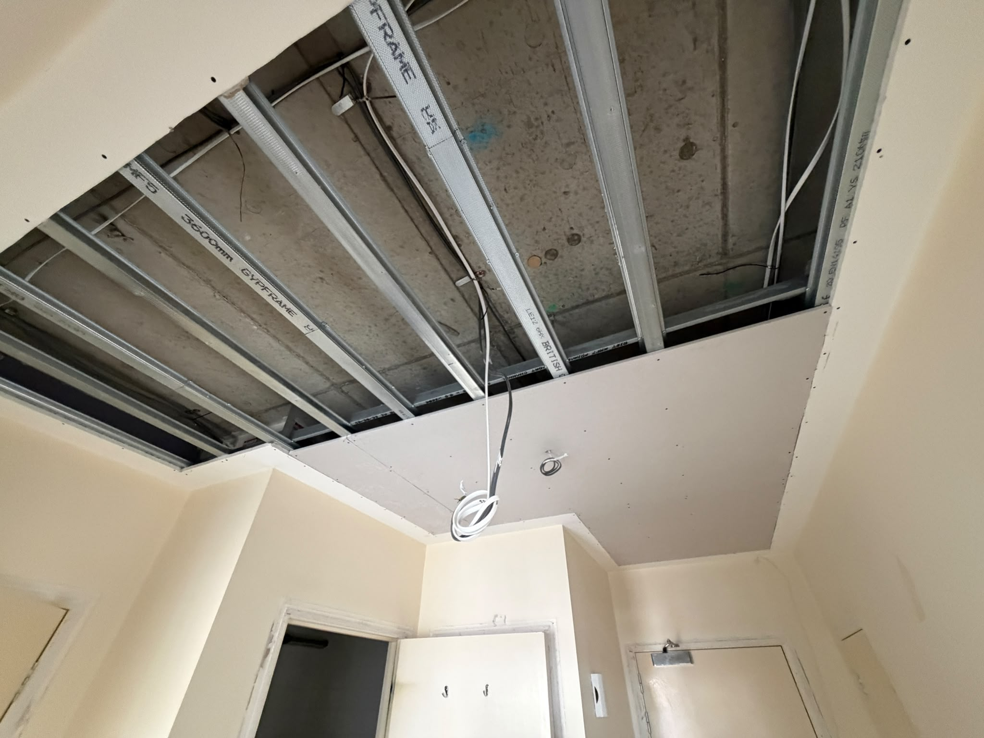
Progress Photos
Ceiling Board Support Installed

Slide 37
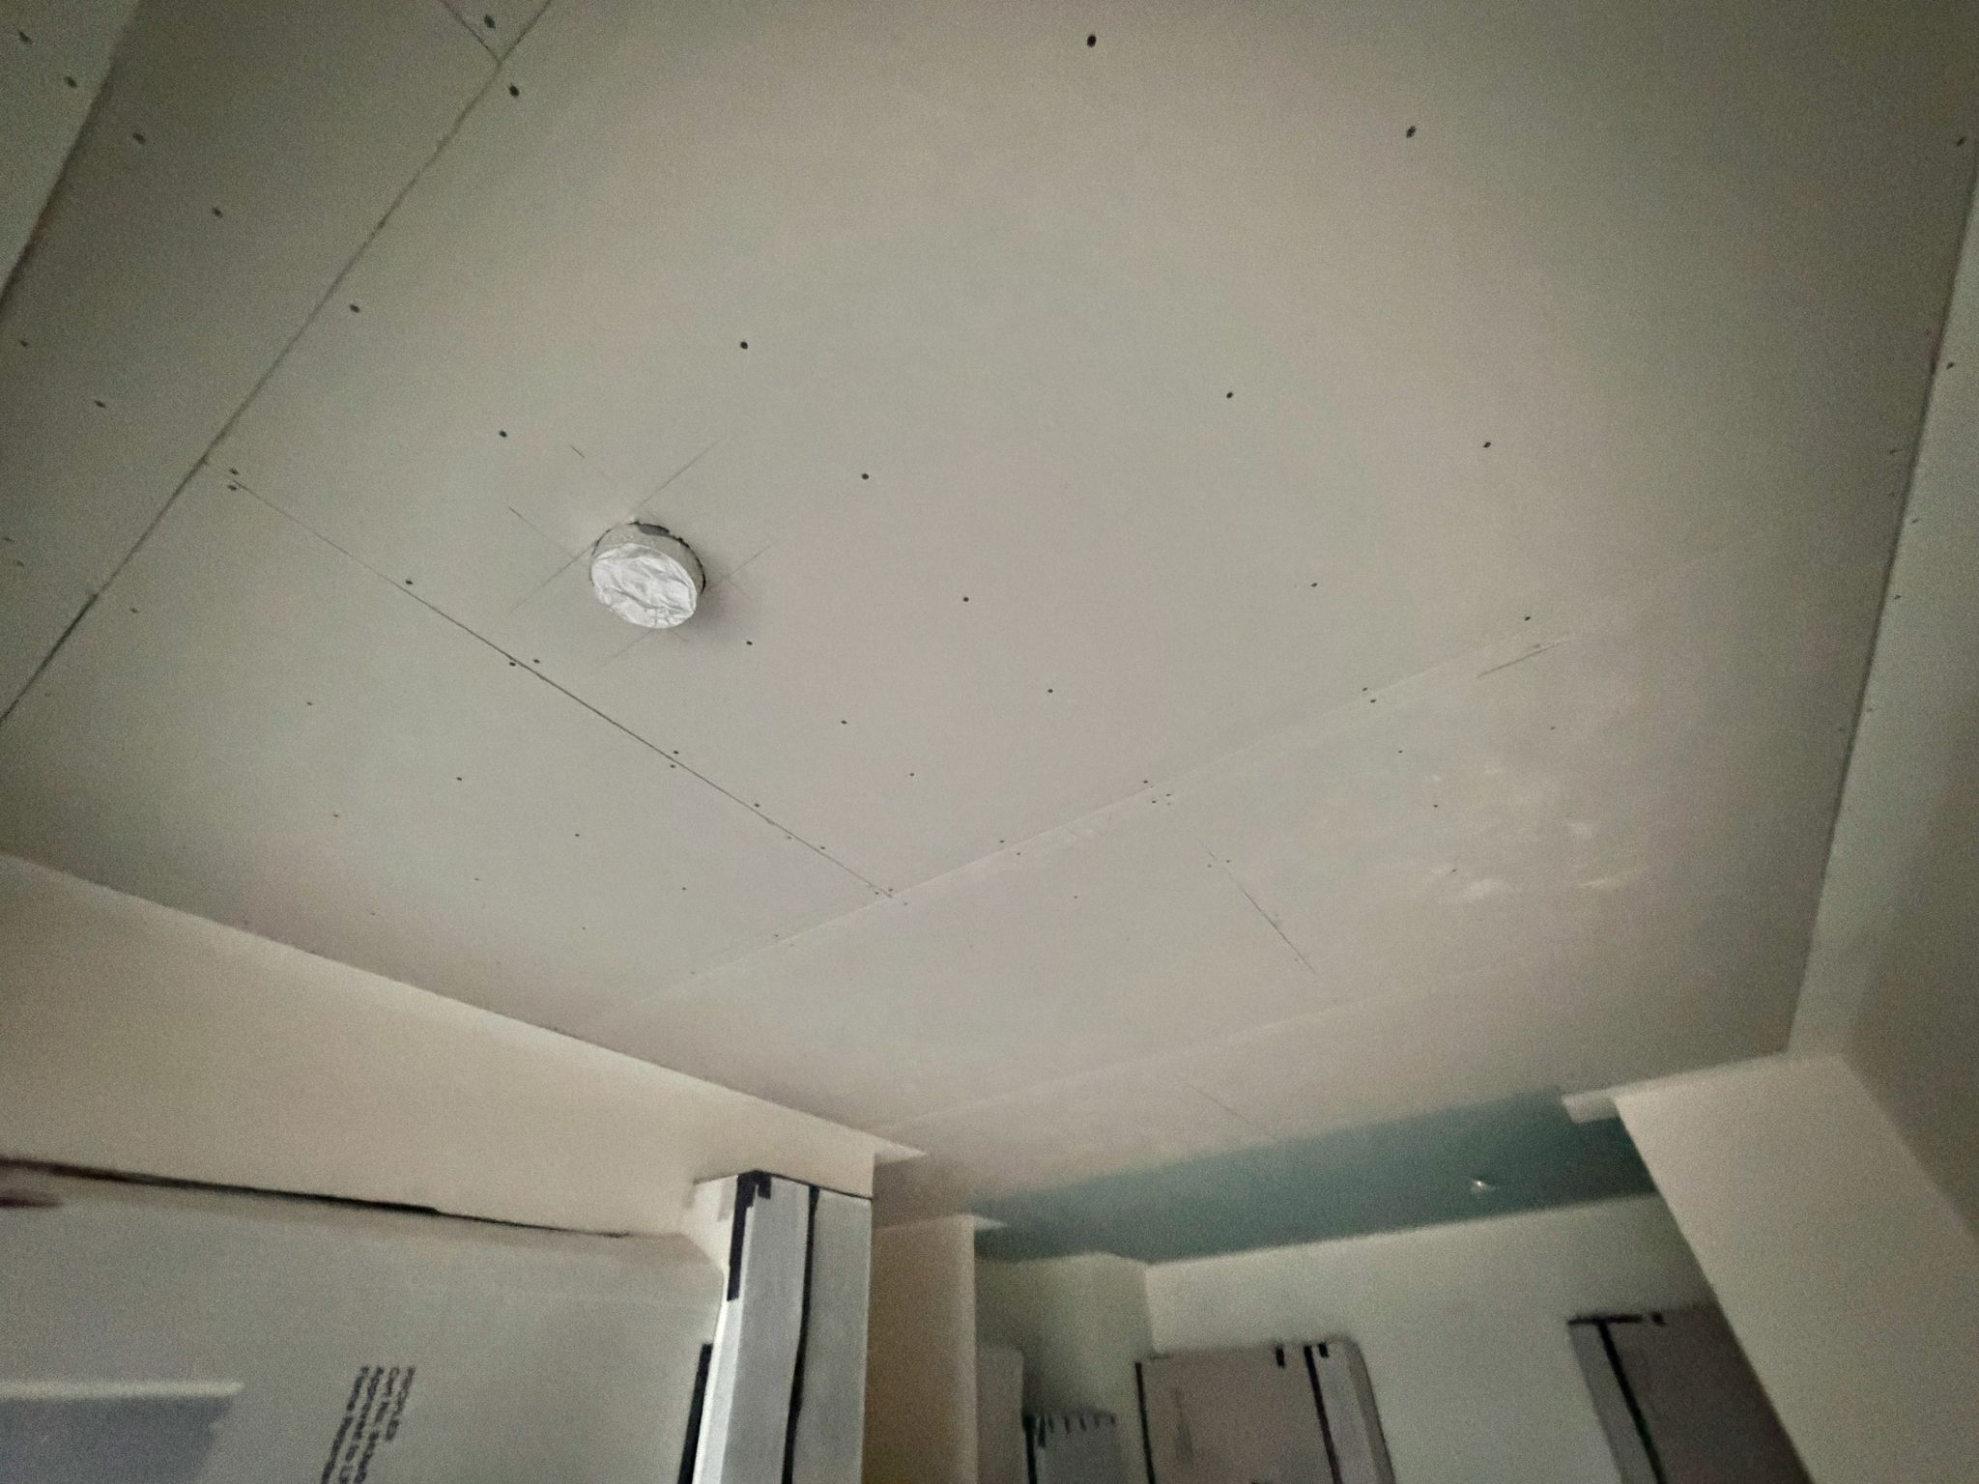
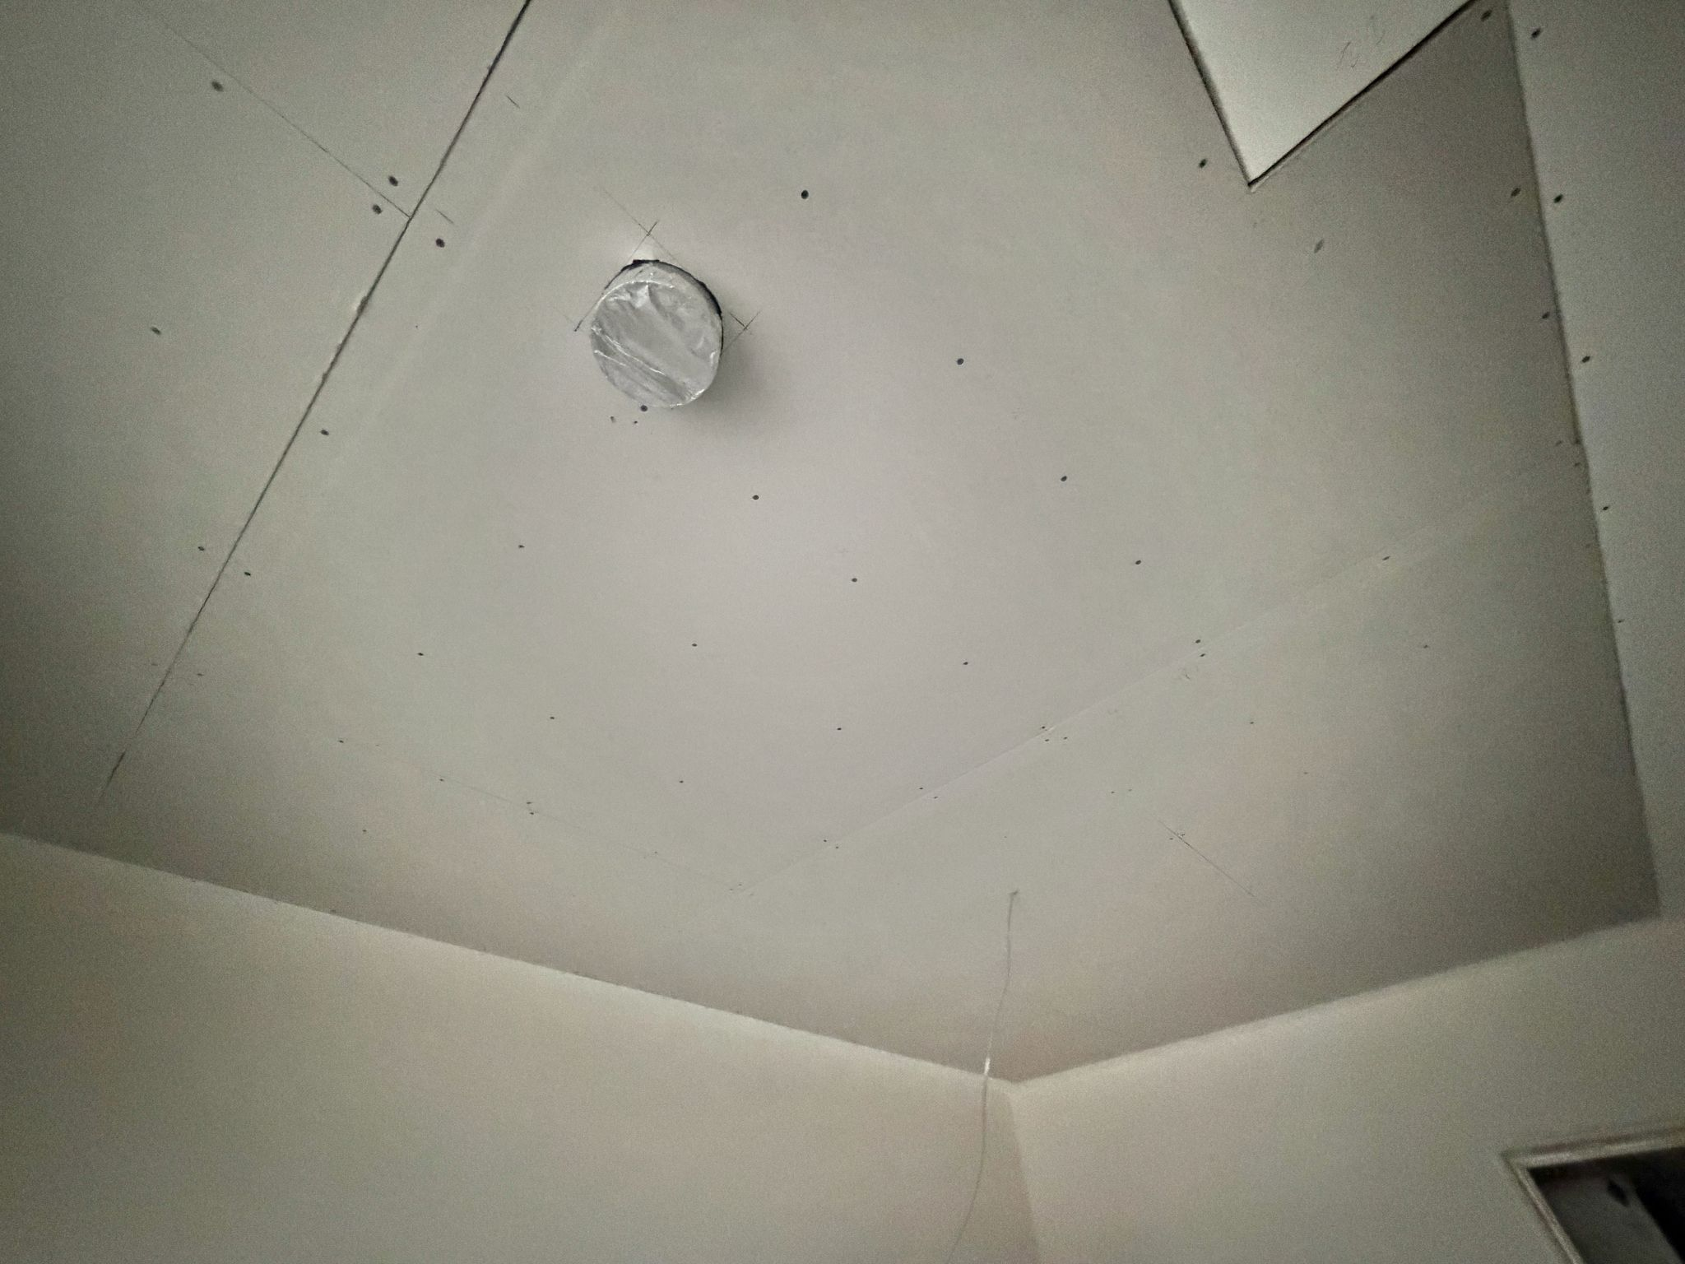
Progress Photos
Ceiling Board Reinstatement

Slide 38
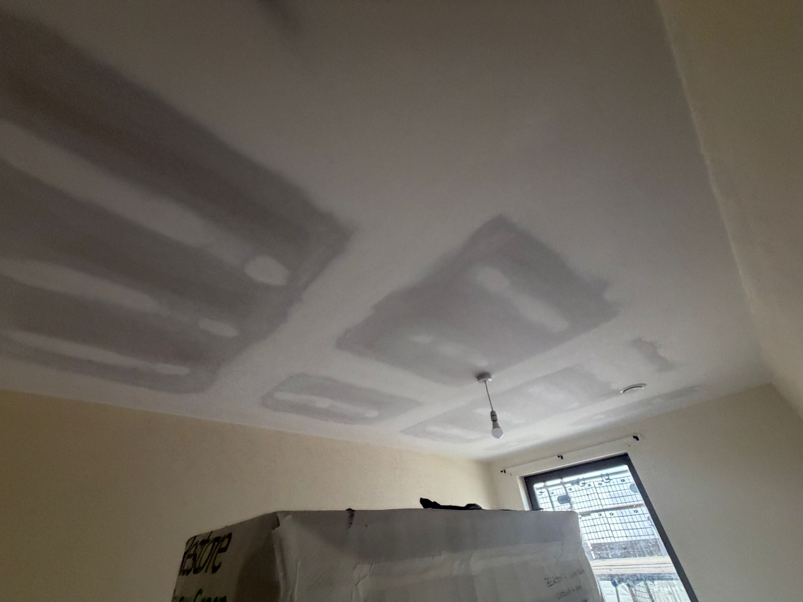
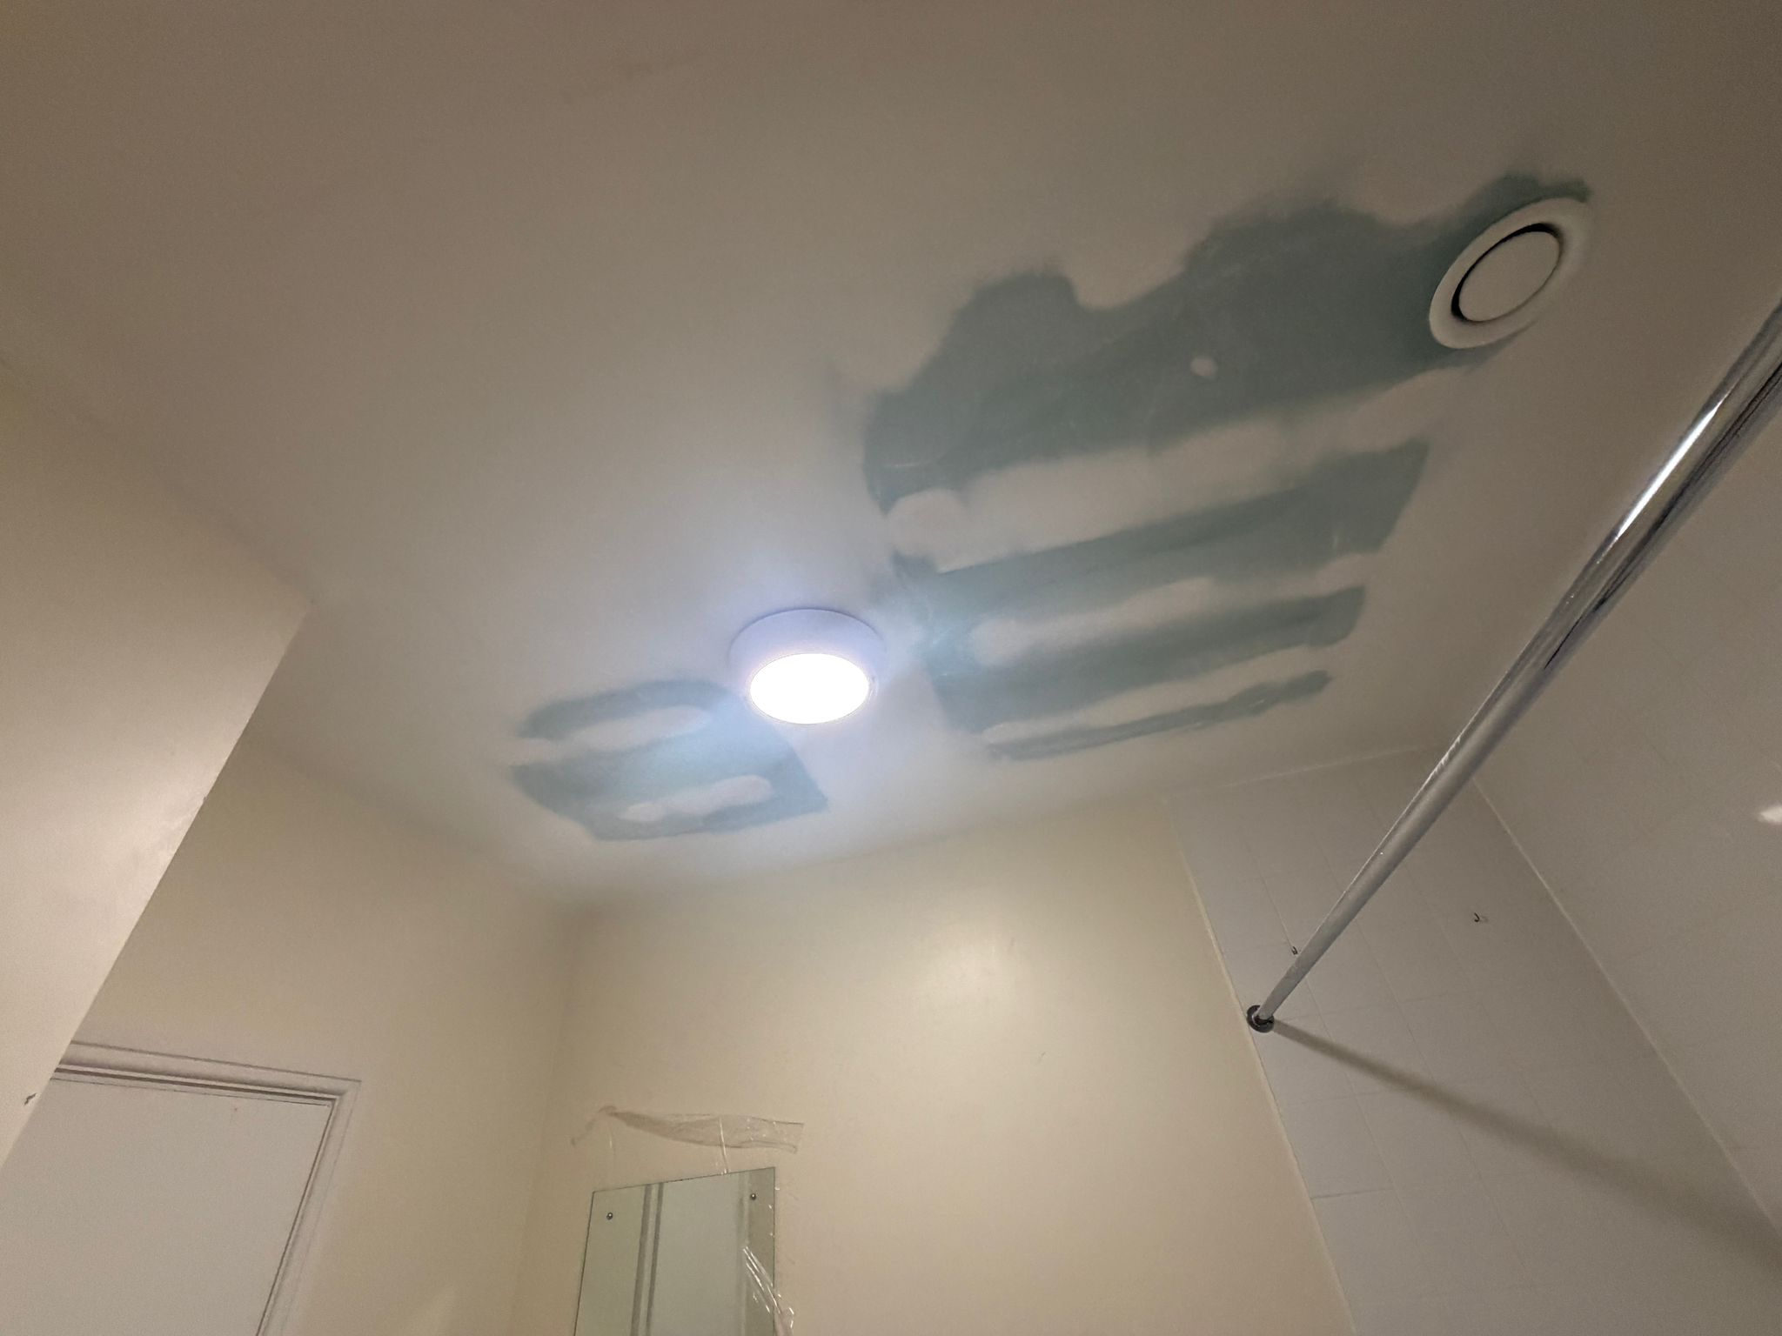
Progress Photos
Ceiling prepared for decoration

Slide 39
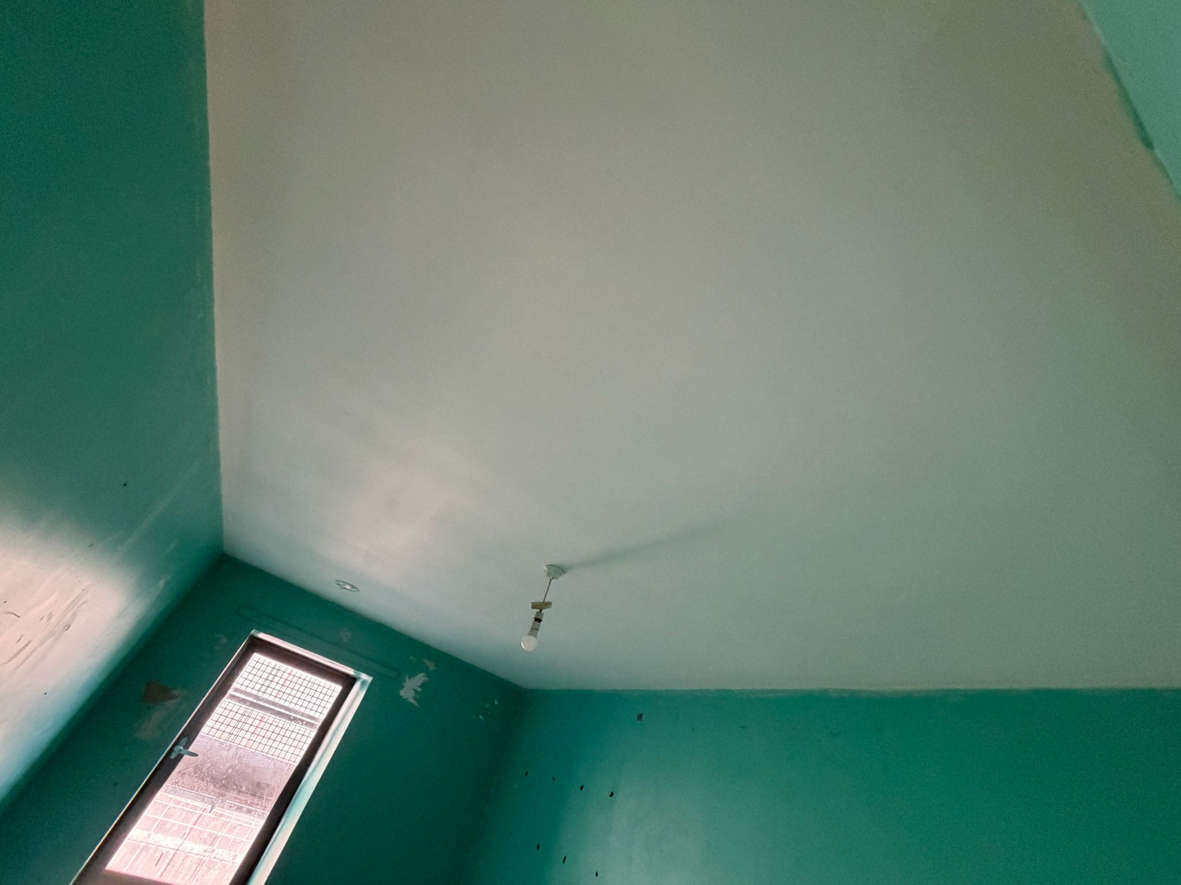
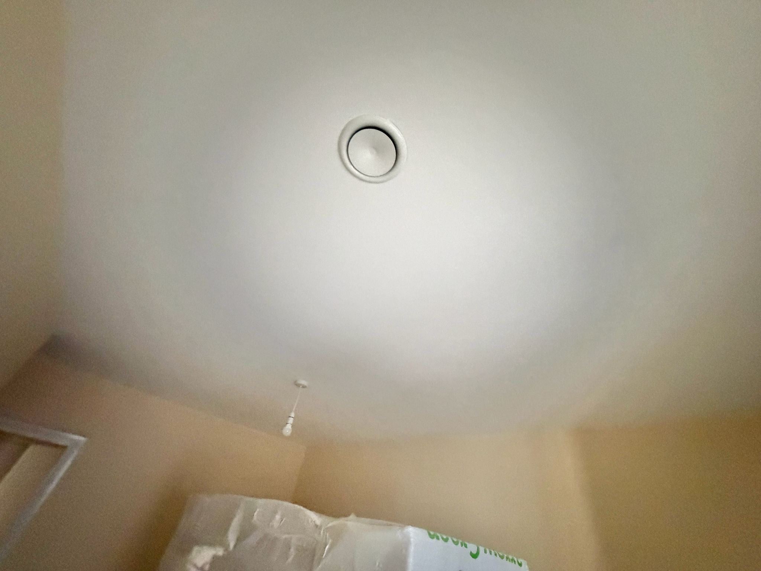
Progress Photos
Ceiling decorated

Slide 40
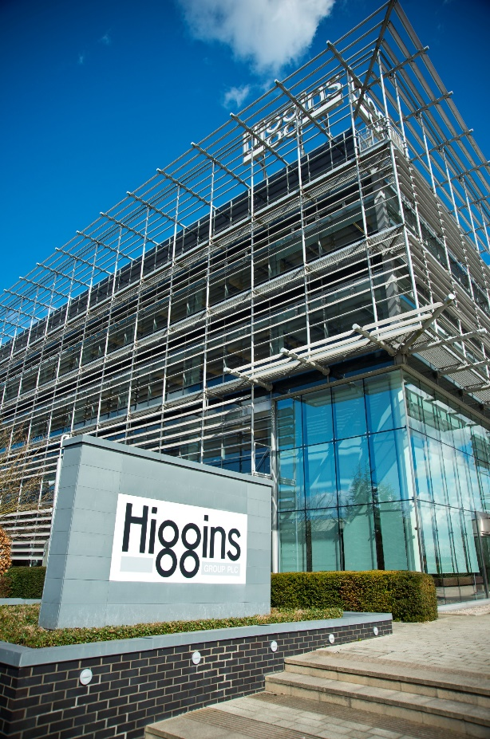
Higgins Contact Details
Dedicated email address:
OakSquare@higginspartnerships.co.uk
Phone Numbers:
Abi Agbabiaka – Resident Liaison Officer: 07714 782 934
James Illingsworth – Project Manager: 07793 902 647
Higgins Head office: 0208 508 5555

Slide 41
Out Of Hours Security Patrol Areas
Patrols frequency is every 1 ½ Hours due to 1 patrol taking over 1 hour
The scaffold and ‘building site’ areas are the primary focus however; the officers are to challenge anti-social behaviour (ASB) when observed or call the police if criminal activity is taking place.
Patrols include:
The Site perimeter
Oak Square Road
Lingham Street
Stockwell Road
The Podium Gardens
Communal areas in blocks
Basement Carpark

Slide 42
Out Of Hours Security Patrol Areas
Patrols frequency is every 1 ½ Hours due to 1 patrol taking over 1 hour
The scaffold and ‘building site’ areas are the primary focus however; the officers are to challenge anti-social behaviour (ASB) when observed or call the police if criminal activity is taking place.
Patrols include:
The Site perimeter
Oak Square Road
Lingham Street
Stockwell Road
The Podium Gardens
Communal areas in blocks
Basement Carpark

Slide 43
Communication Plan
Resident updates being provided at agreed 6-week intervals, this is for both written updates and in-person meetings.
Microsite frequently being updated to reflect current status-Information for residents at Oak Square

Slide 44
Questions

