Slide 1
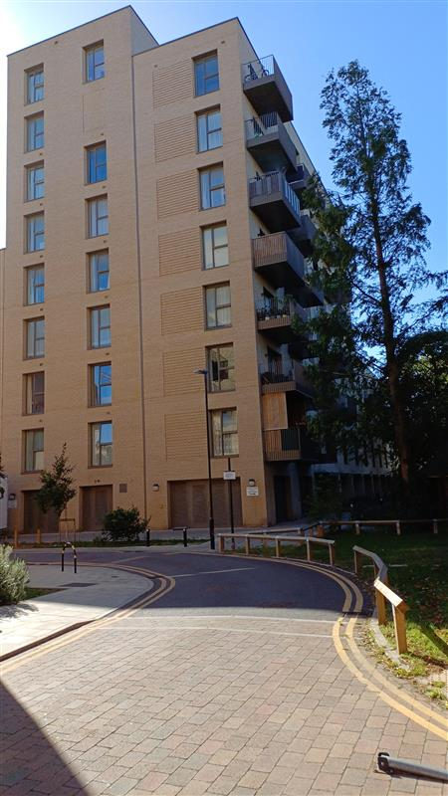
Building safety resident engagement commitment
Althorp Court, TW3 4FF
What is the commitment?
This engagement commitment sets out how we can work together to make decisions that affect the safety of your building. This could be about works being carried out or how your building is managed, for example. Your Building Safety Manager (BSM) Vinoraj Thavarasa, has put this together based on responses from surveys, drop-ins and door knocking over recent weeks. If responses were limited, we may also use feedback from similar buildings, as well as Notting Hill Genesis’ own processes.
Methodology
As your Building Safety Manager, I aim to work with you to keep your building safe. To do this, I visited your block to carry out an inspection on the 10th July 2026. I knocked on a few residents' doors to check what you know about fire safety in your home. During the inspection, I observed that the fire alarm had a fault, items were being stored in communal riser cupboards, and there were other minor issues, all of which have been referred to Hounslow Council.
Your previous BSM sent out a building safety survey by email in September 2025 to understand your information needs, vulnerabilities and awareness of building safety. This was to understand how we can work together to keep your building safe.
Please continue to report any repair concerns, and especially faults, for any of the fire safety equipment that may arise. Please do reach out to me at any point should you like to raise any building safety concerns for your building, discuss any vulnerability or would like any relevant safety information.
On 06 July 2026, I emailed your representative at Hounslow Council to inform you about the evacuation strategy for your building and the importance of fire doors, your responsibilities and those of NHG in keeping your building safe. Your representative should continue to hold regular resident meetings and the BSM will hold at least one building safety drop-in session each year. I will provide relevant building and structural safety information applicable to this building. You were invited to attend a drop-in surgery on the 27th July, 2026 to gather your views and opinions, answer any queries, and provide clarification.
I also informed you that your building had been registered with the Building Safety Regulator (BSR), and provided you with the registration number and the BSR’s contact number for any concerns that you might want to bring to their attention. The registration number is HRB03230K9W0
This commitment was made in September 2025 and was updated in July 2026. This will be reviewed in July 2027 or earlier if you tell us we need to.
How we will share information with you and ask for your opinion
To cater for the diverse needs of our residents, we can communicate in a broad range of ways. We aim to provide this information in different formats that can be understood by all residents including those that have a physical or visual impairment, have other disabilities or who speak another language:
At sign up
New resident home visit
On our website
During building inspections
Face to face appointments
At pop up sessions
By introductory & animation videos
Local newsletters
Via email
Via postal or hand delivered letter
Via text
Fire Action Notices
On local notice boards
At local surgeries

Slide 2

Building safety resident engagement commitment
Althorp Court
Information we will provide you with about building safety decisions
When we need to make decisions about building safety matters, we will make sure to provide you with information to help you understand and influence these decisions. For example: a summary of the technical advice we have received, advice we have received about how to reduce risk, timescales for completion of work, any cost implications for you, and details of who you can get in touch with to ask for more information.
Other types of information you would like to see
Action to take in the event of fire or structural emergency
General information to understand legislation impacting your home including the Building Safety Act and the Fire Safety England Regs
Resident and landlord responsibilities
  Remediation works
  Changes in fire strategy
  Other major works
  Topics or themes that you are interested in
What decisions you can be involved in
We encourage residents to get involved in making decisions relating to the safety of their buildings
You can contact your Building Safety Manager, Vinoraj Thavarasa or Housing Officer, Sandra Richardson of Hounslow Council with any ideas or thoughts you have about safety in your building.
The types of building safety decisions you can expect to be involved in are:
Timings of works, particularly for accessing properties
Placement of equipment during works
Parts of the specification of works that aren’t guided by regulation or expert guidance
Some works can’t always be consulted on. These might involve:
Emergency works – where quick action is needed to reduce a risk
Where a specific product or material is needed to meet a regulation or other requirement
If works will take less than one day and won’t be very disruptive
We might only consult with people directly affected by the work. For example, works accessing the balconies would only be discussed with properties with balconies.

Slide 3
Building safety resident engagement commitment
Althorp Court
How you can influence decisions
Proactively seeking out resident feedback and using that information to tailor our building safety approach:
Primarily contacting BSM or your Estate Management
Contacting your BSM at NHG if you need to escalate any concerns
Drop ins
We will use your feedback in our discussions with our contractors, or other parties like housing management, to consider how we can adapt works planning, timescales and specifications to accommodate as much of your feedback as possible.
How we’ll gather and use your opinions
We’ll keep a record on our Workwise system from our interactions as listed above
We’ll gather your thoughts in line with our usual GDPR policies, just like when you contact us about anything else.
We will feedback to you any decisions made using the information you have told us
How we’ll measure and review this commitment
Use feedback you give us – whether formal or informal – about how this commitment is working.
NHG will review feedback periodically to understand if the commitment needs to be reviewed.
Got a question or concern about this commitment? Get in touch with your building safety manager here:
Email: Vinoraj.Thavarasa@nhg.org.uk
Phone: 07932 816747

Slide 4


Building safety resident engagement commitment
Althorp Court
Transparency of building safety information
At Notting Hill Genesis residents are at the heart of what we do. We want our resident to know they are safe and more importantly feel they are safe. To do this will be transparent in our management of your building’s safety and the information we provide to you. This includes but is not limited to fire protection measures, fire prevention measures, maintenance of fire safety systems, fire risk assessments and building safety inspections.
Maintenance and testing | Frequency
Automatic opening vents | Bi-annually
Alarm sounders | Bi-annually
Asbestos surveys
Building safety inspections | Annually
Communal fire door checks | Quarterly
Door closers | Monthly
Electrical | Five yearly
Emergency lighting | Monthly – discharged annually
Estate inspections | Monthly
Fire Risk Assessment | Annually
Fire alarms | Bi-annually
Flat door checks | Annually
Fire alarm panel servicing | Bi-annually
Dry Risers | Annually
Domestic sprinklers | N/A
Legionella | Every 4 years
Maintenance and testing | Frequency
Booster Pumps | Annually
Lifts servicing | Monthly
Lifting operations and lifting equipment regulations (LOLERS) | Bi-annually
Lightning protection | Annually
Mansafe | Annually
Smoke alarms (communal) | Bi-annually
Wayfinding signage | Monthly and Annually
Contact your building safety manager here:
Email: Vinoraj.Thavarasa@nhg.org.uk
Phone: 07932 816747

