Slide 1
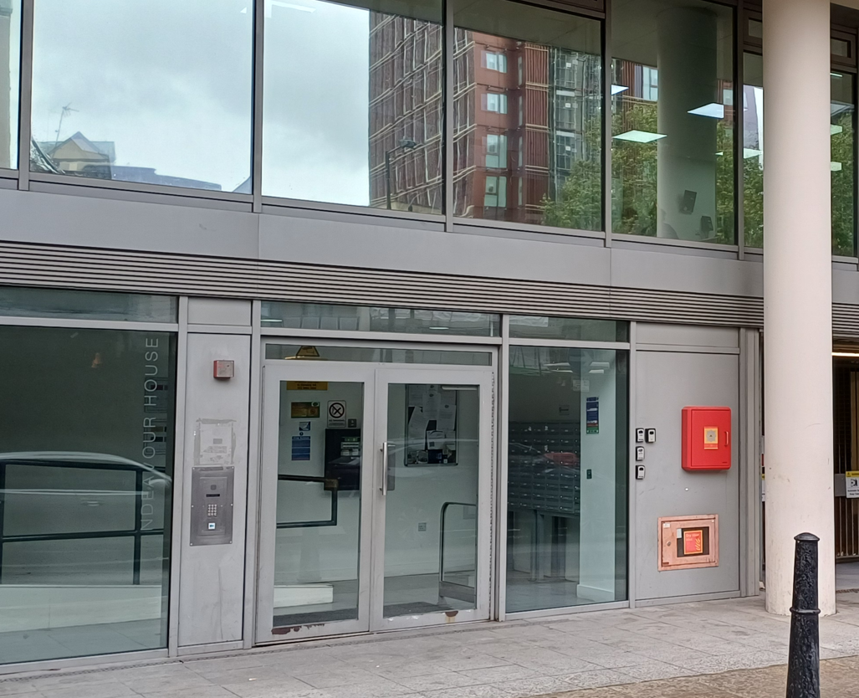
Building safety resident engagement commitment
Endeavour House
What is the commitment?
This engagement commitment sets out how we can work together to make decisions that affect the safety of your building. This could be about works being carried out or how your building is managed for example. Your Building Safety Manager Freya has put this together based on responses from surveys, drop ins and door knocking over recent weeks. If responses were low, we might use responses from other similar buildings to help us, as well as Notting Hill Genesis’ own processes.
Methodology
As your BSM, I aim to work with you to keep your building safe. To do this I visited your block to carry out an inspection on the 20th July 2026. I knocked a few resident doors to check what you know about fire safety in your home and was able to speak to some residents while inspecting the building. The feedback I received was that there was some damage to the communal fire doors and issues with ASB which affected the building. Quarterly communal fire door checks are completed at Endeavour House by our contractors Savills where identify any issues with fire doors in your building. They will then report their findings to NHG and any urgent door actions will be remediated by our Fire Team. I noted there were several faulty door locks on the utility risers and some emergency lights which were not operating. There was also items being stored in the communal risers including bicycles. These have been highlighted to your Housing Officer to make the necessary arrangements to action. As a reminder, all communal areas must be clear of items as these areas are escape routes should a fire occur. Items being stored in hallways and/or in communal risers could impede safe access and even worsen the effects of a fire, should one occur. Please continue to report any ASB or repair concerns and especially faults for any of the fire safety equipment which may arise.
A building safety survey to understand your information needs, vulnerabilities and awareness of building safety in October 2025 by email. This was to understand how we can work together to keep your building safe but did not get any responses. This survey will be sent again during next year’s building safety audit. Please do reach out to me any point should you like to raise any building safety concerns for your building, discuss any vulnerability or would like any relevant safety information.
I also informed you that your building had been registered with the Building Safety Regulator (BSR) and provided you with the registration number and the BSR’s contact number for any concerns that you might want to bring to their attention. In the email, I also sent you a letter to inform you about the evacuation strategy for your building and the importance of fire doors, your responsibilities and those of NHG in keeping your building safe. Invitations to attend a drop-in surgery on 20th August has been sent to further get your views and opinions and answer any queries or provide clarification.
This commitment has been made in October 2025 and updated in July 2026 will be reviewed in July 2027 or earlier if you tell us we need to
How we will share information with you and ask for your opinion
To cater for the diverse needs of our residents, we can communicate in a broad range of ways. We aim to provide this information in different formats that can be understood by all residents including those that have a physical or visual impairment, have other disabilities or who speak another language:
At sign up
New resident home visit
On our website
During building inspections
Face to face appointments
At pop up sessions
By introductory & animation videos
Local newsletters
Via email
Via postal or hand delivered letter
Via text
Fire Action Notices
On local notice boards
At local surgeries

Slide 2

Building safety resident engagement commitment
Endeavour House
Information we will provide you with about building safety decisions
When we need to make decisions about building safety matters, we will make sure to provide you with information to help you understand and influence these decisions. For example: a summary of the technical advice we have received, advice we have received about how to reduce risk, timescales for completion of work, any cost implications for you, and details of who you can get in touch with to ask for more information.
Other types of information you would like to see
Action to take in the event of fire or structural emergency
General information to understand legislation impacting your home including the Building Safety Act and the Fire Safety England Regs
Resident and landlord responsibilities
  Remediation works
  Changes in fire strategy
  Other major works
  Topics or themes that you are interested in
What decisions you can be involved in
We encourage residents to get involved in making decisions relating to the safety of their buildings
You can contact your Building Safety Manager or Property Management Executive with any ideas or thoughts you have about safety in your building.
The types of building safety decisions you can expect to be involved in are:
Timings of works, particularly for accessing properties
Placement of equipment during works
Parts of the specification of works that aren’t guided by regulation or expert guidance
Some works can’t always be consulted on. These might involve:
Emergency works – where quick action is needed to reduce a risk
Where a specific product or material is needed to meet a regulation or other requirement
If works will take less than one day and won’t be very disruptive
We might only consult with people directly affected by the work. For example, works accessing the balconies would only be discussed with properties with balconies.

Slide 3
Building safety resident engagement commitment
Endeavour House
How you can influence decisions
Proactively seeking out resident feedback and using that information to tailor our building safety approach:
Primarily contacting BSM or your Housing Officer: Connor Pithers
Contacting your BSM at NHG if you need to escalate any concerns
Drop ins
We will use your feedback in our discussions with our contractors, or other parties like housing management, to consider how we can adapt works planning, timescales and specifications to accommodate as much of your feedback as possible.
How we’ll gather and use your opinions
We’ll keep a record on our Workwise system from our interactions as listed above
We’ll gather your thoughts in line with our usual GDPR policies, just like when you contact us about anything else.
We will feedback to you any decisions made using the information you have told us
How we’ll measure and review this commitment
Use feedback you give us – whether formal or informal – about how this commitment is working.
NHG will review feedback periodically to understand if the commitment needs to be reviewed.
Got a question or concern about this commitment? Get in touch with your building safety manager here:
Email: freya.jewett@nhg.org.uk
Phone: 07352744438

Slide 4

Building safety resident engagement commitment
Endeavour House
Transparency of building safety information
At Notting Hill Genesis residents are at the heart of what we do. We want our resident to know they are safe and more importantly feel they are safe. To do this will be transparent in our management of your building’s safety and the information we provide to you. This includes but is not limited to fire protection measures, fire prevention measures, maintenance of fire safety systems, fire risk assessments and building safety inspections.
Maintenance and testing | Frequency
Automatic opening vents | Bi-annually
Alarm sounders | N/A
Asbestos surveys | N/A
Building safety inspections | Annually
Communal fire door checks | Quarterly
Door closers | Monthly
Electrical | Five yearly
Emergency lighting | Monthly – discharged annually
Estate inspections | Monthly
Fire Risk Assessment | Annually
Fire alarms | Bi-annually
Flat door checks | Annually
Fire alarm panel servicing | Bi-annually
Fire extinguishers | N/A
Domestic sprinklers | N/A
Legionella | Every 4 years
Maintenance and testing | Frequency
Booster Pumps | Annually
Lifts servicing | Monthly
Lifting operations and lifting equipment regulations (LOLERS) | Bi-annually
Lightning protection | Annually
Mansafe | Annually
Smoke alarms (communal) | Bi-annually
Wayfinding signage | Monthly and Annually

