Slide 1
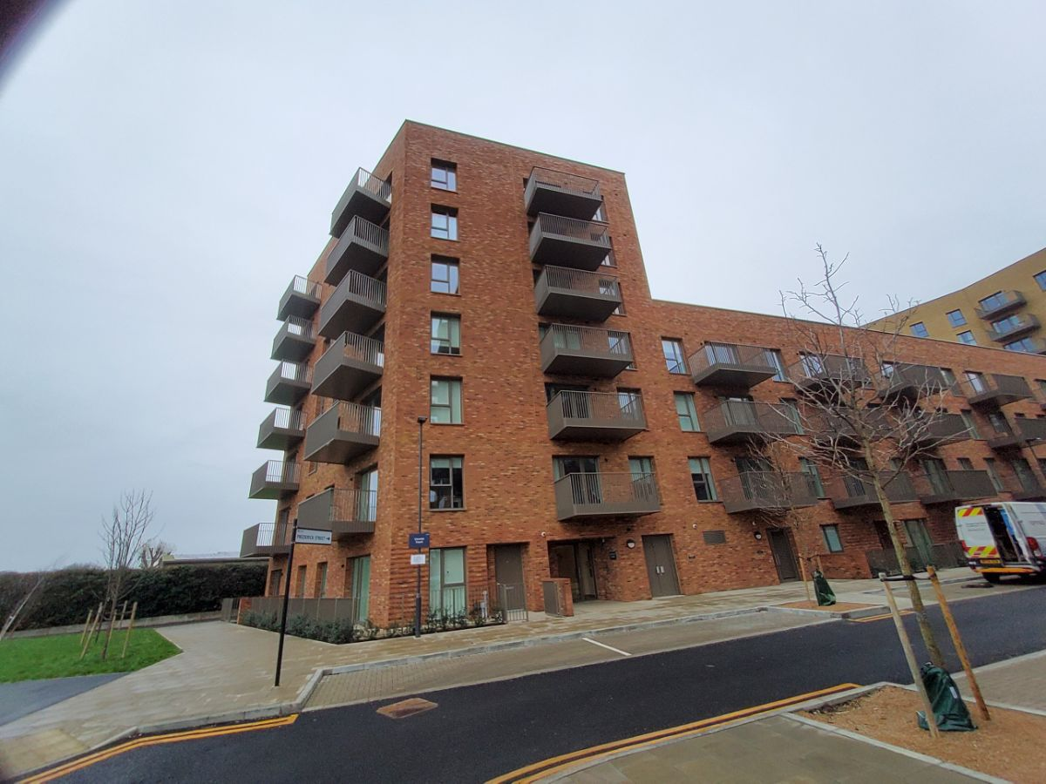
Building safety resident engagement commitment
Cheviot Court, TW3 4FZ
What is the commitment?
This engagement commitment sets out how we can work together to make decisions that affect the safety of your building. This could be about works being carried out or how your building is managed, for example. Your Building Safety Manager (BSM) Vinoraj Thavarasa, has put this together based on responses from surveys, drop-ins and door knocking over recent weeks. If responses were limited, we may also use feedback from similar buildings, as well as Notting Hill Genesis’ own processes.
Methodology
As your Building Safety Manager, I aim to work with you to keep your building safe. To do this, I visited your block to carry out an
inspection on 08 September 2026. I knocked on a few residents' doors to check what you know about fire safety in your home.
During the inspection, I observed that rear entrance door from the car park was faulty, the cycle store had items stored there, inappropriate items (electrical and other combustible items) were dumped in the bin store, some AOV panels were missing covers on different floors and items were stored in communal areas. I have referred all of these to your Housing Officer and Estates Manager. The Housing Officer will follow up on these actions, which I will further review.
Please continue to report any repair concerns, and especially faults, for any of the fire safety equipment that may arise. Please do reach out to me at any point should you like to raise any building safety concerns for your building, discuss any vulnerability or would like any relevant safety information.
On 21 August 2026, I emailed you to inform you about the evacuation strategy for your building and the importance of fire doors, your responsibilities and those of NHG in keeping your building safe. Your Property Manager should continue to hold regular resident meetings and the BSM will hold at least one building safety drop-in session each year. I will provide relevant building and structural safety information applicable to this building. You are invited to attend a drop-in surgery on Thursday 08 October 2026 at the Lampton Park Concierge Office or Online on Teams to share your views and opinions, ask questions, and receive clarification.
I also informed you that your building had been registered with the Building Safety Regulator (BSR), and provided you with the registration number and the BSR’s contact number for any concerns that you might want to bring to their attention. The registration number is HRB18132V9Z2
This commitment was made in September 2026. This will be reviewed in September 2027 or earlier if you tell us we need to.
How we will share information with you and ask for your opinion
To cater for the diverse needs of our residents, we can communicate in a broad range of ways. We aim to provide this information in different formats that can be understood by all residents including those that have a physical or visual impairment, have other disabilities or who speak another language:
At sign up
New resident home visit
On our website
During building inspections
Face to face appointments
At pop up sessions
By introductory & animation videos
Local newsletters
Via email
Via postal or hand delivered letter
Via text
Fire Action Notices
On local notice boards
At local surgeries

Slide 2
Building safety resident engagement commitment
Cheviot Court
Information we will provide you with about building safety decisions
When we need to make decisions about building safety matters, we will make sure to provide you with information to help you understand and influence these decisions. For example: a summary of the technical advice we have received, advice we have received about how to reduce risk, timescales for completion of work, any cost implications for you, and details of who you can get in touch with to ask for more information.
Other types of information you would like to see
Action to take in the event of fire or structural emergency
General information to understand legislation impacting your home including the Building Safety Act and the Fire Safety England Regs
Resident and landlord responsibilities
  Remediation works
  Changes in fire strategy
  Other major works
  Topics or themes that you are interested in
What decisions you can be involved in
We encourage residents to get involved in making decisions relating to the safety of their buildings
You can contact your Building Safety Manager or Housing Officer with any ideas or thoughts you have about safety in your building.
The types of building safety decisions you can expect to be involved in are:
Timings of works, particularly for accessing properties
Placement of equipment during works
Parts of the specification of works that aren’t guided by regulation or expert guidance
Some works can’t always be consulted on. These might involve:
Emergency works – where quick action is needed to reduce a risk
Where a specific product or material is needed to meet a regulation or other requirement
If works will take less than one day and won’t be very disruptive
We might only consult with people directly affected by the work. For example, works accessing the balconies would only be discussed with properties with balconies.

Slide 3
Building safety resident engagement commitment
Cheviot Court
How you can influence decisions
Proactively seeking out resident feedback and using that information to tailor our building safety approach:
Primarily contacting BSM, your Housing Officer or your Estate Management
Contacting your BSM at NHG if you need to escalate any concerns
Drop ins
We will use your feedback in our discussions with our contractors, or other parties like housing management, to consider how we can adapt works planning, timescales and specifications to accommodate as much of your feedback as possible.
How we’ll gather and use your opinions
We’ll keep a record on our Workwise system from our interactions as listed above
We’ll gather your thoughts in line with our usual GDPR policies, just like when you contact us about anything else.
We will feedback to you any decisions made using the information you have told us
How we’ll measure and review this commitment
Use feedback you give us – whether formal or informal – about how this commitment is working.
NHG will review feedback periodically to understand if the commitment needs to be reviewed.
Got a question or concern about this commitment? Get in touch with your building safety manager here:
Email: Vinoraj.Thavarasa@nhg.org.uk
Phone: 02039870959 / 07932 816747

